Slide 1
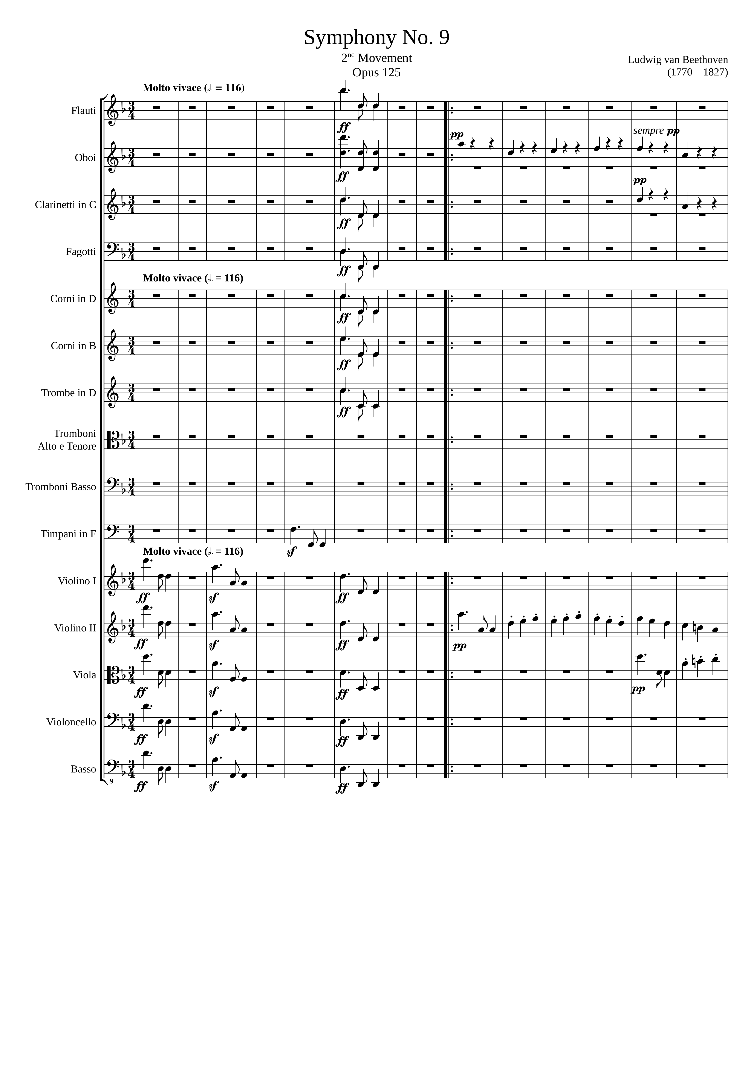
mel
24
mel
rhythm
mel
rhythm
mel
mel
mel
mel
mel+rhythm
mel
mel
mel
mel
mel+rhythm
mel
mel
mel+rhythm
mel
mel
mel
mel

Slide 2
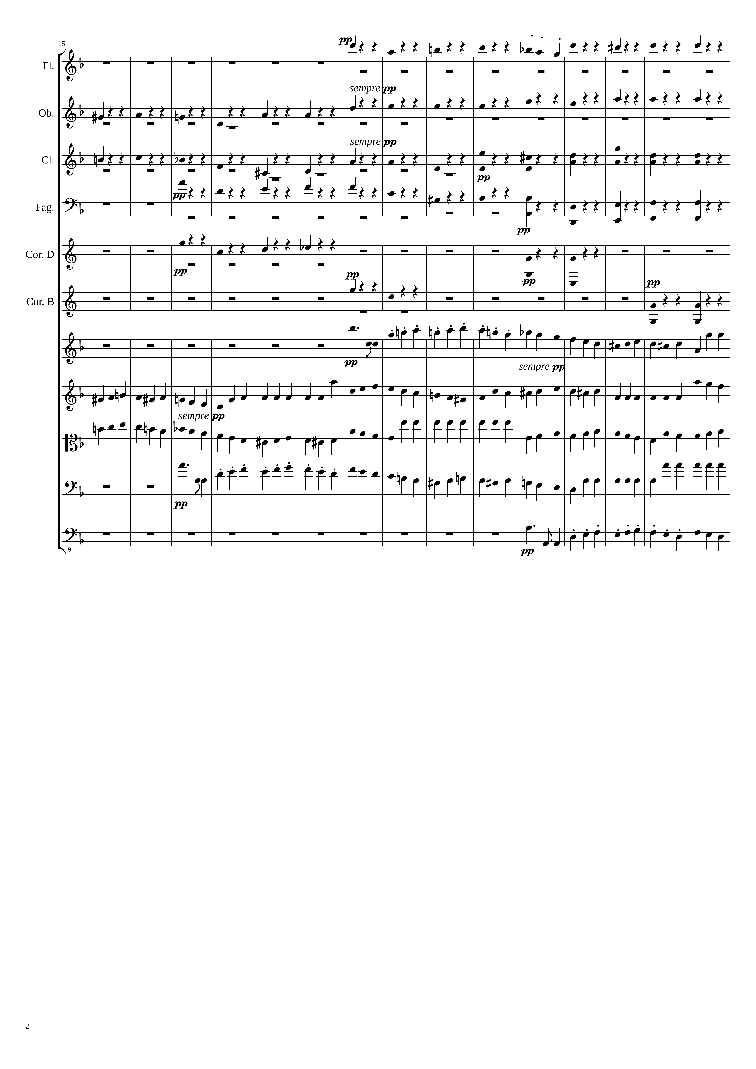
rhythm
rhythm
rhythm
rhythm
rhythm
rhythm
rhythm
rhythm
mel+rhythm
mel+rhythm
mel+rhythm
mel+rhythm
mel+rhythm

Slide 3
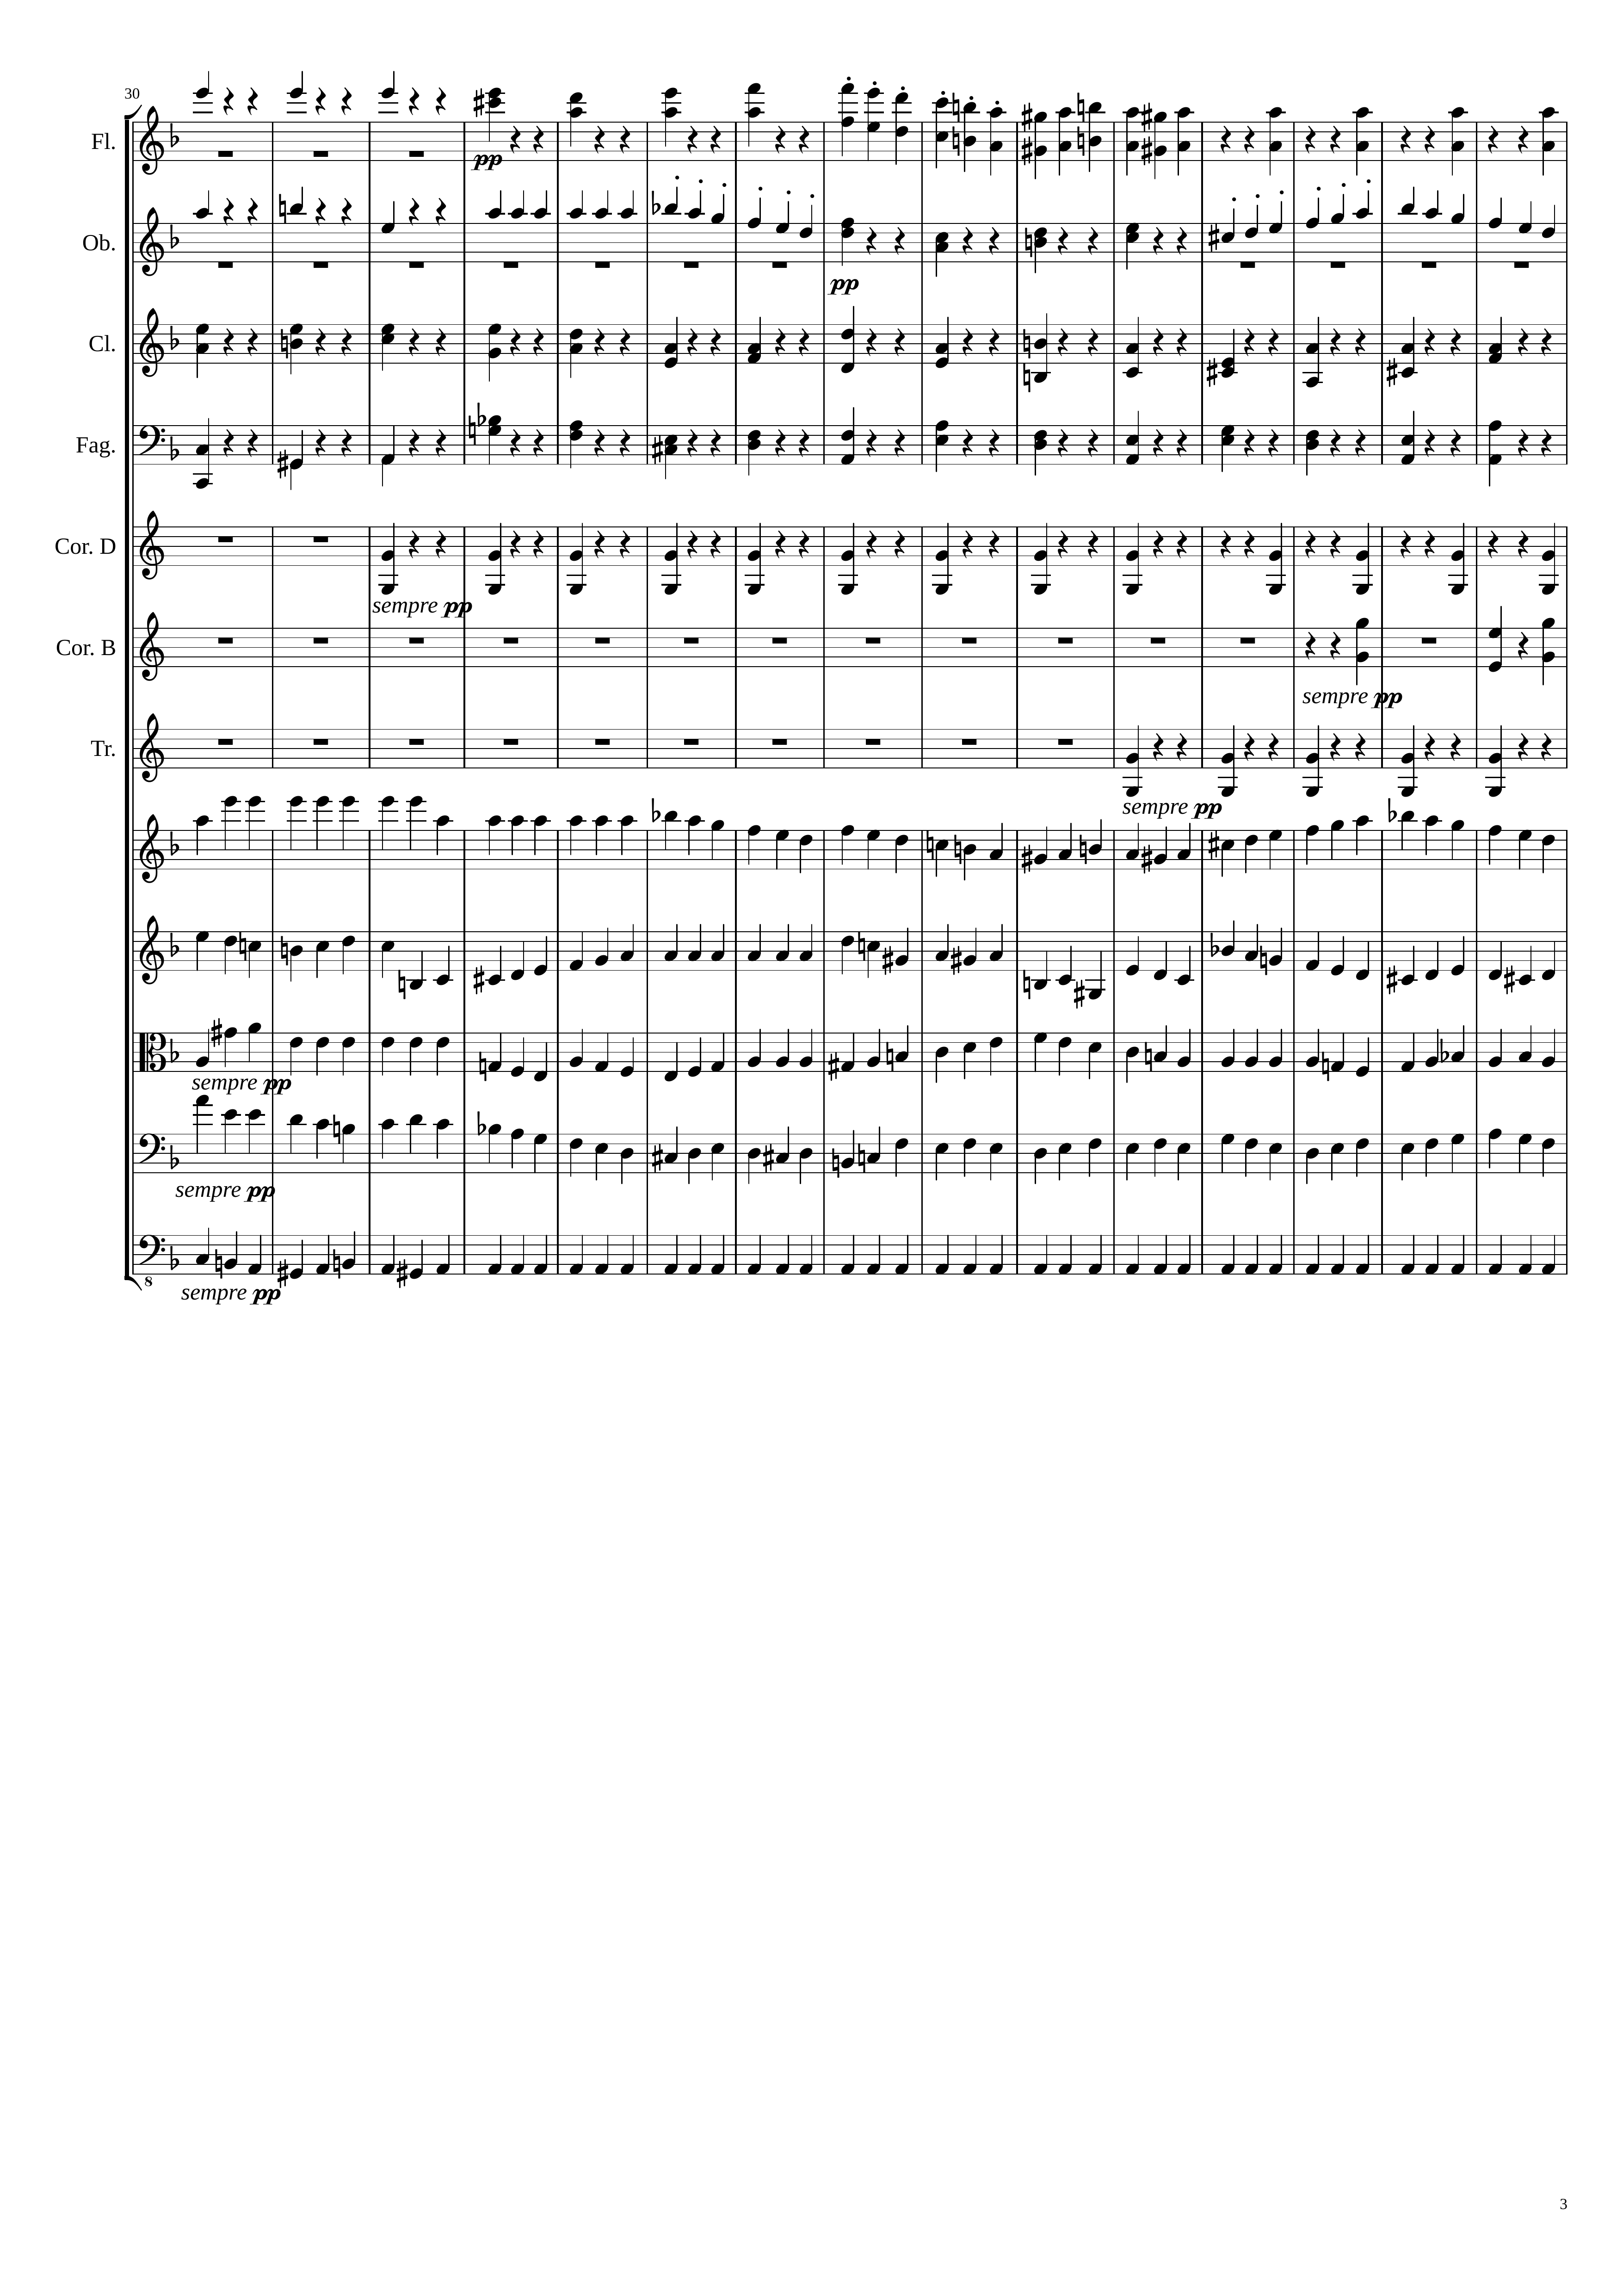
96
rhythm
rhythm
mel+rhythm
rhythm
rhythm
rhythm
mel+rhythm
rhythm
mel+rhythm
rhythm
rhythm
rhythm
rhythm
rhythm
rhythm
rhythm
mel+rhythm
mel+rhythm
mel+rhythm
mel+rhythm
mel+rhythm
mel+rhythm
mel+rhythm
mel+rhythm
mel+rhythm
rhythm

Slide 4
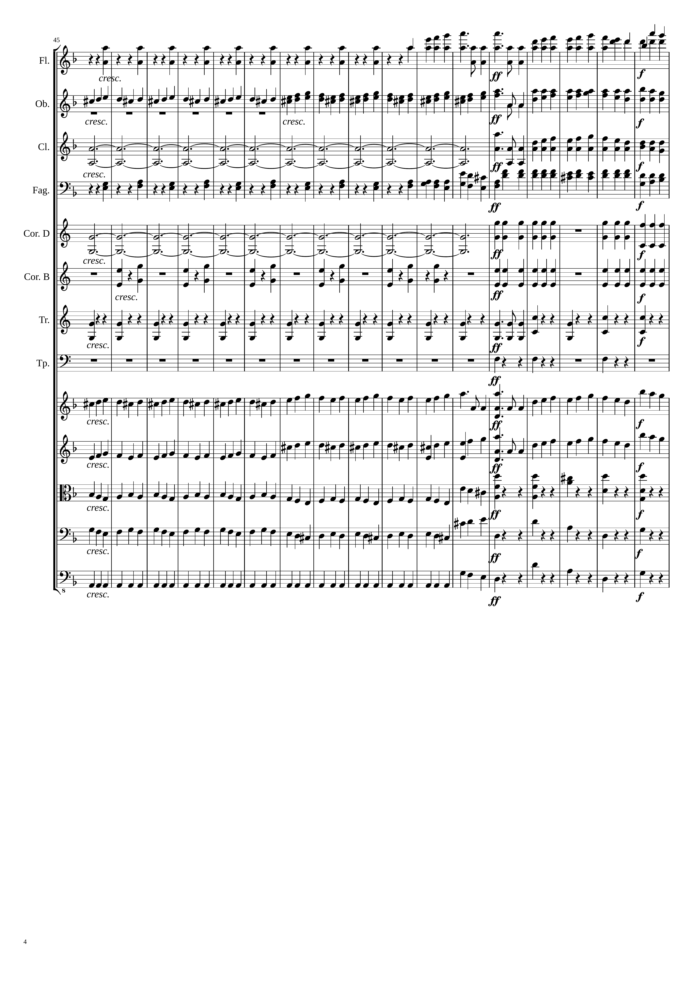
132
168
rhythm
mel+rhythm
mel+rhythm
mel+rhythm
rhythm
harm
mel+rhythm
rhythm
mel+rhythm
mel+rhythm
harm
rhythm
rhythm
rhythm
rhythm
rhythm
rhythm
mel+rhythm
mel
mel+rhythm
mel
mel+rhythm
rhythm
mel+rhythm
rhythm
rhythm
rhythm

Slide 5
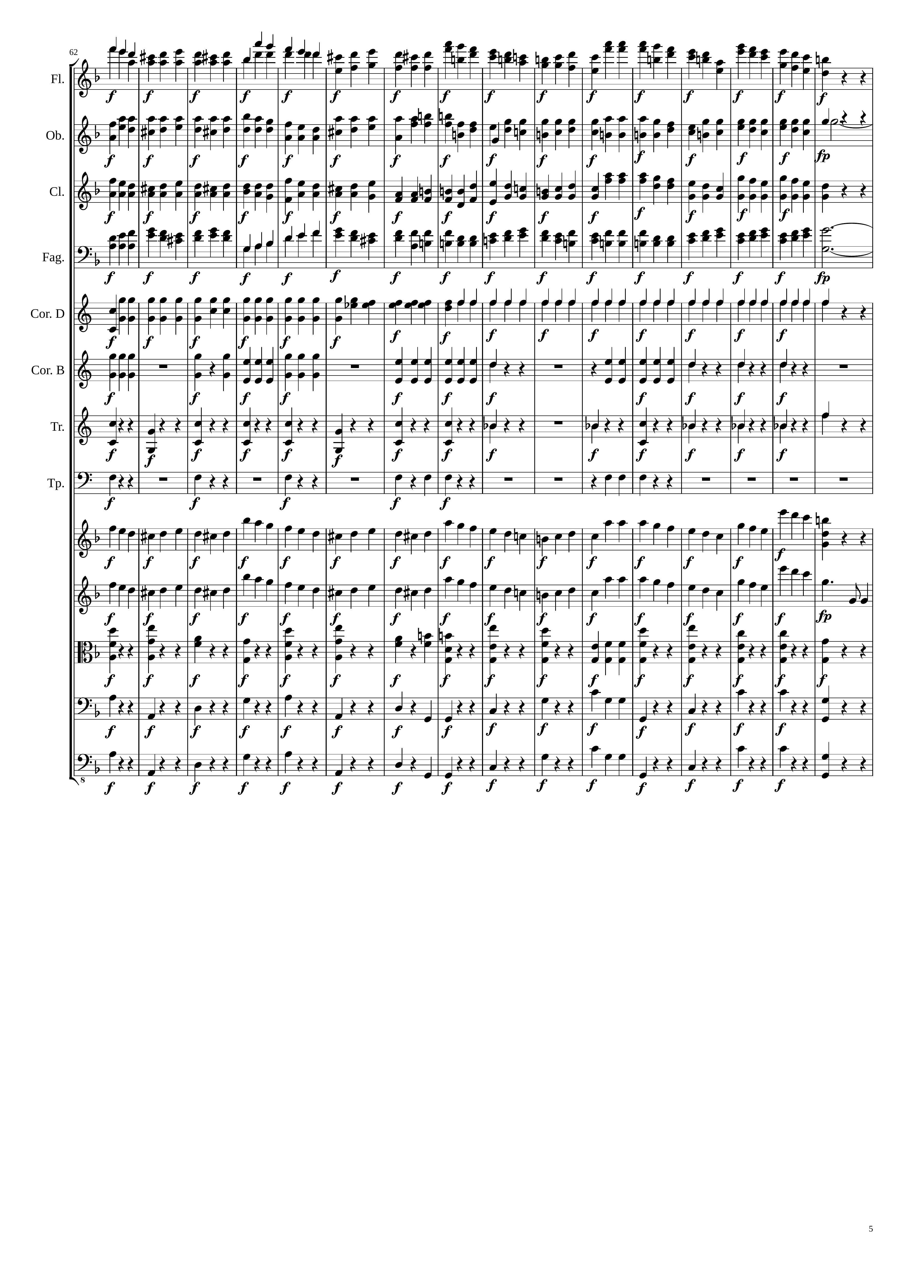
228
mel+rhythm
rhythm
harm
mel+rhythm
mel+rhythm
harm
rhythm
rhythm
rhythm
rhythm
mel
mel
mel+rhythm
rhythm
rhythm
rhythm

Slide 6
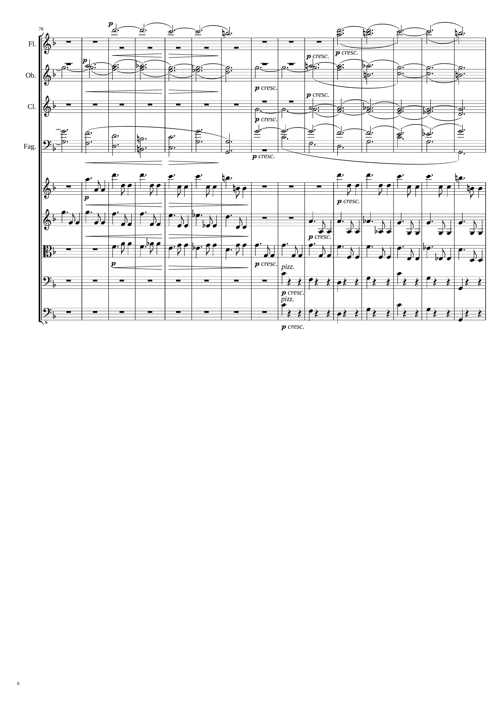
252
harm
harm
harm
harm
harm
harm
harm
mel+rhythm
mel+rhythm
mel+rhythm
mel+rhythm
rhythm
mel+rhythm
rhythm
rhythm

Slide 7
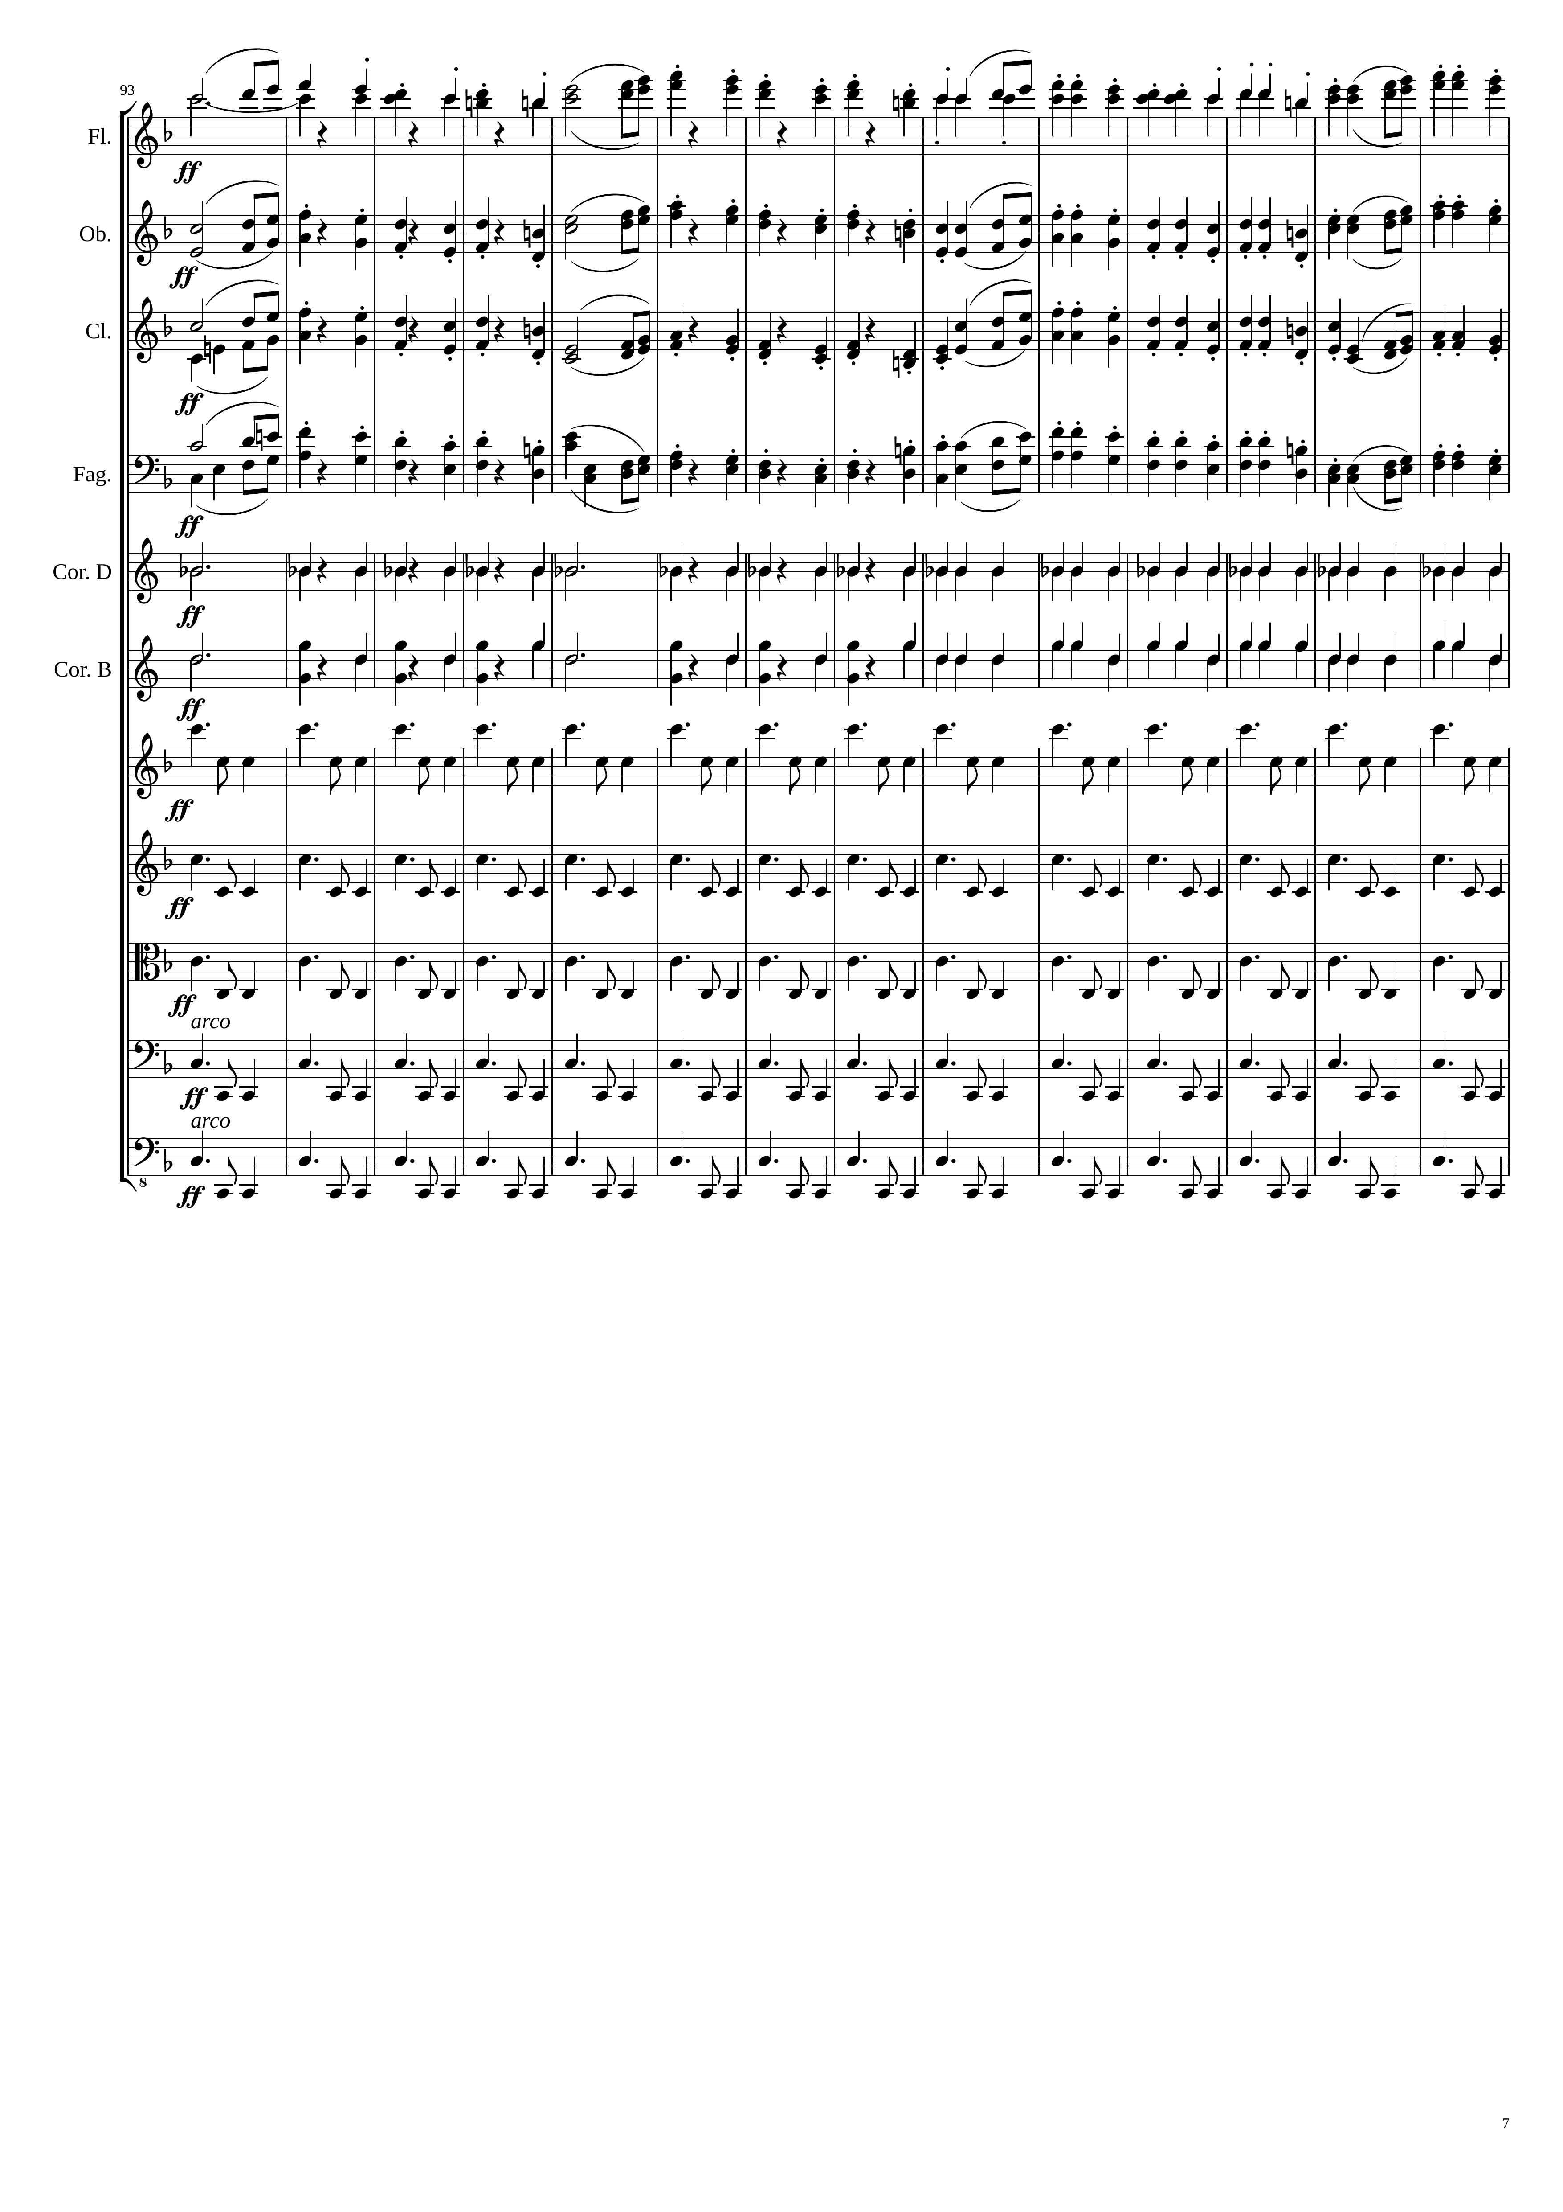
276
mel
mel
mel
mel
rhythm
rhythm
rhythm
rhythm
rhythm
rhythm
rhythm

Slide 8
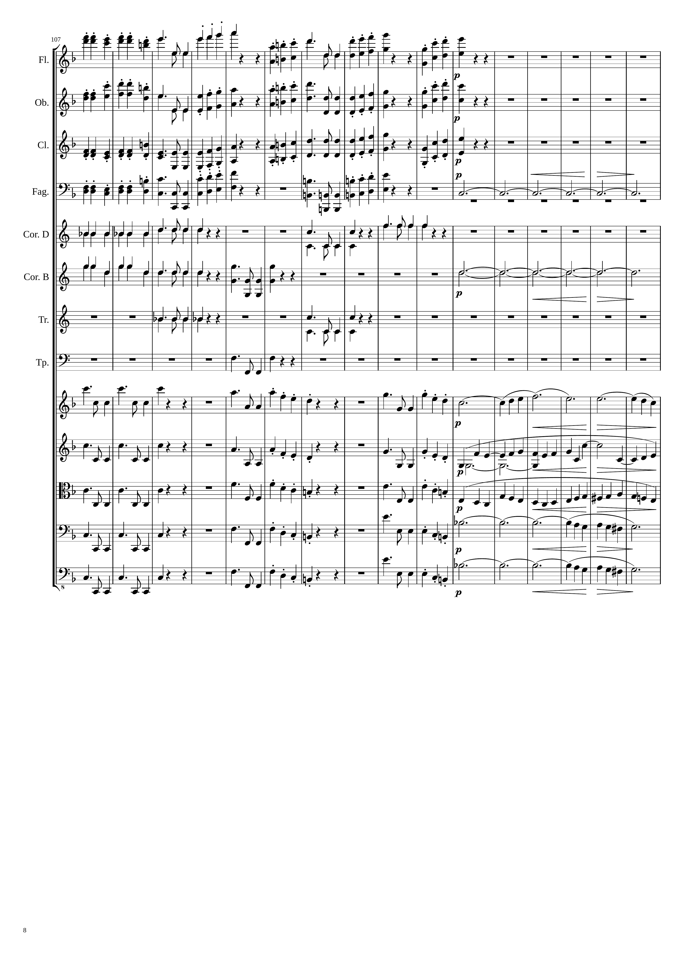
324
348
mel
mel+rhythm
mel
mel+rhythm
mel
mel+rhythm
mel
mel+rhythm
harm
rhythm
rhythm
harm
rhythm
rhythm
rhythm
mel+rhythm
mel
rhythm
mel+rhythm
mel+rhythm
rhythm
mel+rhythm
mel+rhythm
rhythm
mel+rhythm
rhythm+harm
rhythm
mel+rhythm
rhythm+harm

Slide 9
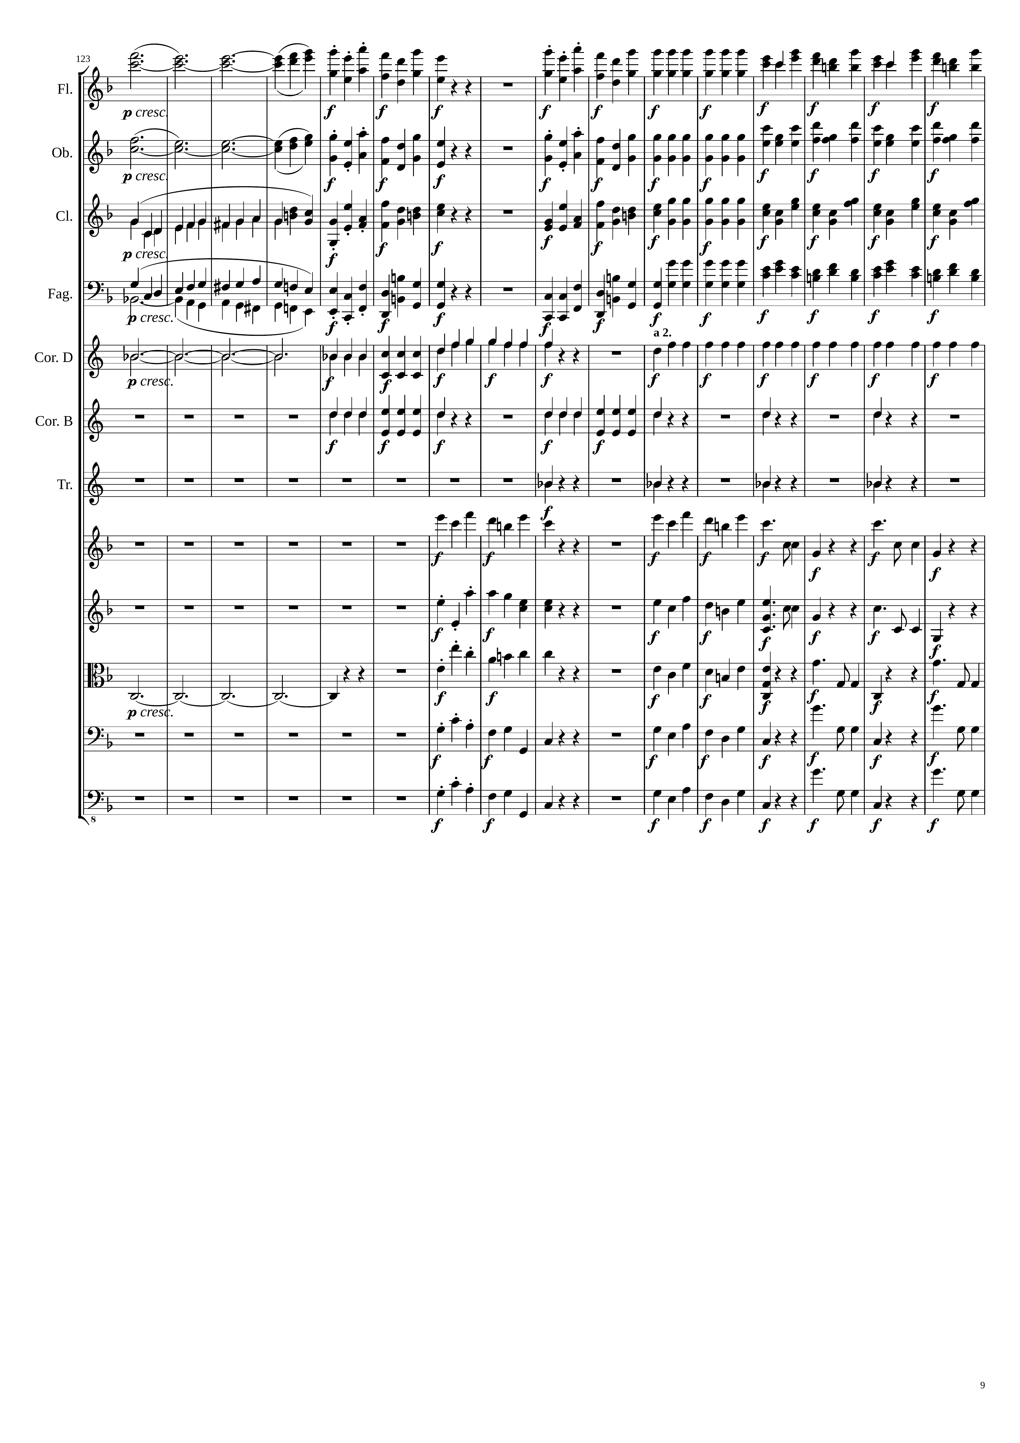
366
384
harm
mel
mel
rhythm
mel+rhythm
harm
mel
mel
rhythm
mel+rhythm
mel
mel
rhythm
mel+rhythm
mel
mel
rhythm
mel+rhythm
harm
rhythm
rhythm
rhythm
mel
mel
rhythm
mel
mel
rhythm
harm
mel
mel
rhythm
mel
mel
rhythm
mel
mel
rhythm

Slide 10
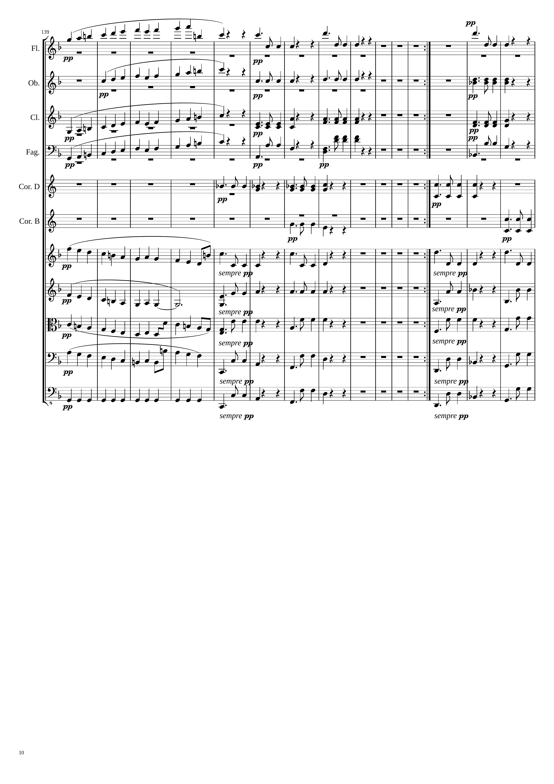
414
438
876
293rd bar
mel+rhythm
mel+rhythm
Repeat 142 bars
mel+rhythm
mel+rhythm
rhythm
rhythm
mel+rhythm
rhythm
rhythm
mel+rhythm
rhythm
rhythm
rhythm
rhythm
rhythm
rhythm
mel+rhythm
mel+rhythm
mel+rhythm
mel+rhythm
rhythm
rhythm
mel+rhythm
rhythm
rhythm
mel+rhythm
rhythm
rhythm
rhythm
rhythm
rhythm

Slide 11
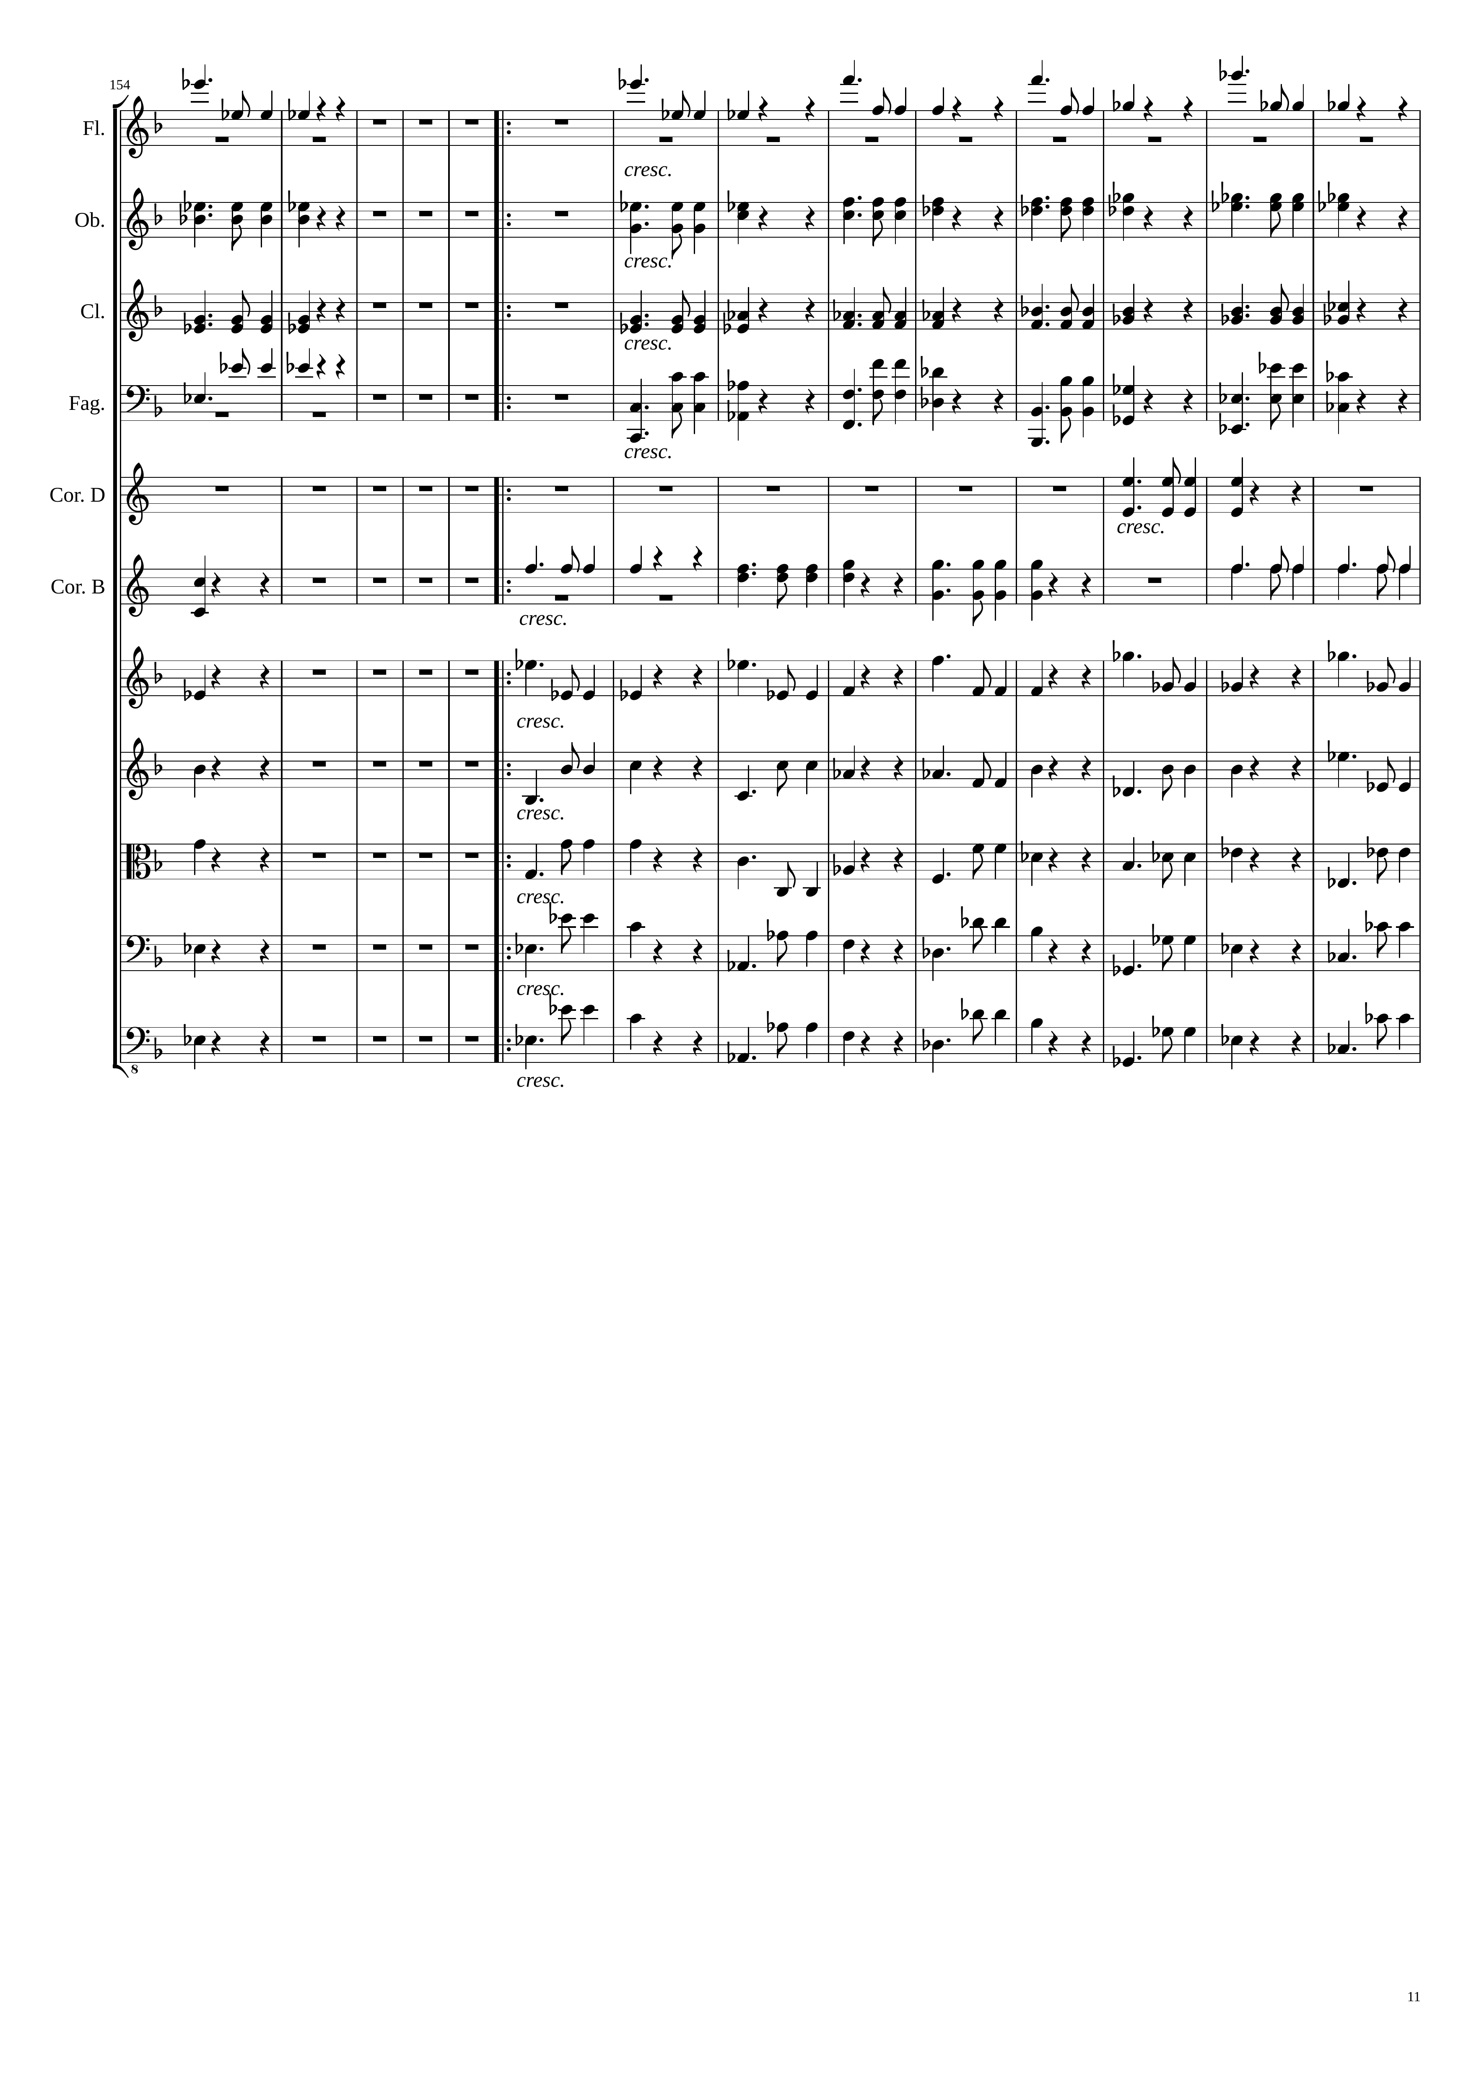
888
542nd bar
900
mel+rhythm
301st bar
mel+rhythm
rhythm
rhythm
rhythm
rhythm
rhythm
rhythm
rhythm
rhythm
rhythm
mel+rhythm
mel+rhythm
rhythm
rhythm
rhythm
rhythm
rhythm
rhythm
rhythm
rhythm

Slide 12
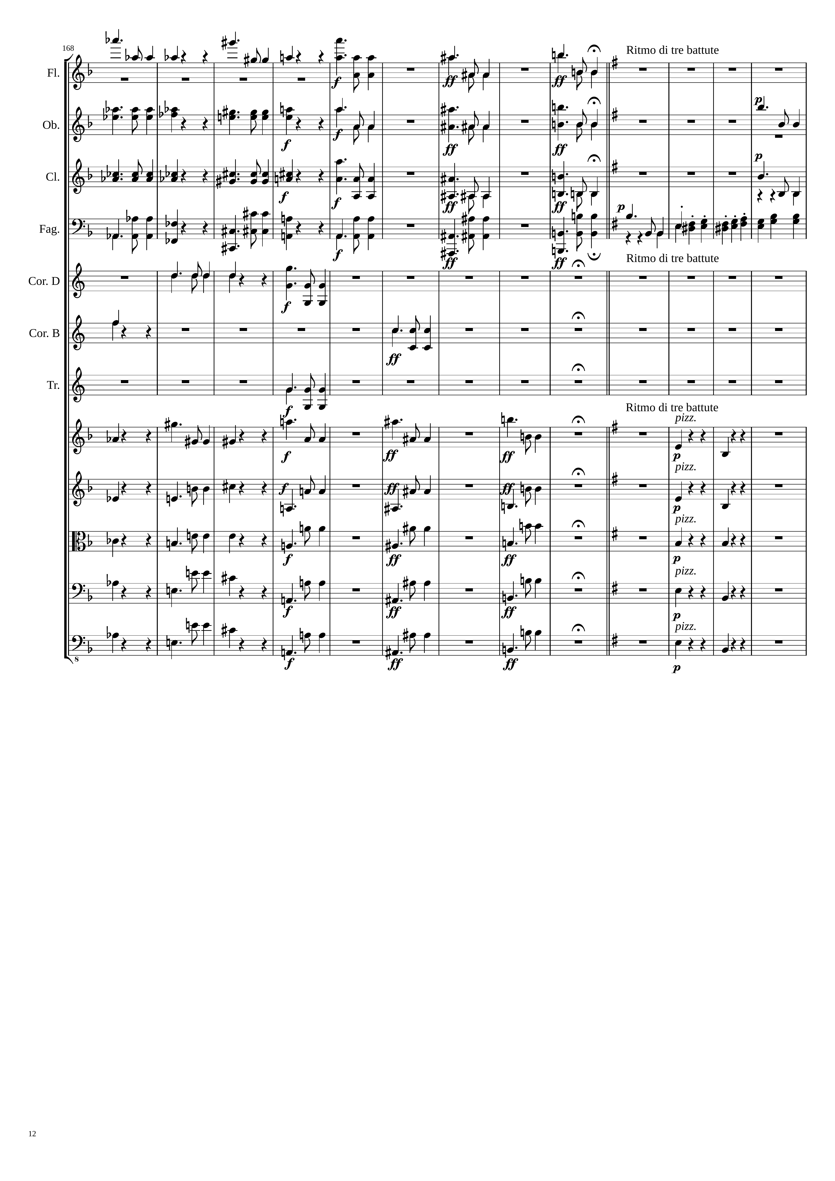
936
954
mel+rhythm
mel+rhythm
mel+rhythm
mel+rhythm
rhythm
mel+rhythm
mel+rhythm
mel+rhythm
mel+rhythm
rhythm
mel+rhythm
mel+rhythm
mel+rhythm
mel+rhythm
rhythm
mel+rhythm
mel+rhythm
mel+rhythm
mel+rhythm
rhythm
rhythm
rhythm
mel+rhythm
mel+rhythm
mel+rhythm
mel+rhythm
rhythm
rhythm
mel+rhythm
mel+rhythm
mel+rhythm
rhythm
rhythm
mel+rhythm
mel+rhythm
mel+rhythm
rhythm
rhythm
rhythm
mel+rhythm
mel+rhythm
mel+rhythm
rhythm
rhythm
mel+rhythm
mel+rhythm
mel+rhythm
rhythm

Slide 13
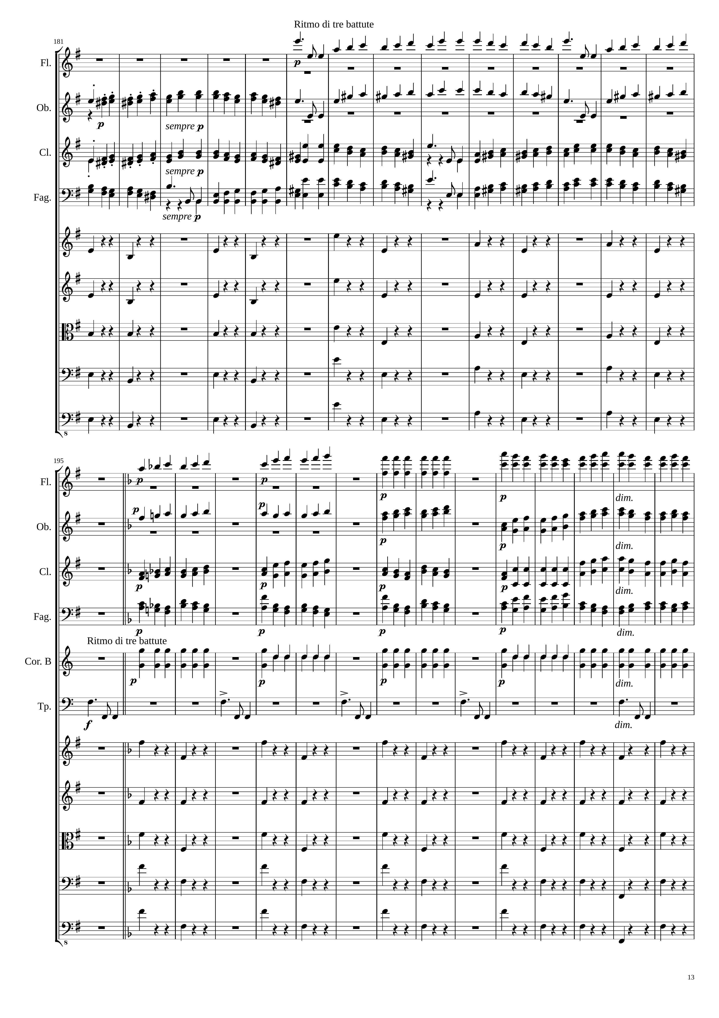
mel+rhythm
mel+rhythm
mel+rhythm
mel+rhythm
rhythm
rhythm
rhythm
rhythm
rhythm
1008
mel+rhythm
mel+rhythm
mel+rhythm
mel+rhythm
rhythm
mel+rhythm
rhythm
rhythm
rhythm
rhythm
rhythm

Slide 14
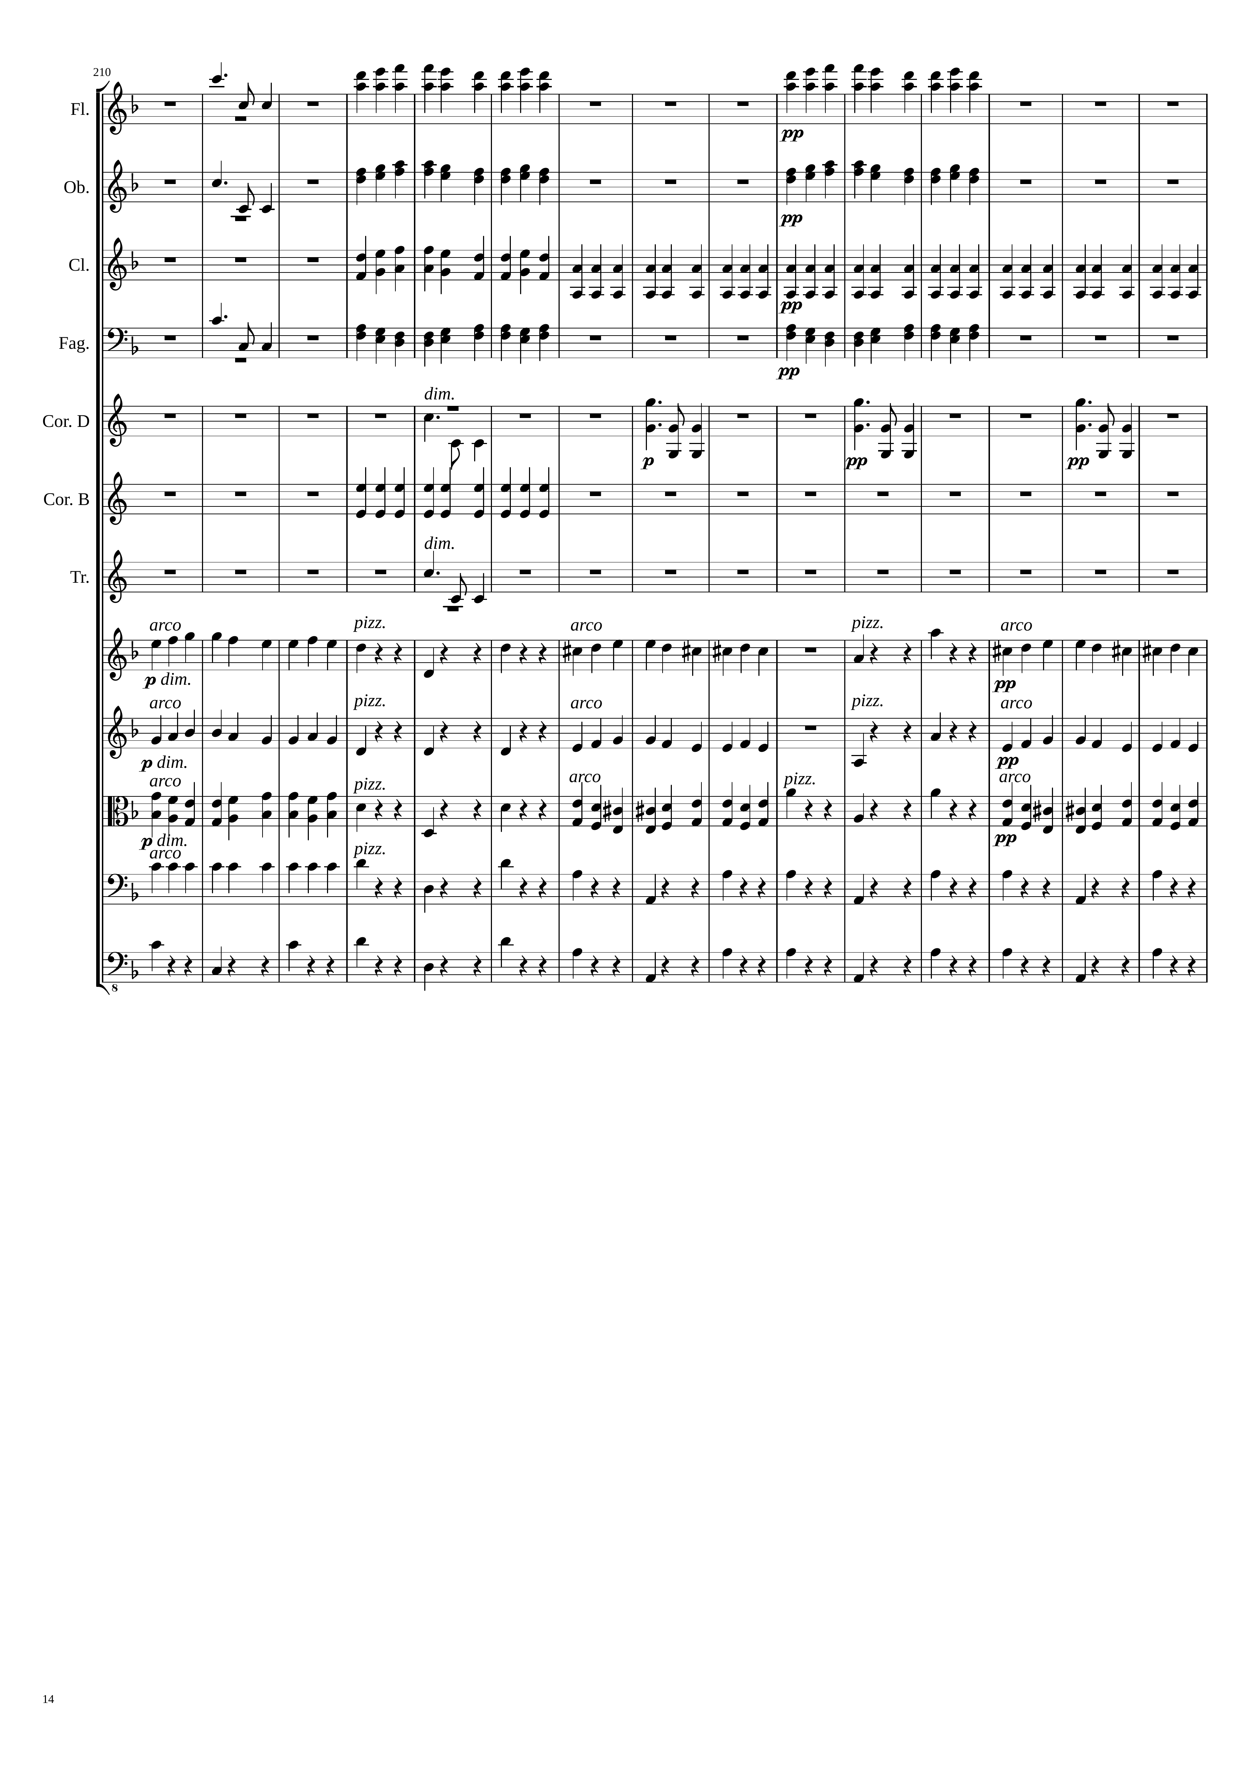
1053
1071
1089
rhythm
mel+rhythm
mel+rhythm
rhythm
mel+rhythm
mel+rhythm
mel+rhythm
rhythm
mel+rhythm
rhythm
rhythm
mel+rhythm
mel+rhythm
rhythm
rhythm
rhythm
mel+rhythm
rhythm
mel+rhythm
rhythm
mel+rhythm
mel+rhythm
rhythm
mel+rhythm
rhythm
mel+rhythm
mel+rhythm
rhythm
mel+rhythm
rhythm
mel+rhythm
rhythm
rhythm

Slide 15
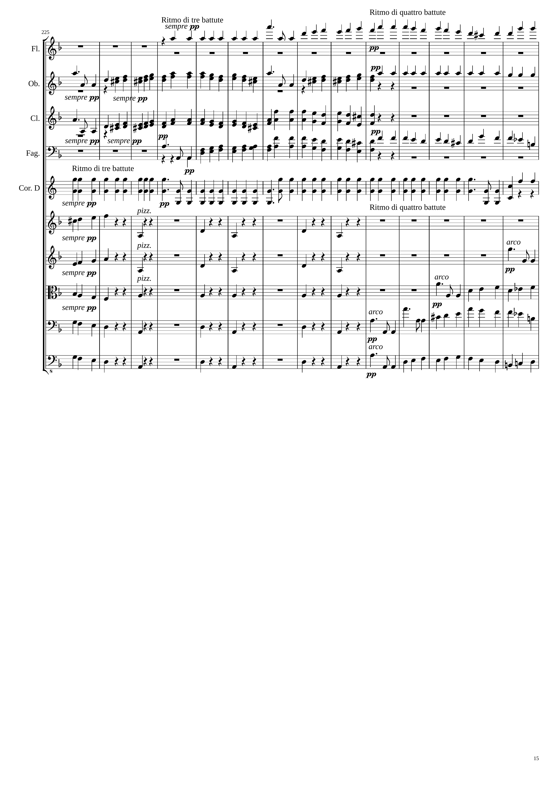
1107
1125
mel+rhythm
mel+rhythm
rhythm
mel+rhythm
mel+rhythm
mel+rhythm
rhythm
rhythm
rhythm
mel+rhythm
rhythm
mel+rhythm
rhythm
mel+rhythm
rhythm
mel+rhythm

Slide 16
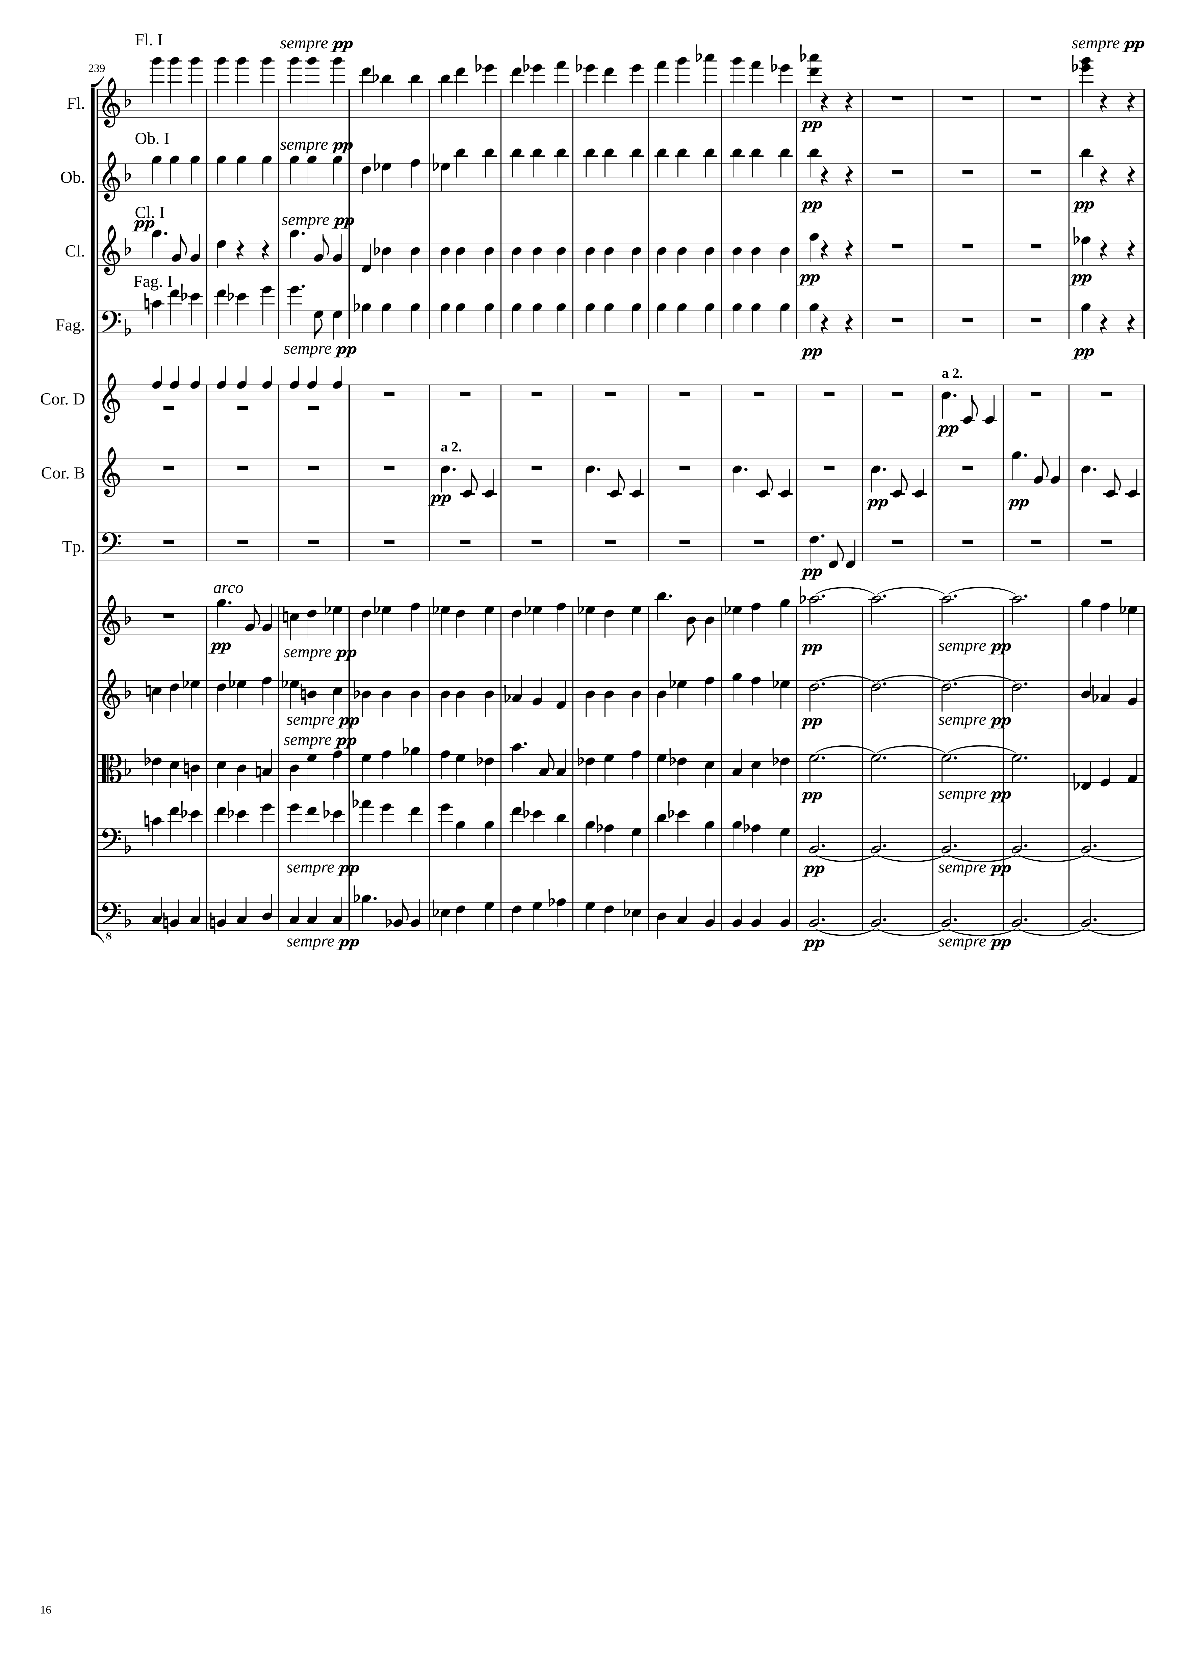
1149
1167
rhythm
mel+rhythm
rhythm
rhythm
rhythm
rhythm
rhythm
mel+rhythm
rhythm
rhythm
rhythm
mel+rhythm
rhythm
mel+rhythm
mel+rhythm
rhythm
mel+rhythm
mel+rhythm
harm
mel+rhythm
mel+rhythm
harm
mel+rhythm
mel+rhythm
harm
mel+rhythm
mel+rhythm
harm
mel+rhythm
harm

Slide 17
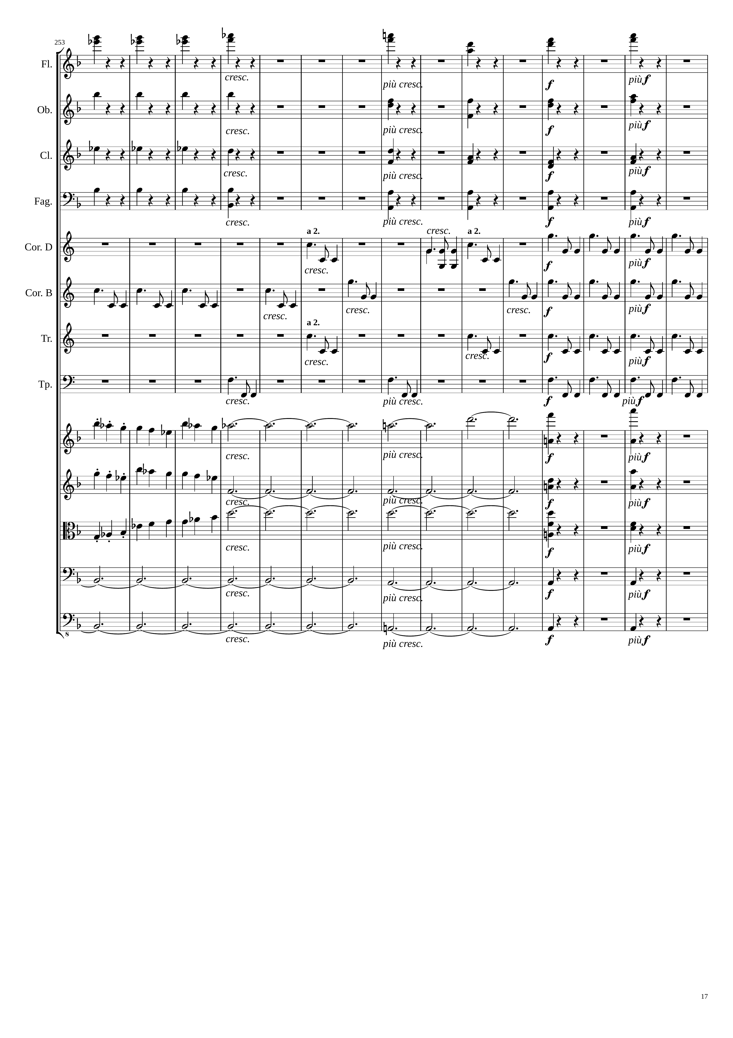
1191
1215
rhythm
rhythm
rhythm
rhythm
rhythm
rhythm
rhythm
rhythm
mel+rhythm
mel+rhythm
rhythm
rhythm
mel+rhythm
mel+rhythm
mel+rhythm
rhythm
mel+rhythm
mel+rhythm
rhythm
mel+rhythm
mel+rhythm
rhythm
mel+rhythm
harm
mel+rhythm
mel+rhythm
harm
mel+rhythm
mel+rhythm
harm
mel+rhythm
harm
rhythm
harm
rhythm

Slide 18
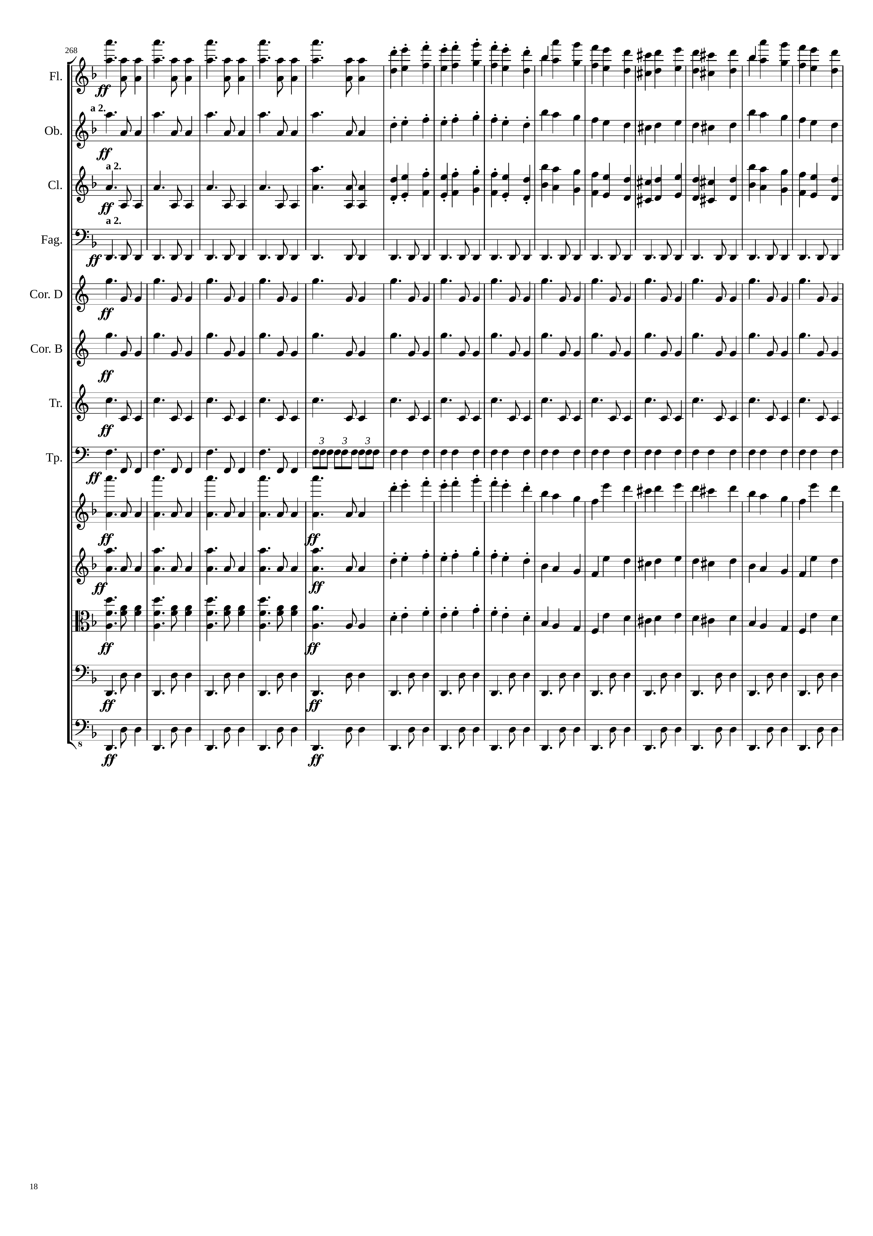
1242
rhythm
mel+rhythm
rhythm
mel+rhythm
rhythm
mel+rhythm
rhythm
rhythm
rhythm
rhythm
rhythm
rhythm
rhythm
rhythm
rhythm
rhythm
rhythm
mel+rhythm
rhythm
mel+rhythm
rhythm+harm
mel+rhythm
rhythm
rhythm
rhythm
rhythm

Slide 19
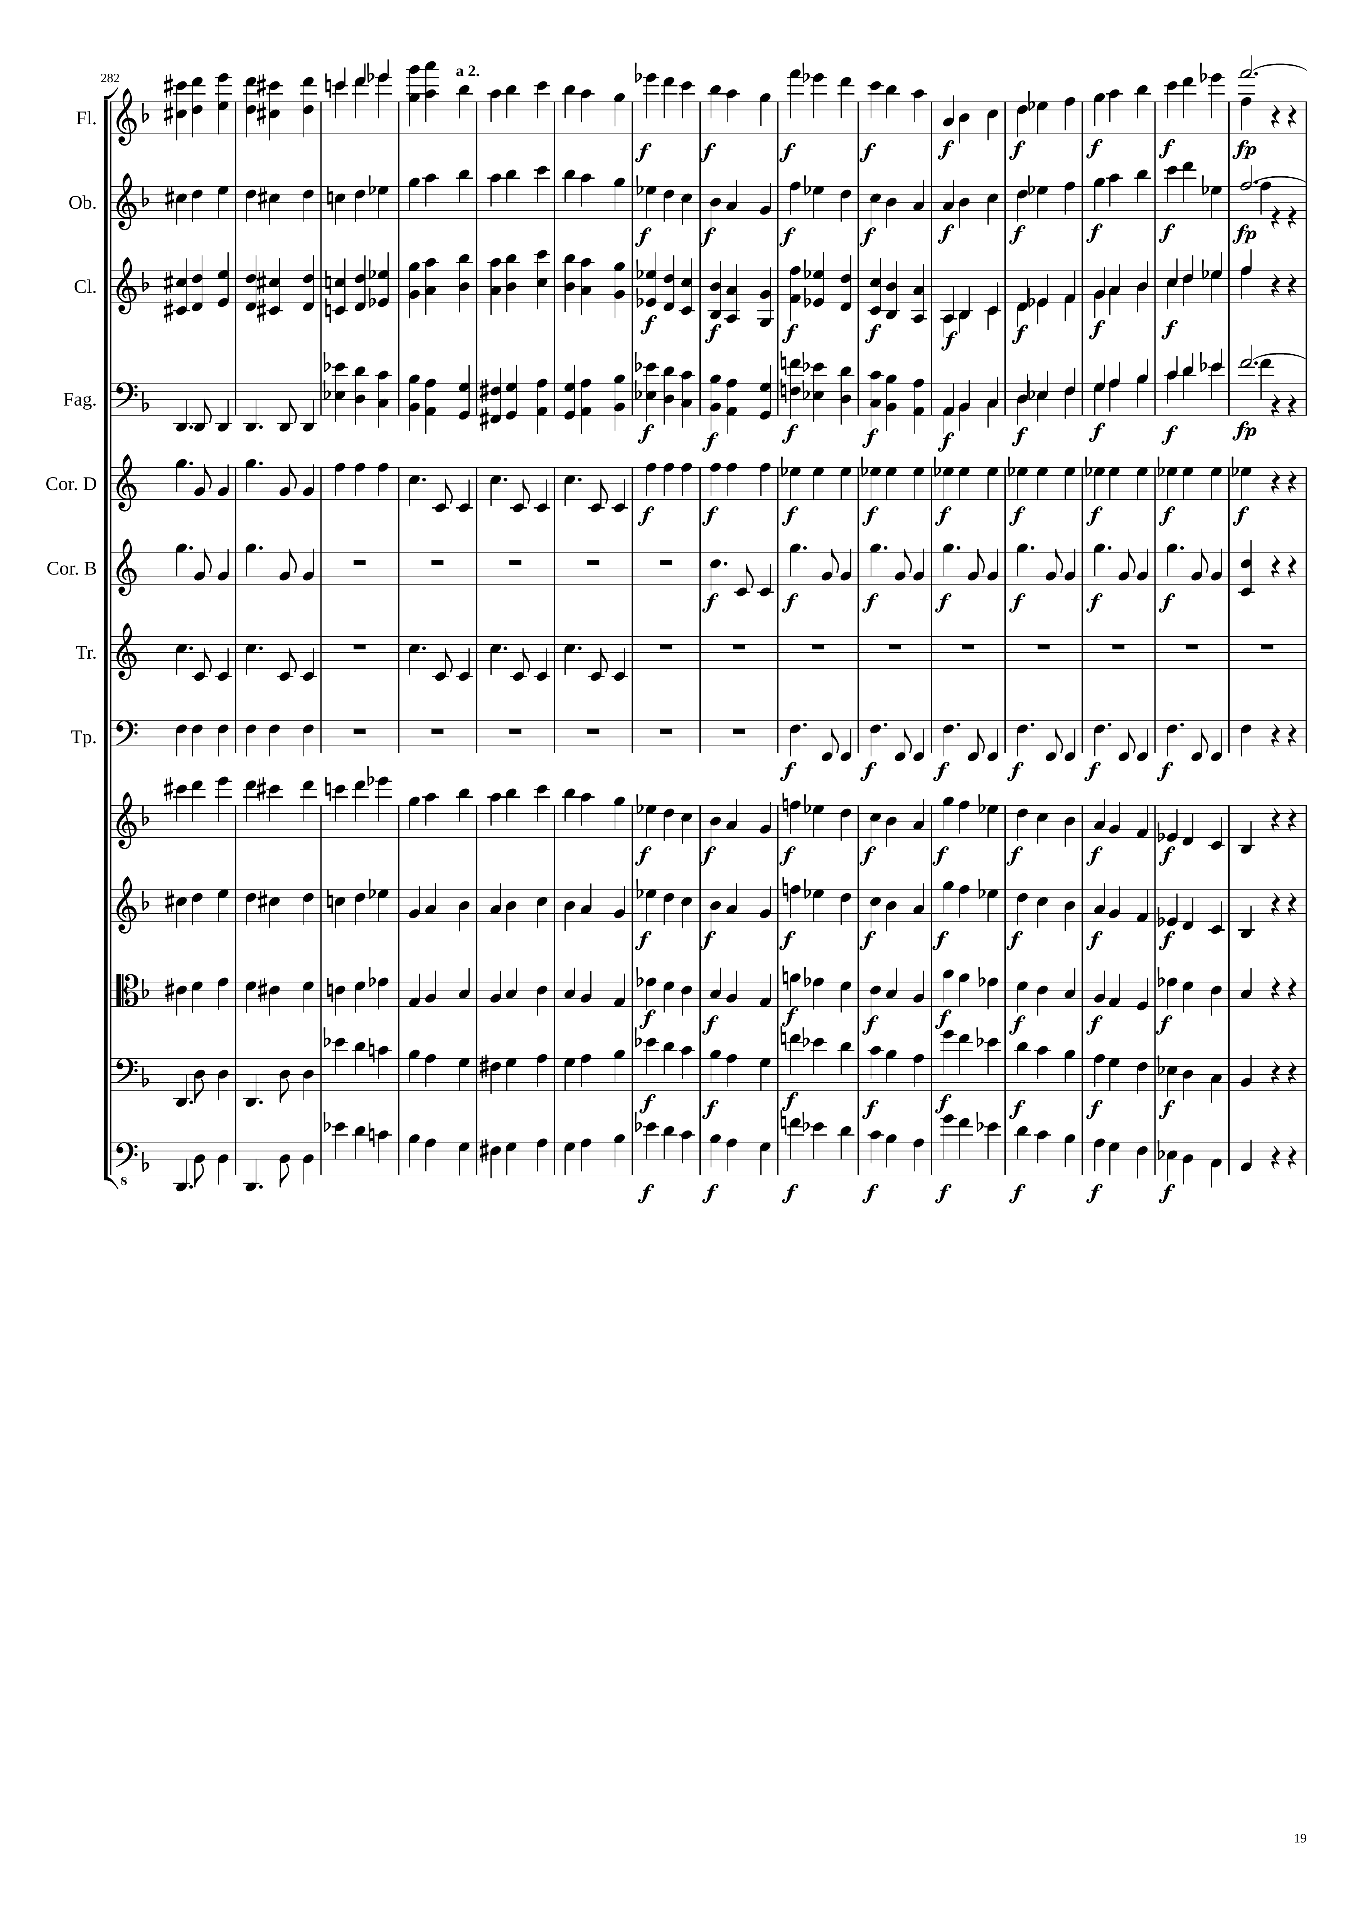
1275
1311
mel+rhythm
mel+rhythm
mel+harm
mel+rhythm
mel+rhythm
mel+harm
mel+rhythm
mel+rhythm
rhythm
mel+rhythm
mel+harm
rhythm
rhythm
rhythm
rhythm
rhythm
rhythm
rhythm
rhythm
mel+rhythm
mel+rhythm
mel+rhythm
mel+rhythm
mel+rhythm
mel+rhythm
rhythm
mel+rhythm
rhythm
mel+rhythm

Slide 20
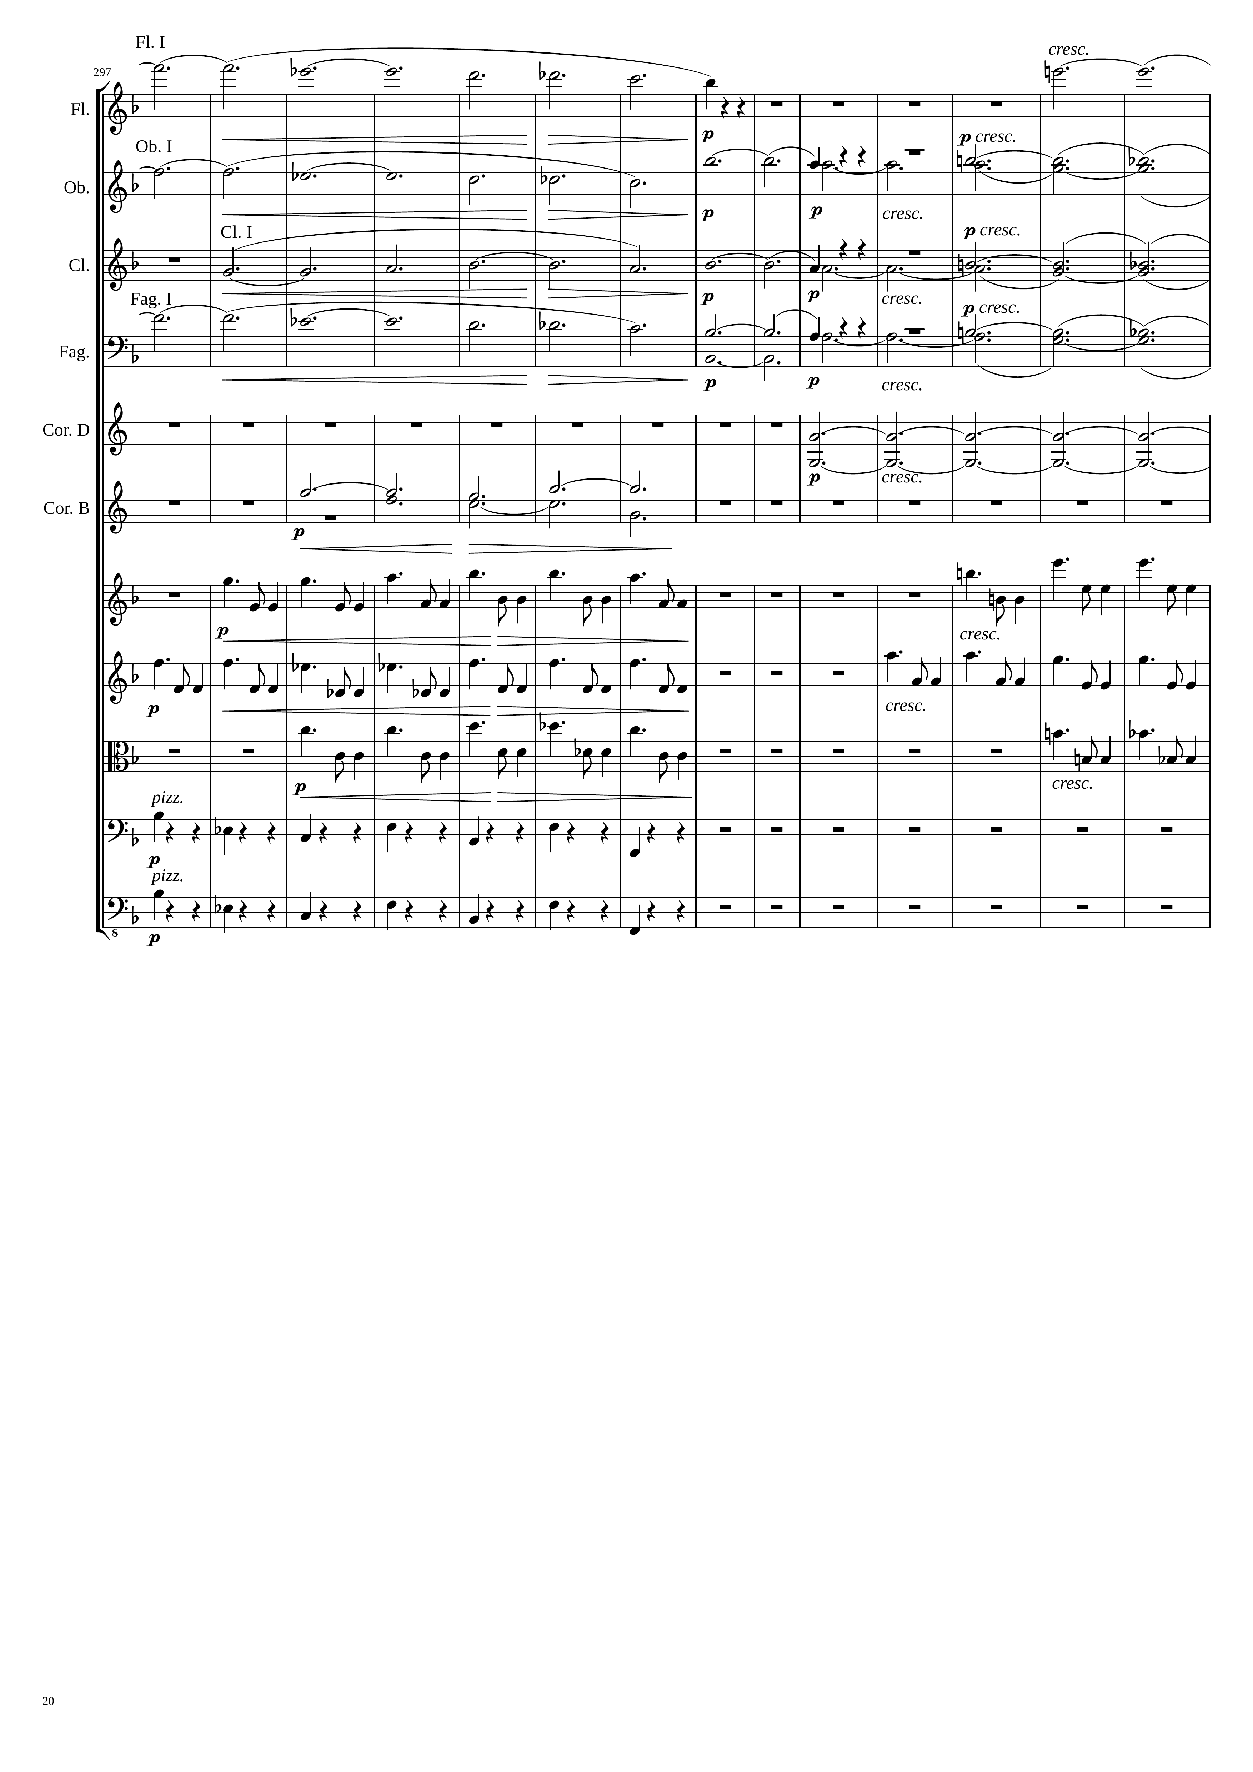
1335
harm
mel+harm
mel+harm
harm
mel+harm
harm
mel+harm
harm
harm
harm
harm
mel+rhythm
mel+rhythm
mel+rhythm
mel+rhythm
mel+rhythm
mel+rhythm
rhythm
rhythm

Slide 21
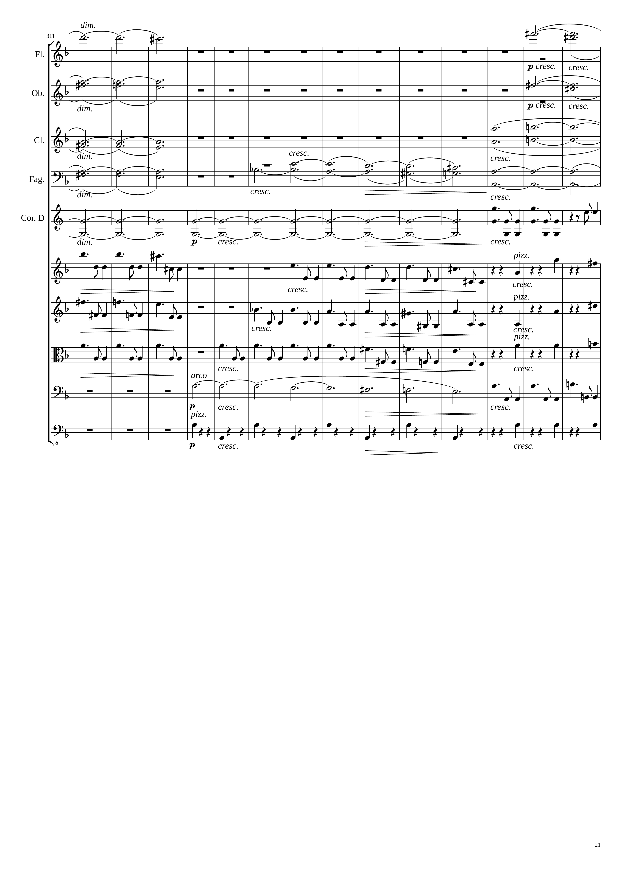
1365
1389
harm
mel+harm
harm
mel+harm
harm
mel+harm
harm
mel+harm
mel+harm
harm
harm
rhythm
mel+rhythm
mel+rhythm
rhythm
mel+rhythm
mel+rhythm
rhythm
mel+rhythm
mel+rhythm
rhythm
mel+harm
mel+rhythm
rhythm
rhythm

Slide 22
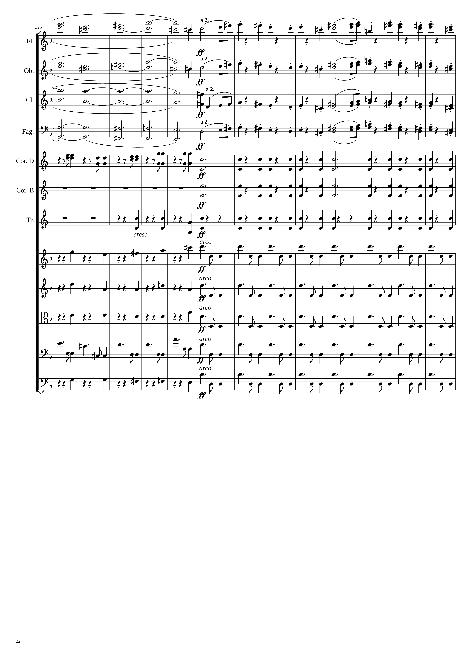
mel+harm
1413
mel
mel+harm
mel
mel+harm
mel
mel+harm
mel
rhythm
rhythm
rhythm
rhythm
rhythm
rhythm
rhythm
rhythm
rhythm
rhythm
rhythm
rhythm
mel+rhythm
rhythm
rhythm
rhythm

Slide 23
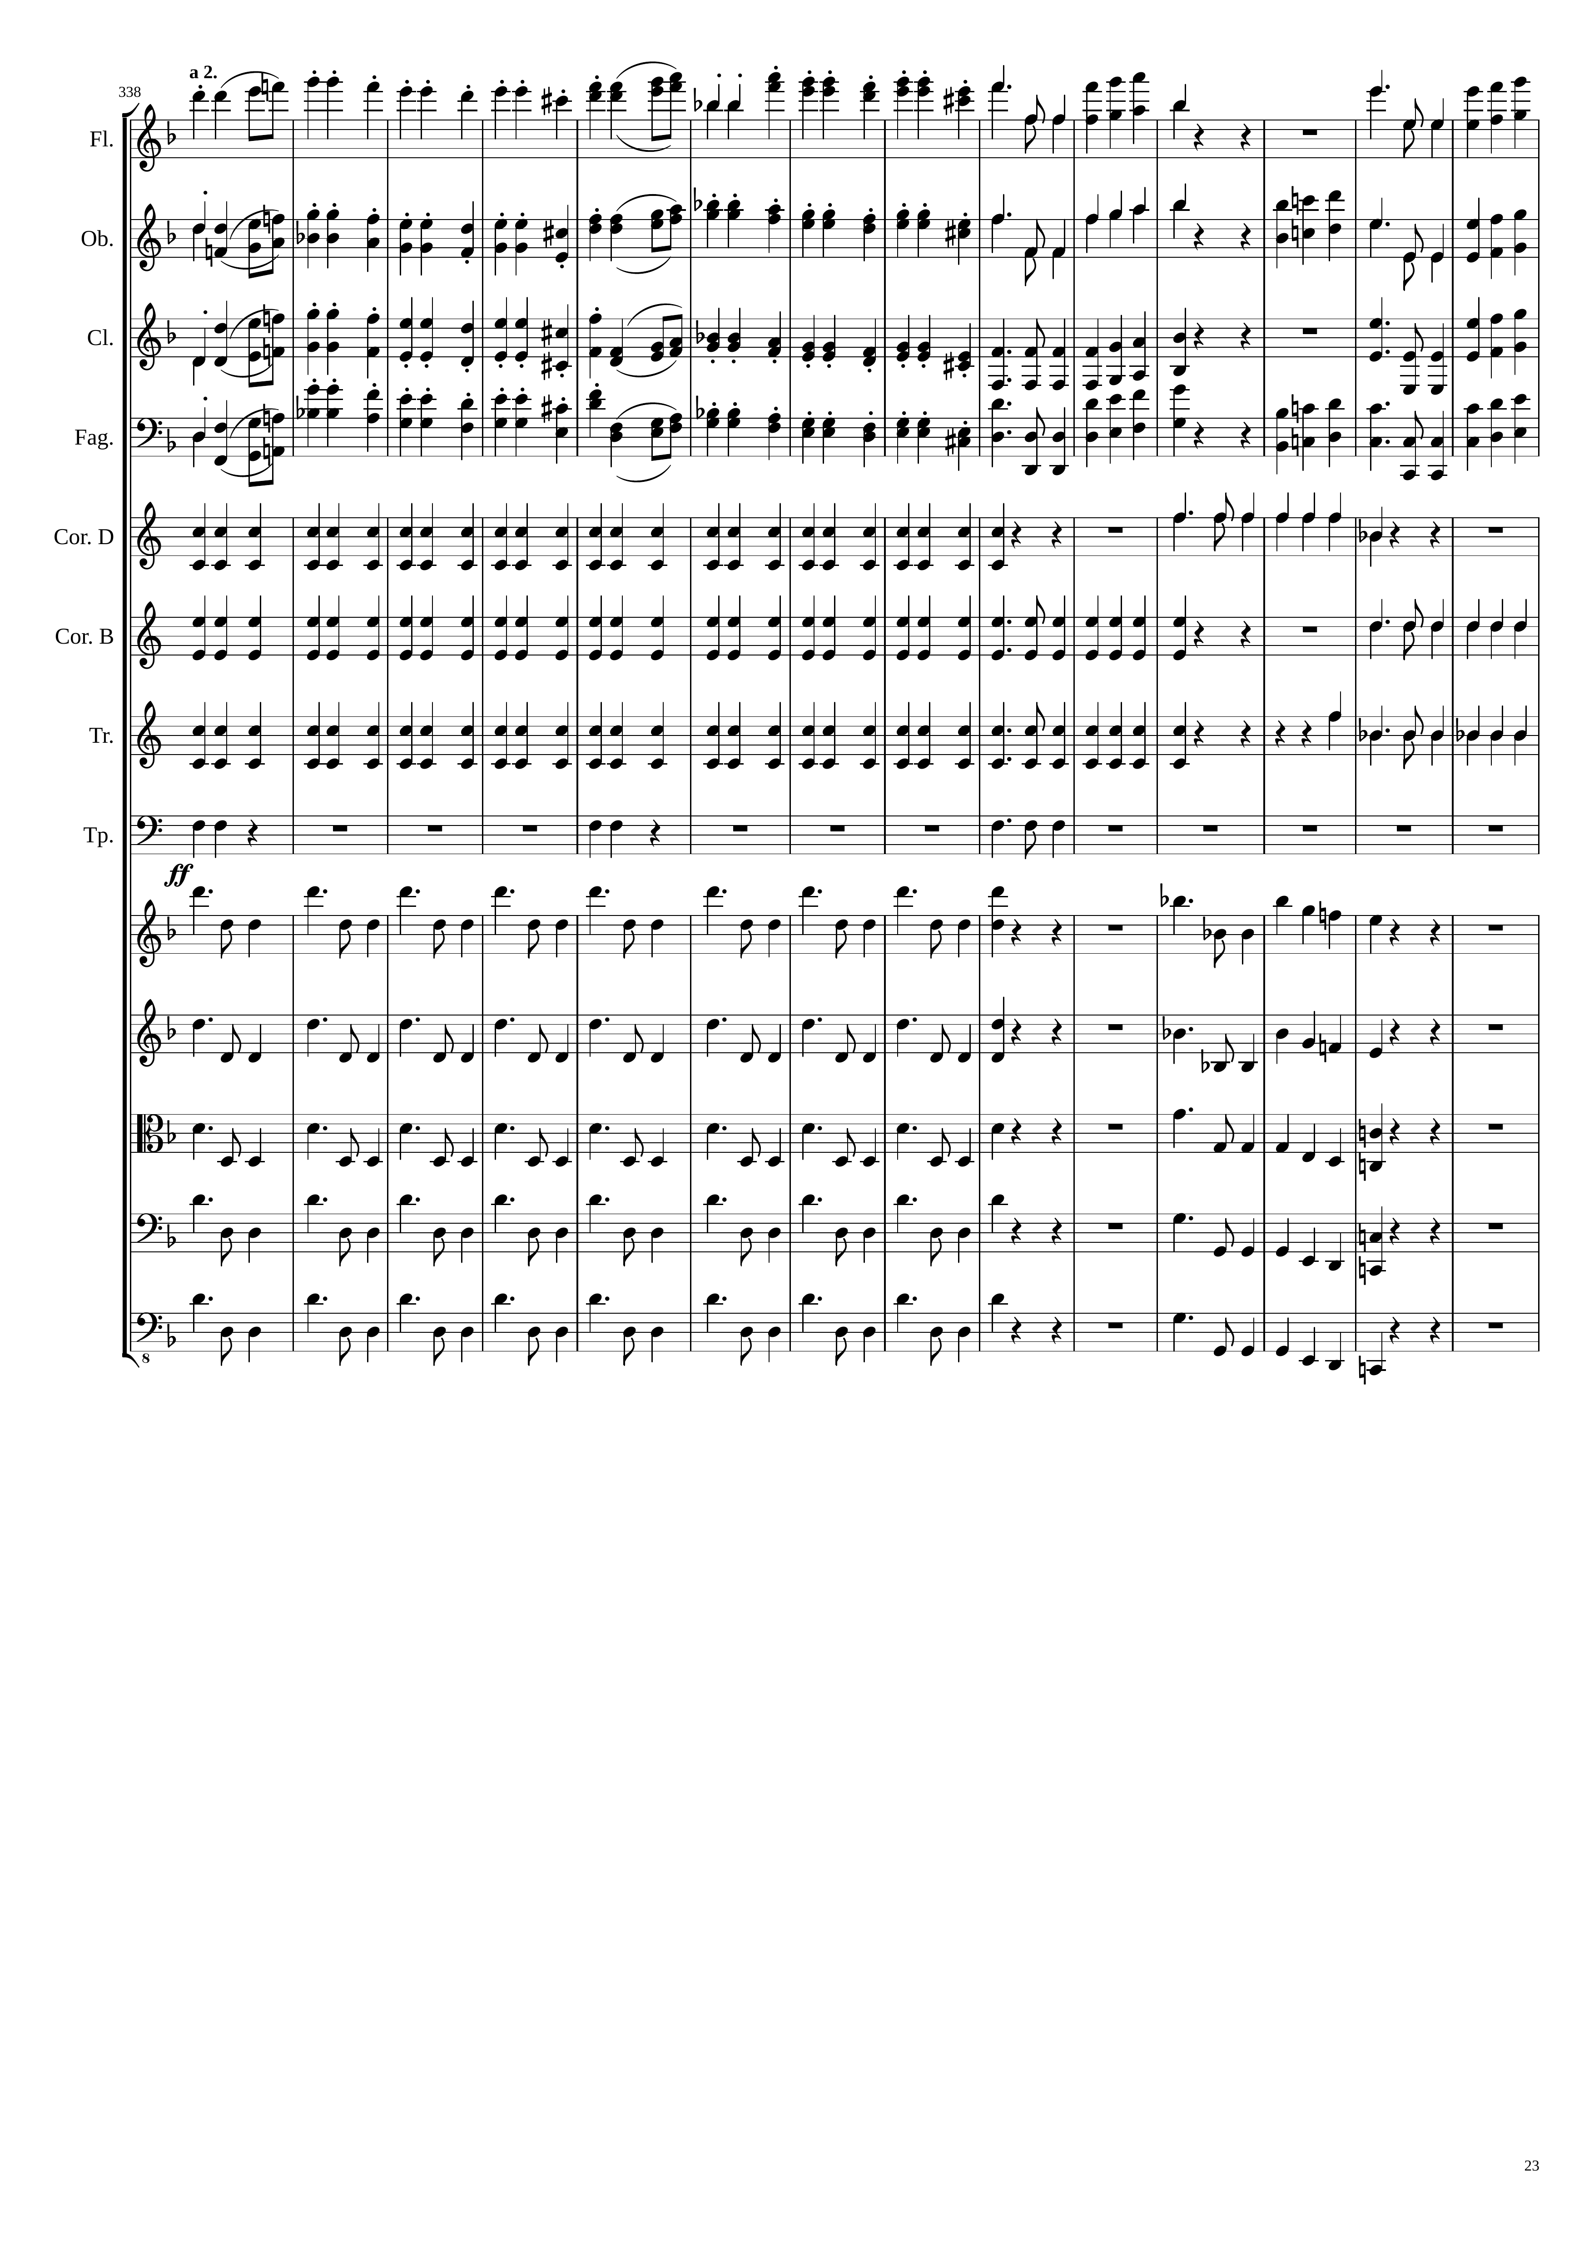
1461
mel
mel
mel
mel
mel
mel
mel
mel
rhythm
rhythm
rhythm
rhythm
rhythm
rhythm
rhythm
rhythm
mel
rhythm
mel
rhythm
mel
rhythm
mel
rhythm
mel

Slide 24
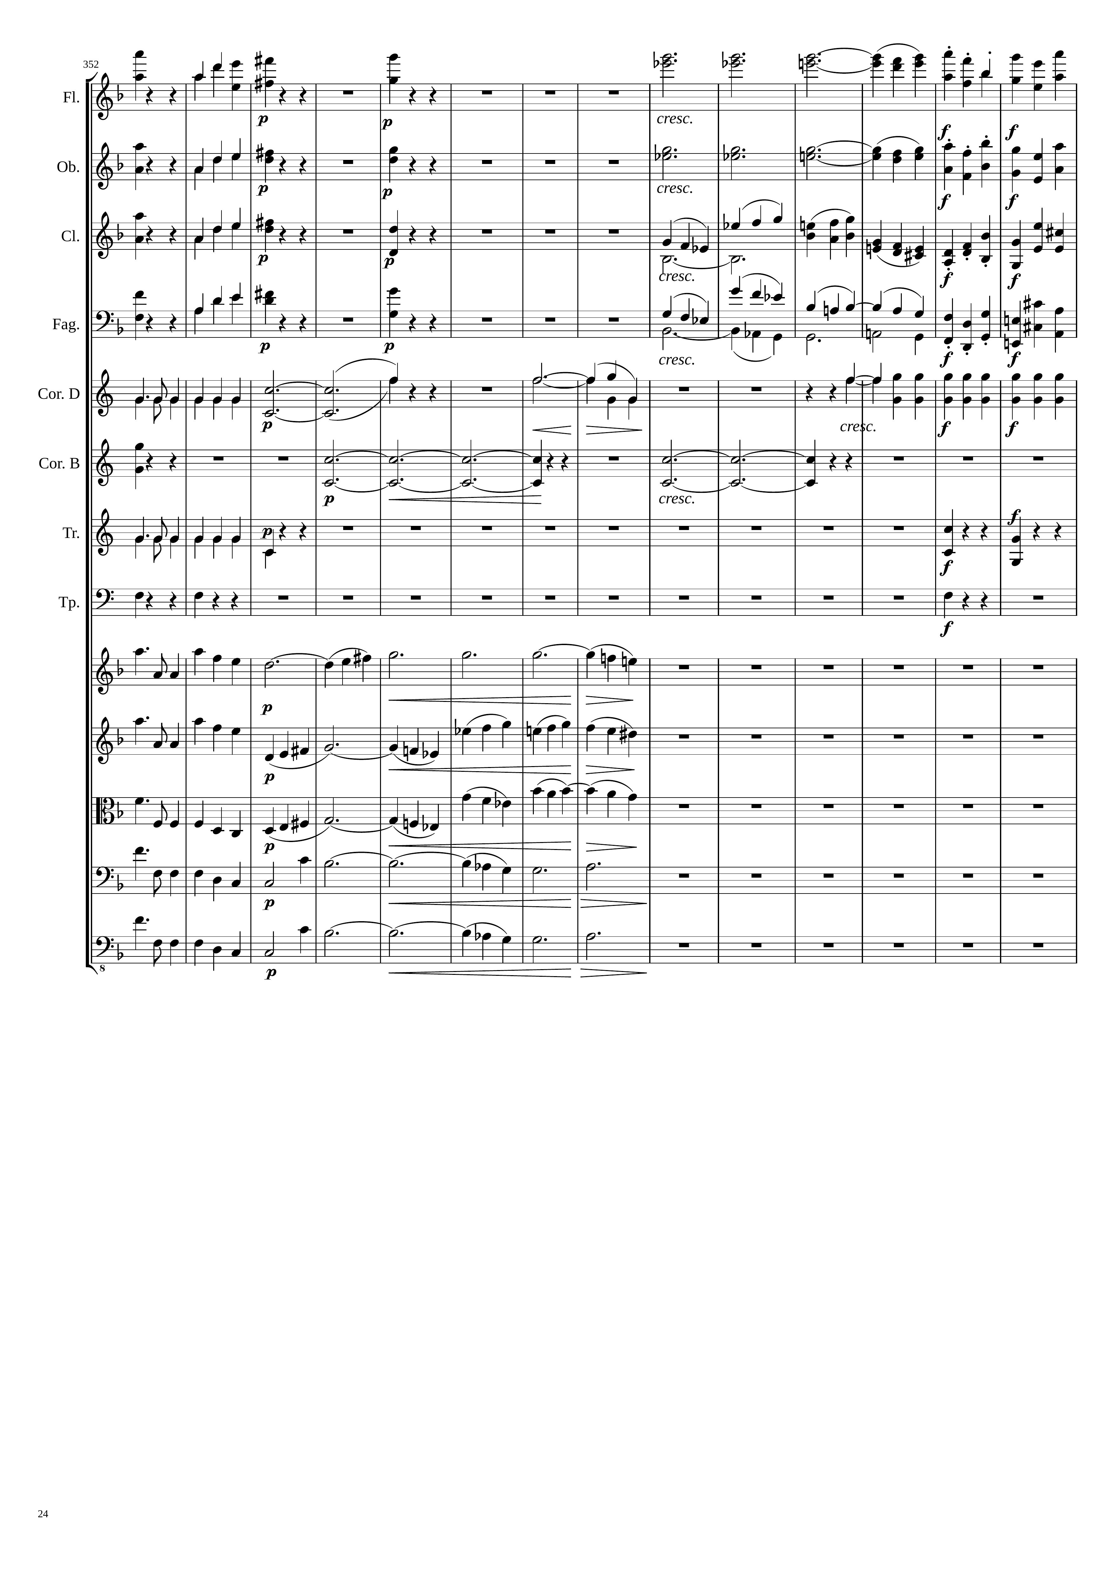
1485
1515
mel
rhythm
harm
mel
mel
rhythm
harm
mel
mel
rhythm
rhythm
mel
mel
rhythm
rhythm
mel
rhythm
harm
rhythm
rhythm
harm
rhythm
rhythm
rhythm
rhythm
mel
rhythm+harm
mel
rhythm+harm
mel
rhythm+harm
mel
rhythm+harm
mel
rhythm+harm

Slide 25
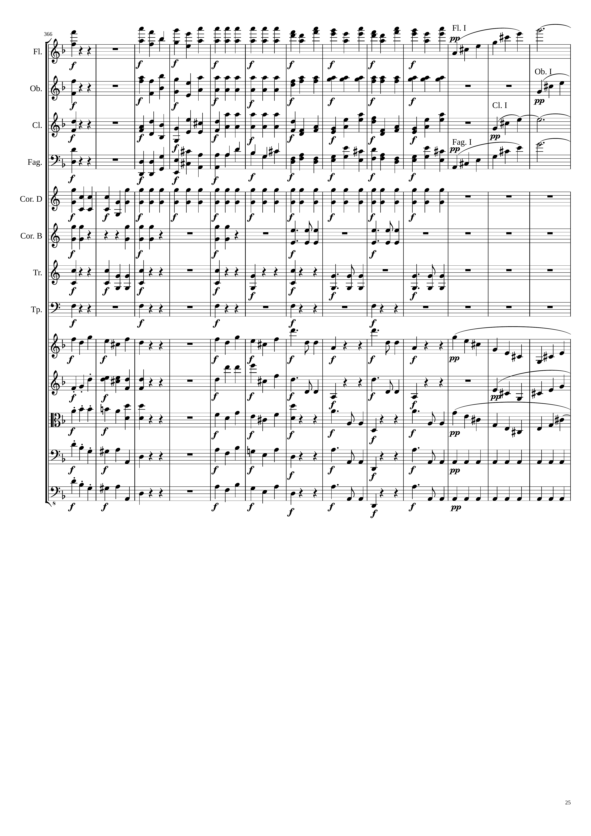
1539
1551
mel
mel
rhythm
mel+rhythm
rhythm
mel
mel
rhythm
rhythm
rhythm
mel
mel
rhythm
rhythm
rhythm
mel
mel
mel
rhythm
rhythm
mel
rhythm
rhythm
rhythm
rhythm
mel
mel
rhythm
rhythm
mel
mel
rhythm
rhythm
mel
mel
rhythm
rhythm
mel
mel
rhythm
rhythm
mel
mel
rhythm
rhythm

Slide 26
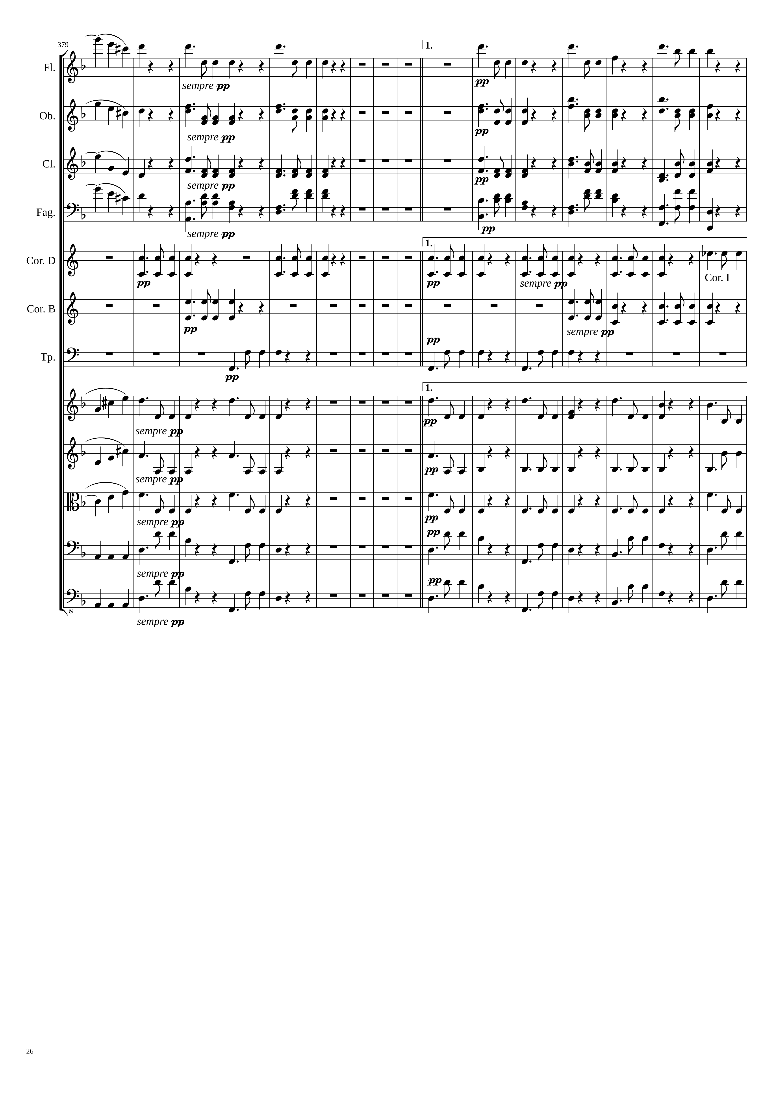
1575
530th bar
有些錄音的版本沒有反覆直接跳2房
rhythm
1590
rhythm
rhythm
rhythm
rhythm
rhythm
rhythm
rhythm
rhythm
rhythm
rhythm
rhythm
rhythm
rhythm
rhythm
rhythm
rhythm
rhythm
rhythm
rhythm
rhythm
rhythm
rhythm
rhythm

Slide 27
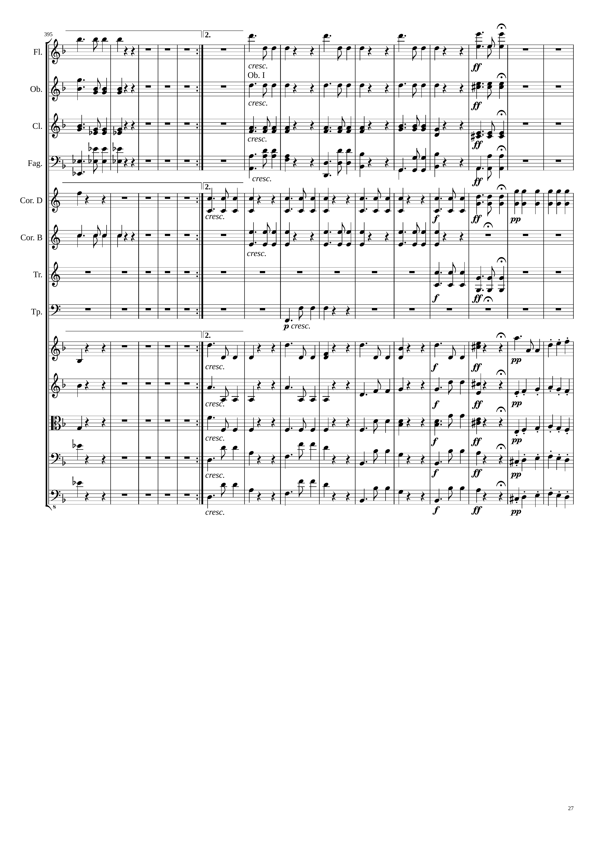
1614
Repeat: +229 bars
(+371 bars so far)
771st bar
2310
rhythm
2334
rhythm
rhythm
rhythm
rhythm
rhythm
rhythm
rhythm
rhythm
rhythm
rhythm
rhythm
rhythm
rhythm
rhythm
rhythm
rhythm
mel
rhythm
rhythm
mel+rhythm
rhythm
rhythm
mel+rhythm
rhythm
rhythm
mel+rhythm
rhythm
rhythm
mel+rhythm

Slide 28
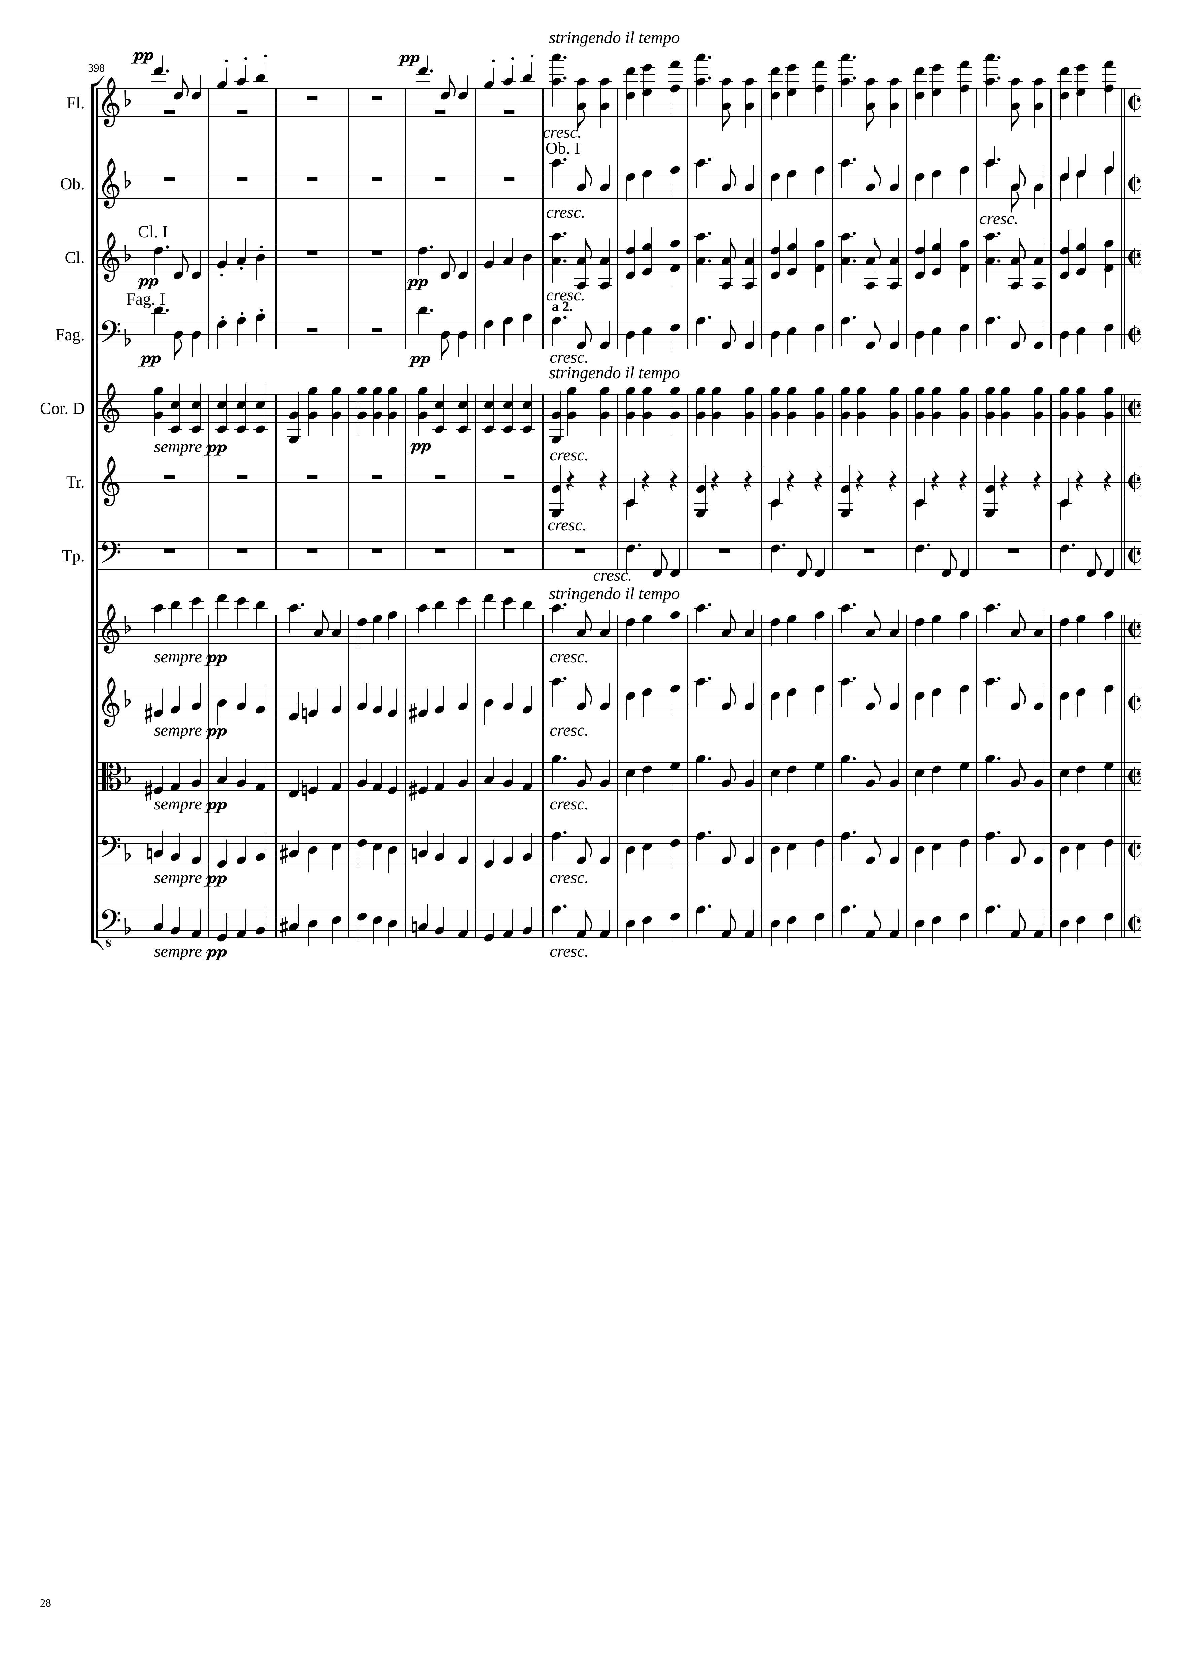
實際小節比譜面小節再多371(repeat)+12(1房) = 383 小節
2358
2382
mel
mel
mel
mel
rhythm
rhythm
rhythm
mel
mel+rhythm
mel
mel+rhythm
mel
mel+rhythm
mel
mel+rhythm
mel

Slide 29
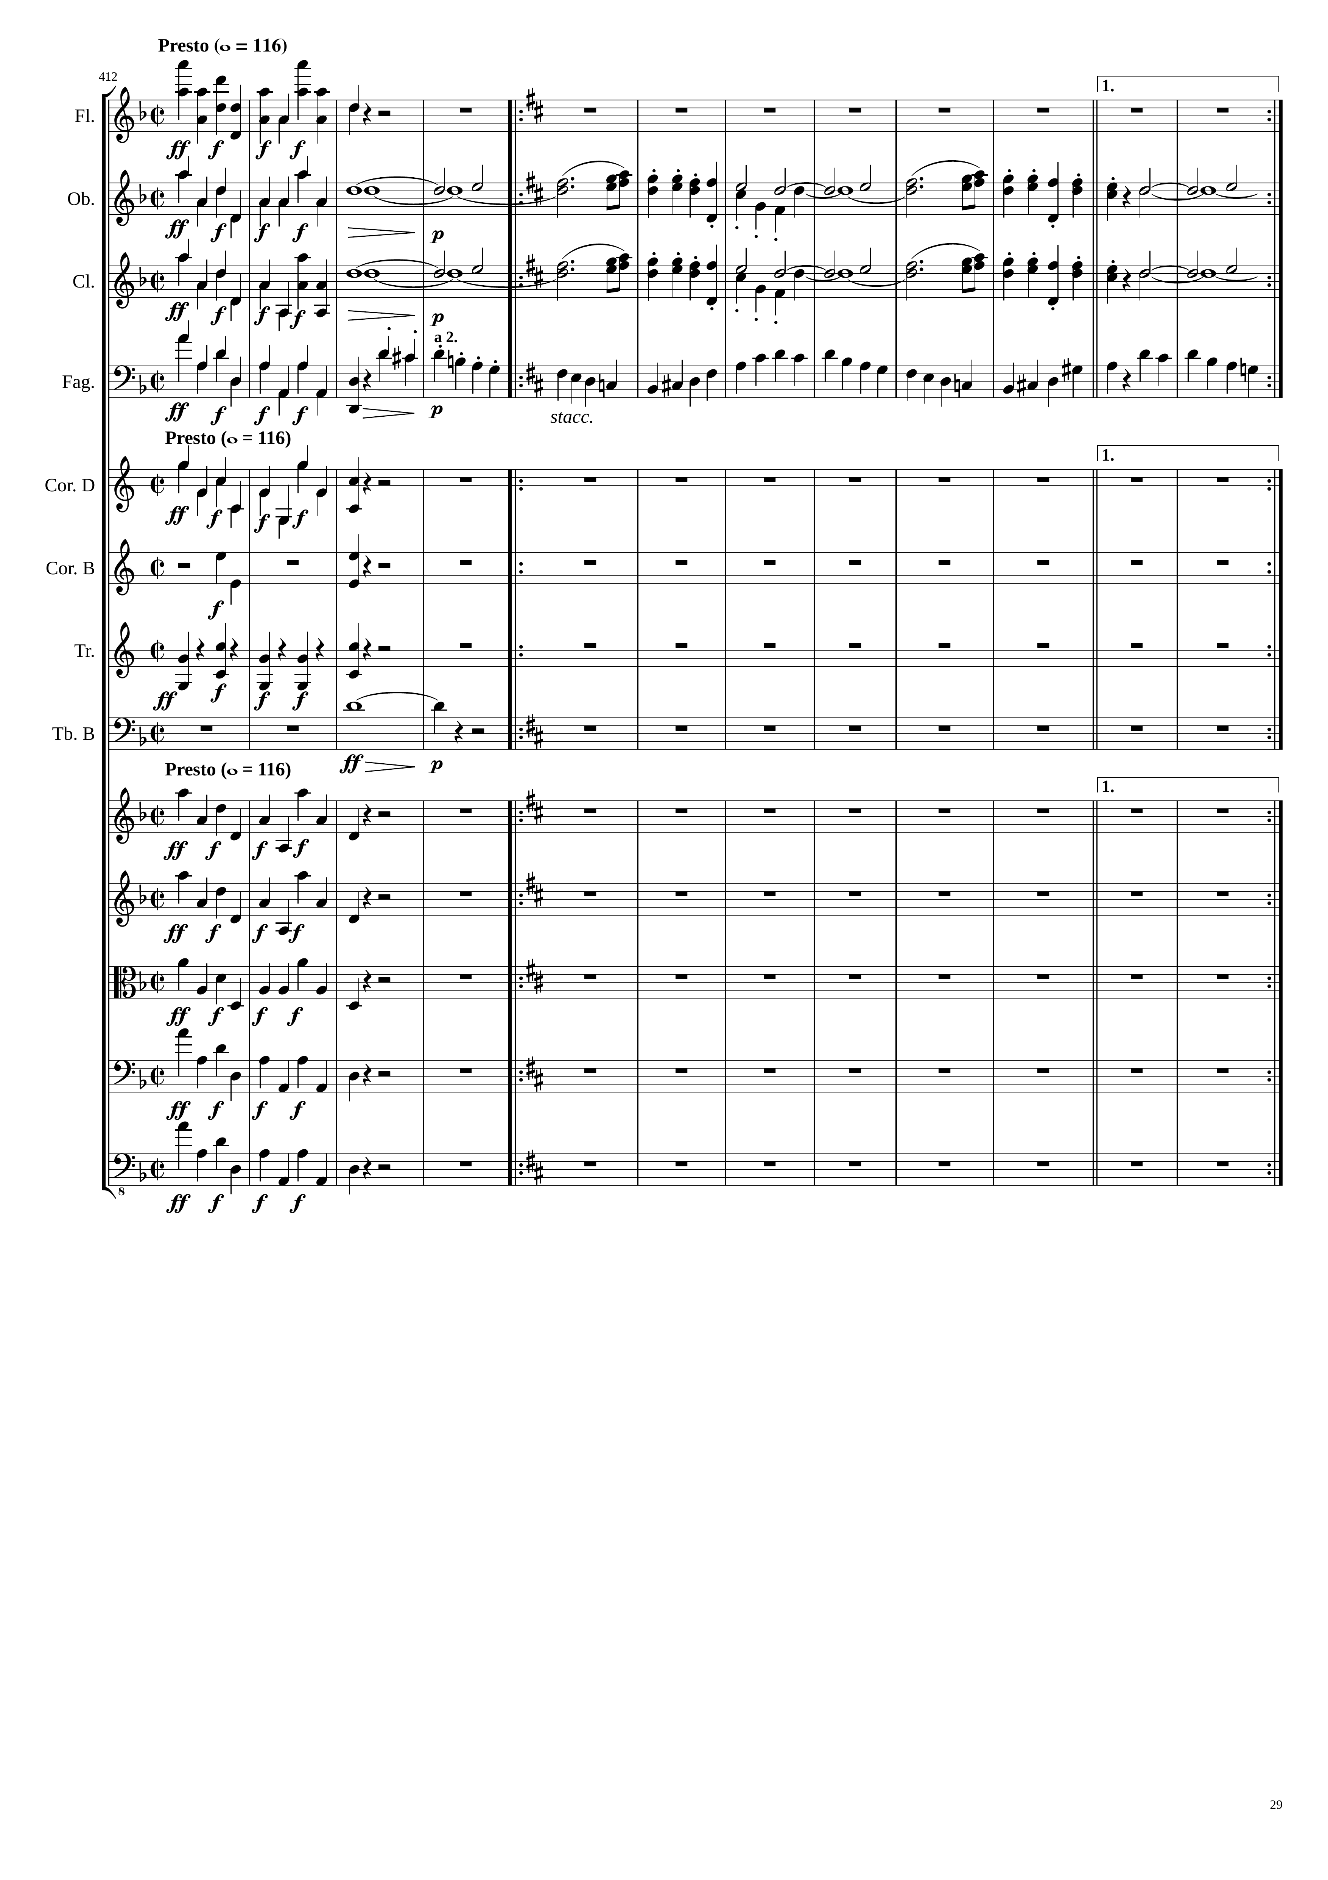
Time sig change to 4/4 (794 bars with 3/4 so far)
實際: 2382+x , where x 是4/4/開始之後的beat數 (x用橘色)
Repeat for 6 bars
0
799th bar
(5th bar 4/4)
2382
mel+rhythm
mel+rhythm
mel+harm
mel
mel+rhythm
mel+harm
mel
mel+rhythm
mel+rhythm
mel+rhythm
mel+rhythm
rhythm
mel+harm
mel+rhythm
mel+rhythm
mel+rhythm
mel+rhythm
mel+rhythm

Slide 30
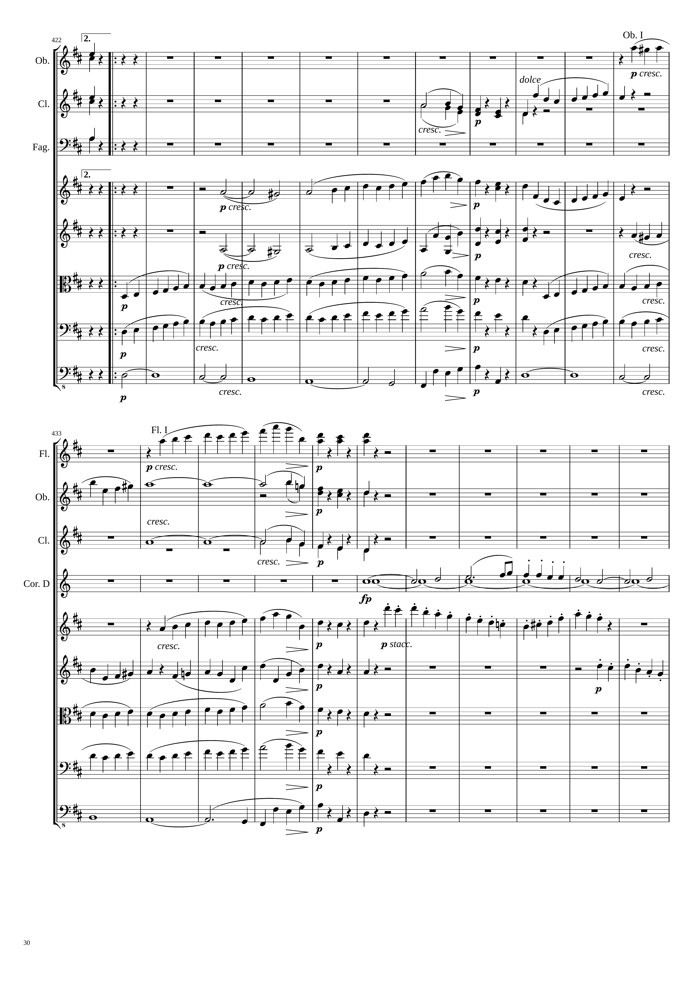
實際小節比譜面再加 391 bars ( -403 bars 4/4 )
813rd bar (19th bar 4/4)
72
96
mel+rhythm
mel
352
mel
883rd bar
(89th bar 4/4)
mel
mel+rhythm
mel+rhythm
mel+rhythm
mel
mel+rhythm
mel+rhythm
mel
mel+rhythm
mel+rhythm
mel
mel+rhythm
mel+rhythm
mel
mel+rhythm
harm
mel
harm
128
mel+rhythm
mel
mel+rhythm
harm
mel
harm
mel
mel
harm
mel+rhythm
mel
mel+rhythm
mel+rhythm
mel
mel+rhythm
mel+rhythm
mel
mel+rhythm
mel
harm
mel

Slide 31
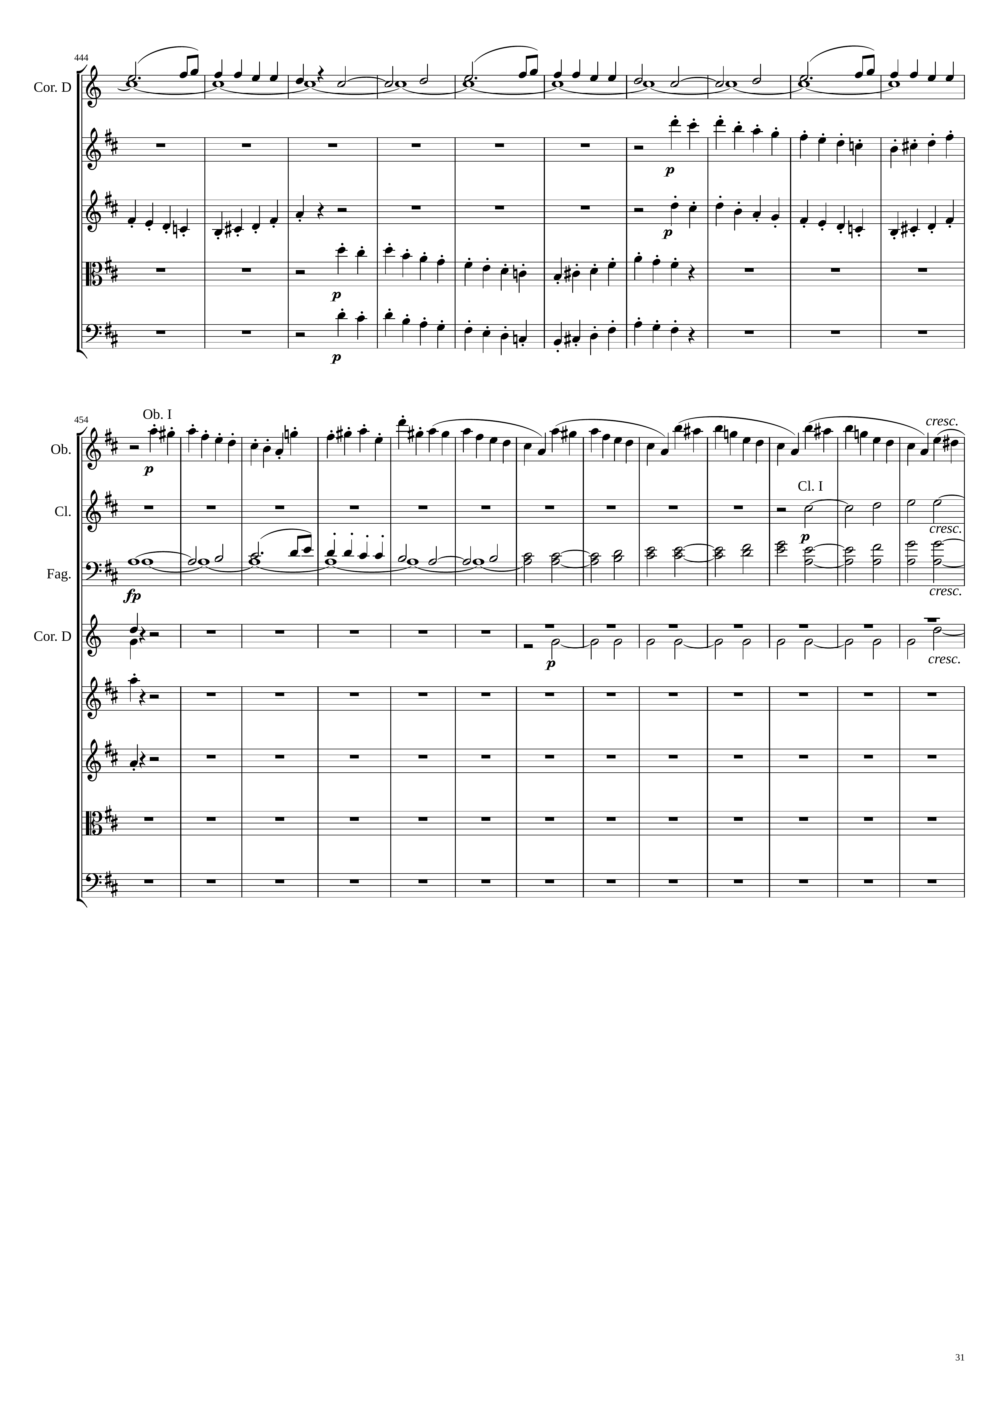
168
mel
harm
mel+rhythm
mel+rhythm
mel+rhythm
mel+rhythm
mel+rhythm
200
mel+rhythm
224
mel
harm
mel
harm
harm
mel
harm
harm
mel+rhythm
mel+rhythm

Slide 32
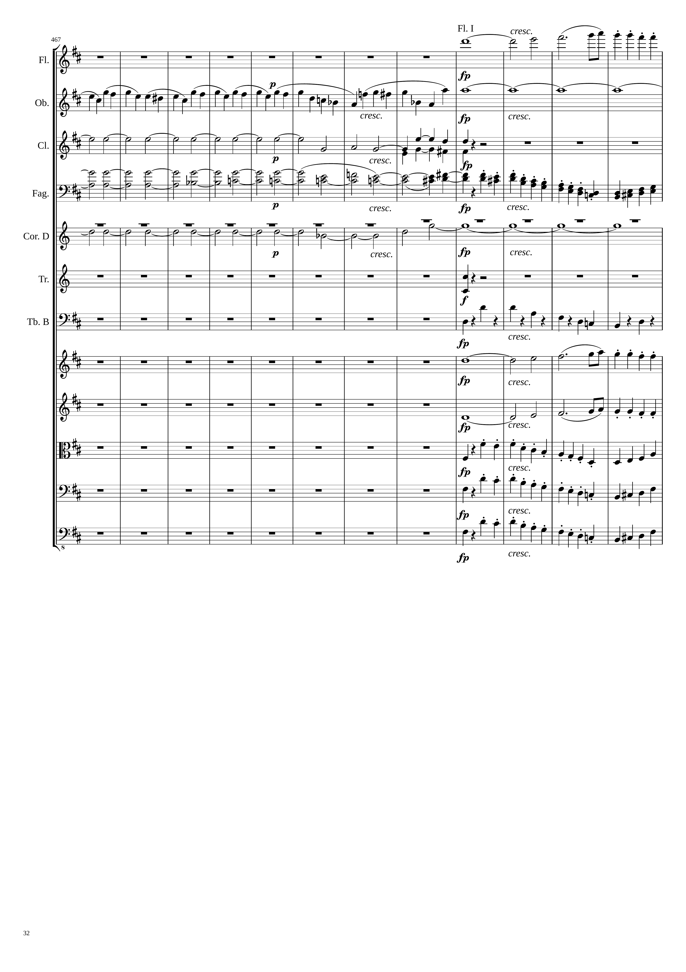
284
mel
mel
harm
harm
harm
mel+rhythm
harm
harm
rhythm
rhythm
mel
mel
mel+rhythm
mel+rhythm
mel+rhythm

Slide 33
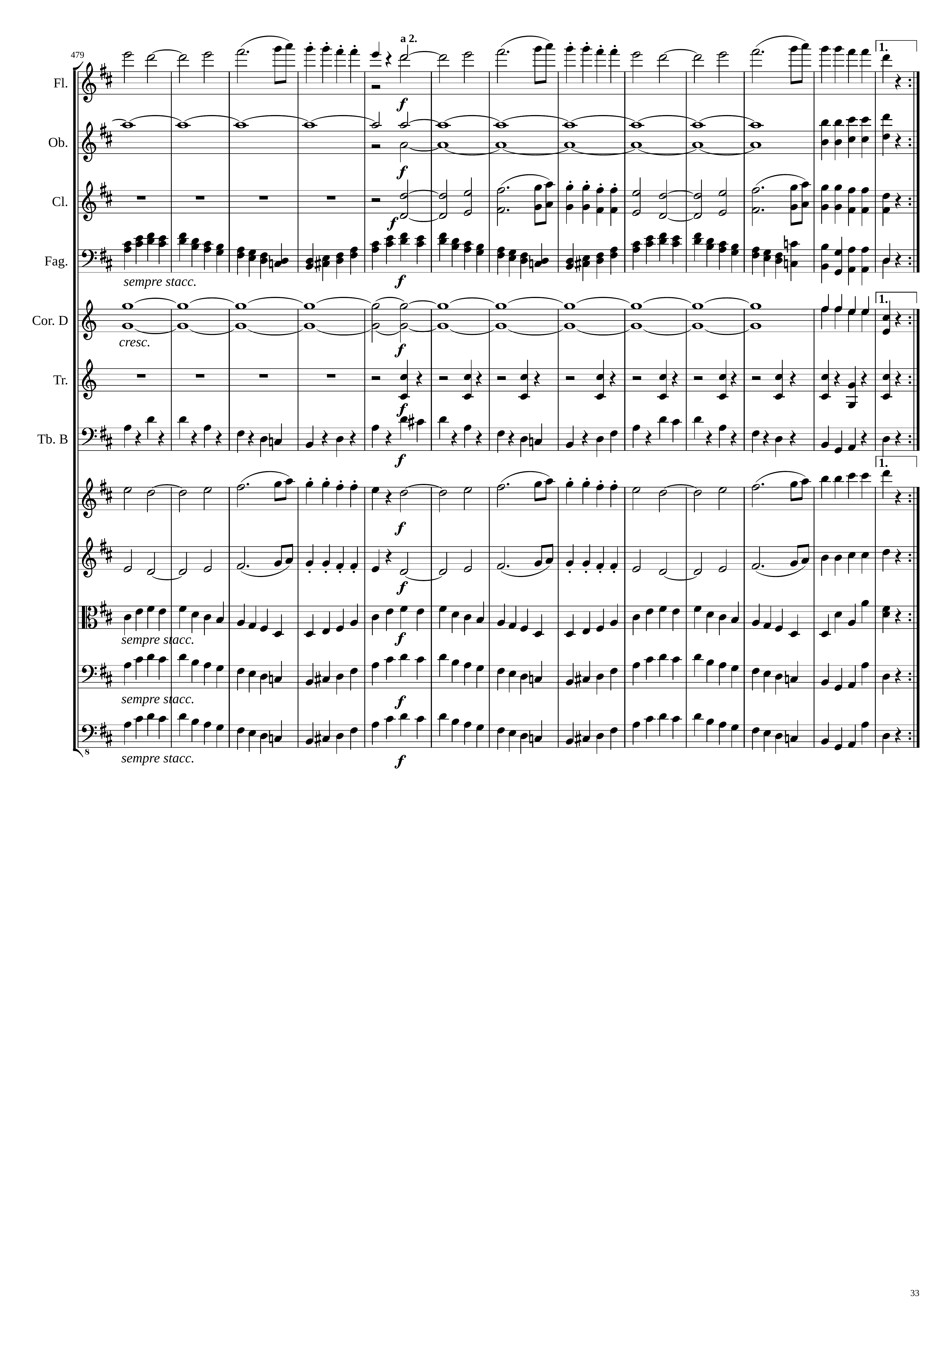
316
Only 2 beat
mel
348
harm
mel
mel
mel+rhythm
harm
mel
rhythm
rhythm
mel
mel
mel+rhythm
mel+rhythm
mel+rhythm

Slide 34
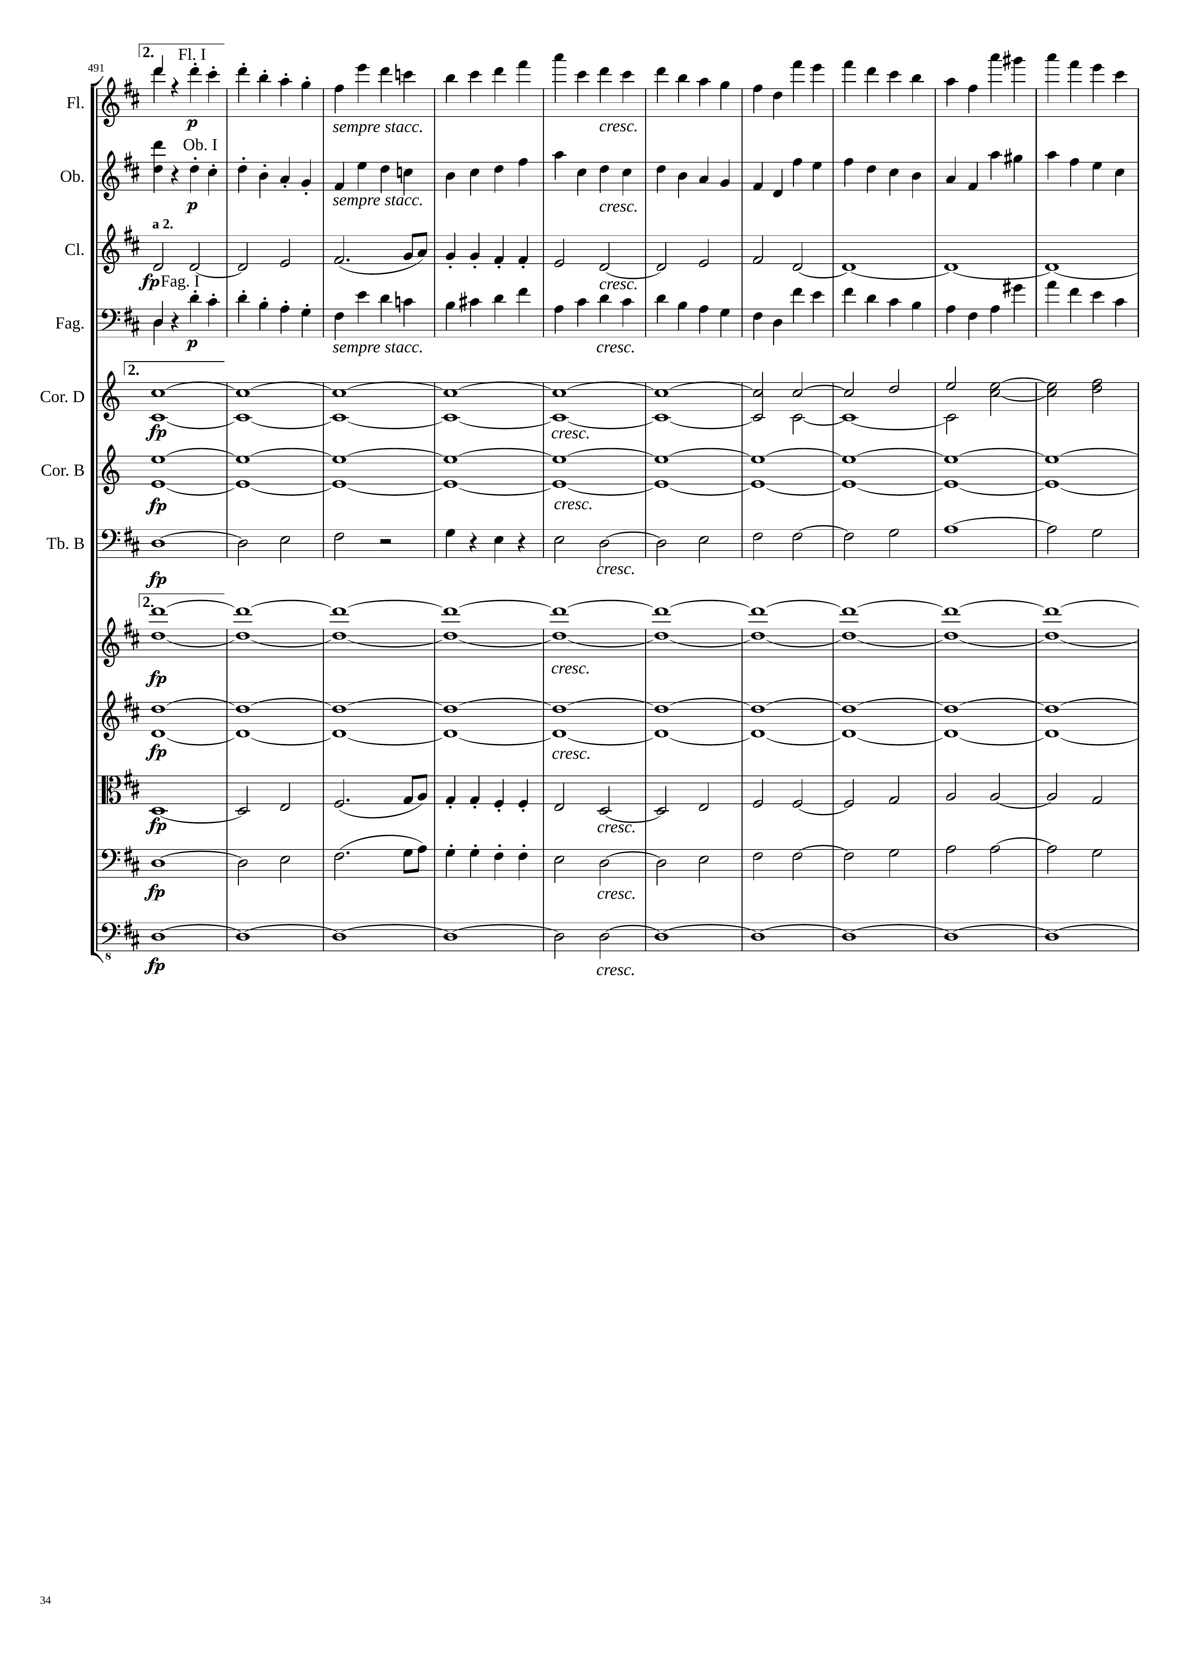
譜面小節-334=小結數in 4/4
157th bar 4/4
624
mel
mel+rhythm
mel
mel+rhythm
mel
mel+harm
mel+rhythm
harm
mel+harm
mel+harm
harm
harm
mel+harm
harm
harm
mel
mel+harm
mel
mel+harm
harm

Slide 35
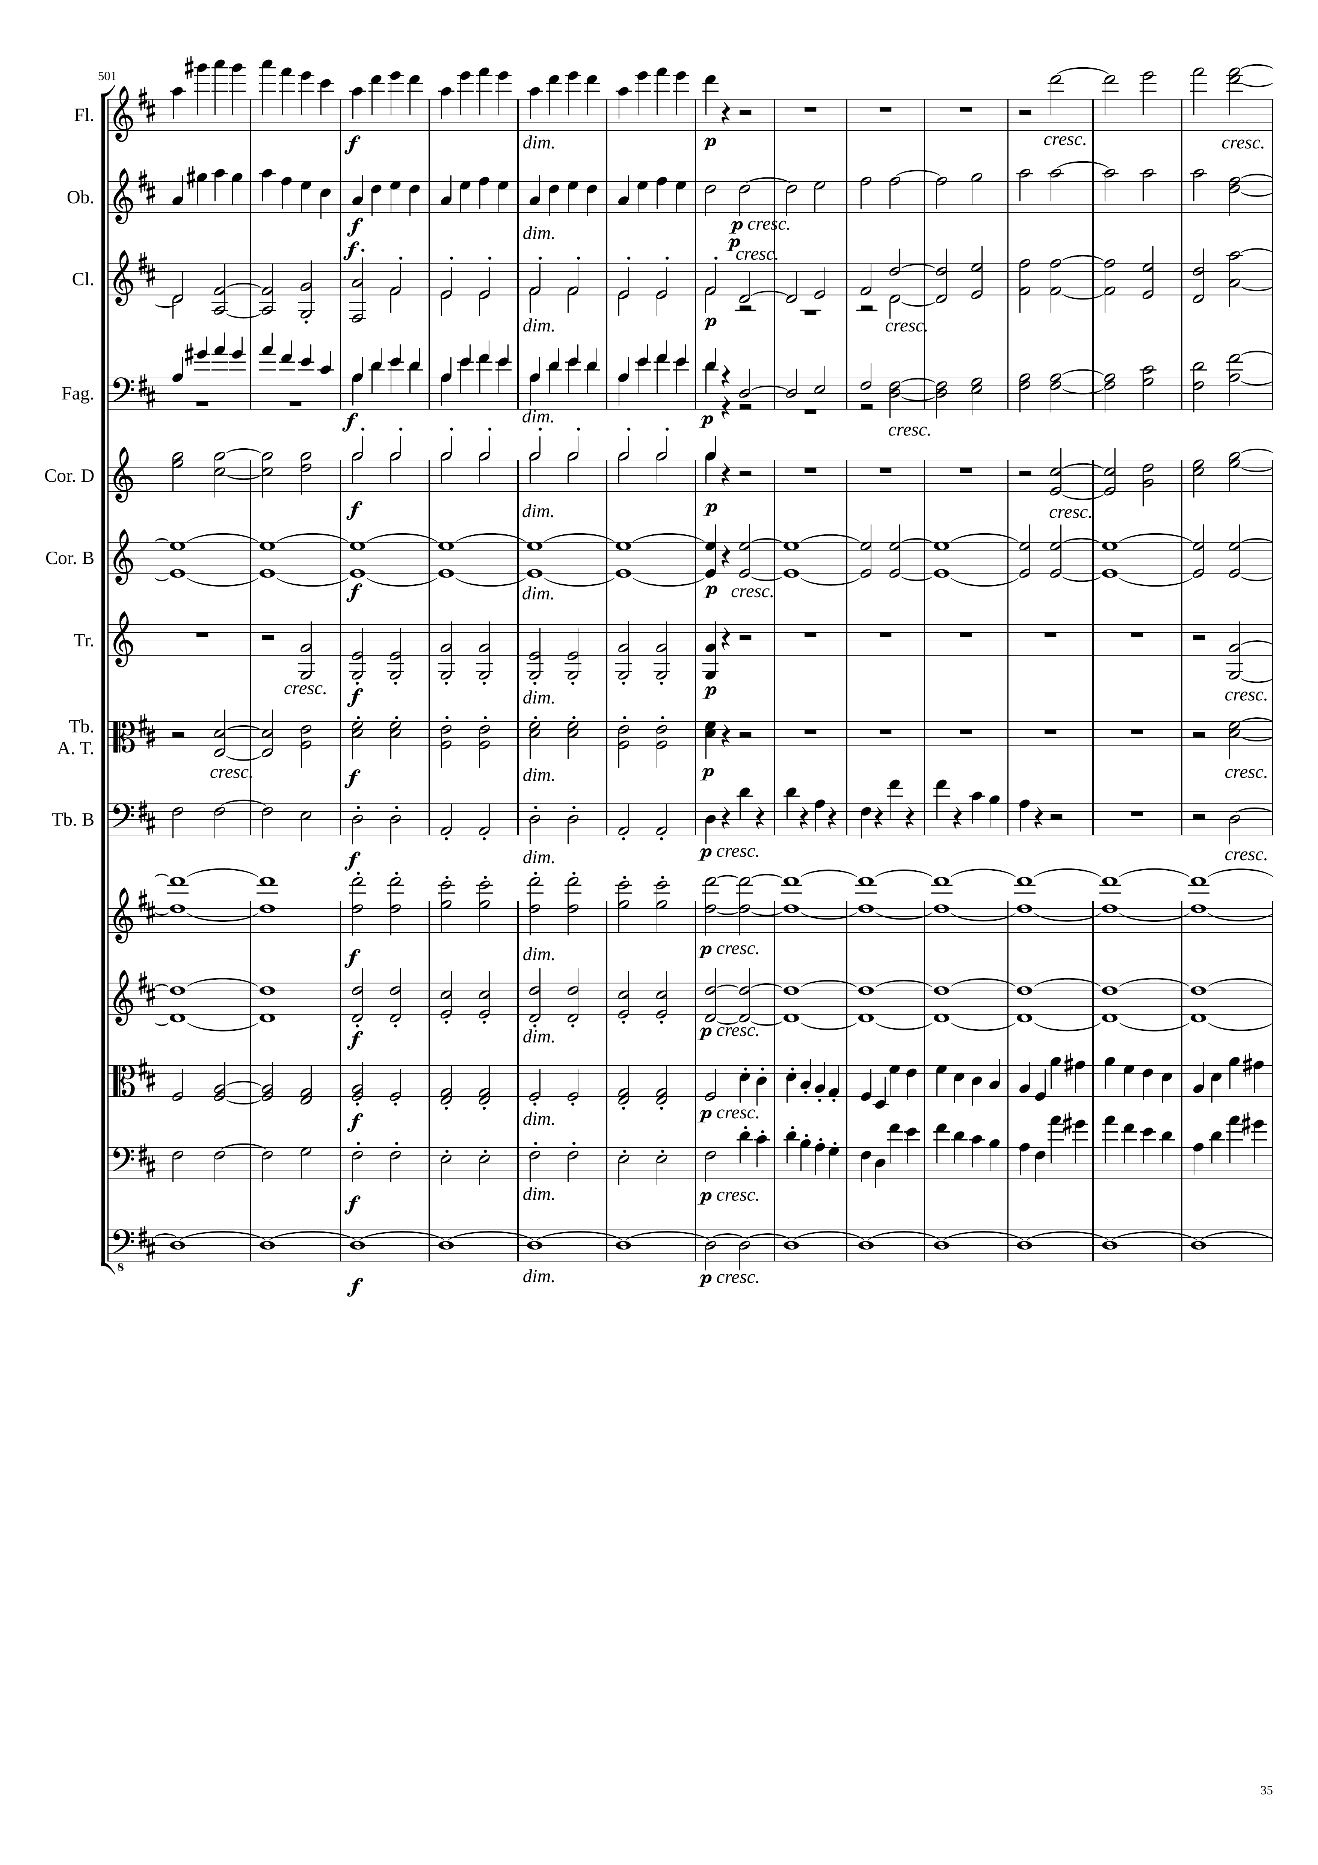
672
688
mel+harm
mel+rhythm
mel+rhythm
mel+harm
mel+harm
harm
mel+harm
mel+rhythm
mel+harm
mel+harm
harm
harm
harm
harm
rhythm+harm
harm
rhythm+harm
harm
mel+harm
rhythm
rhythm
rhythm
harm
rhythm+harm
harm
harm
rhythm+harm
harm
mel+harm
mel+rhythm
mel+harm
mel+rhythm
harm
harm

Slide 36
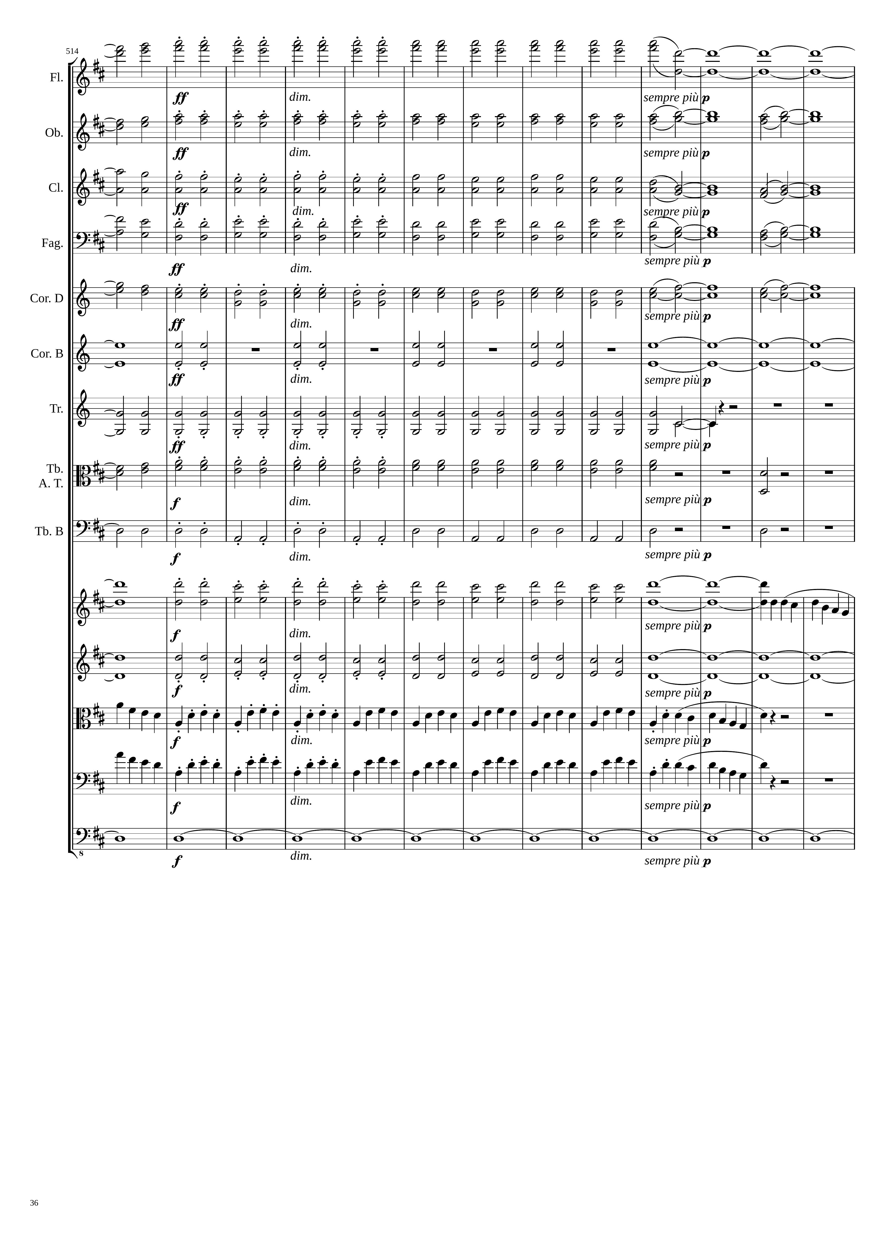
720
752
mel+harm
harm
mel+harm
harm
mel+harm
harm
mel+harm
harm
harm
harm
rhythm
harm
harm
harm
rhythm
rhythm
rhythm
harm
mel
harm
mel+rhythm
rhythm
mel
mel+rhythm
rhythm
mel
harm

Slide 37
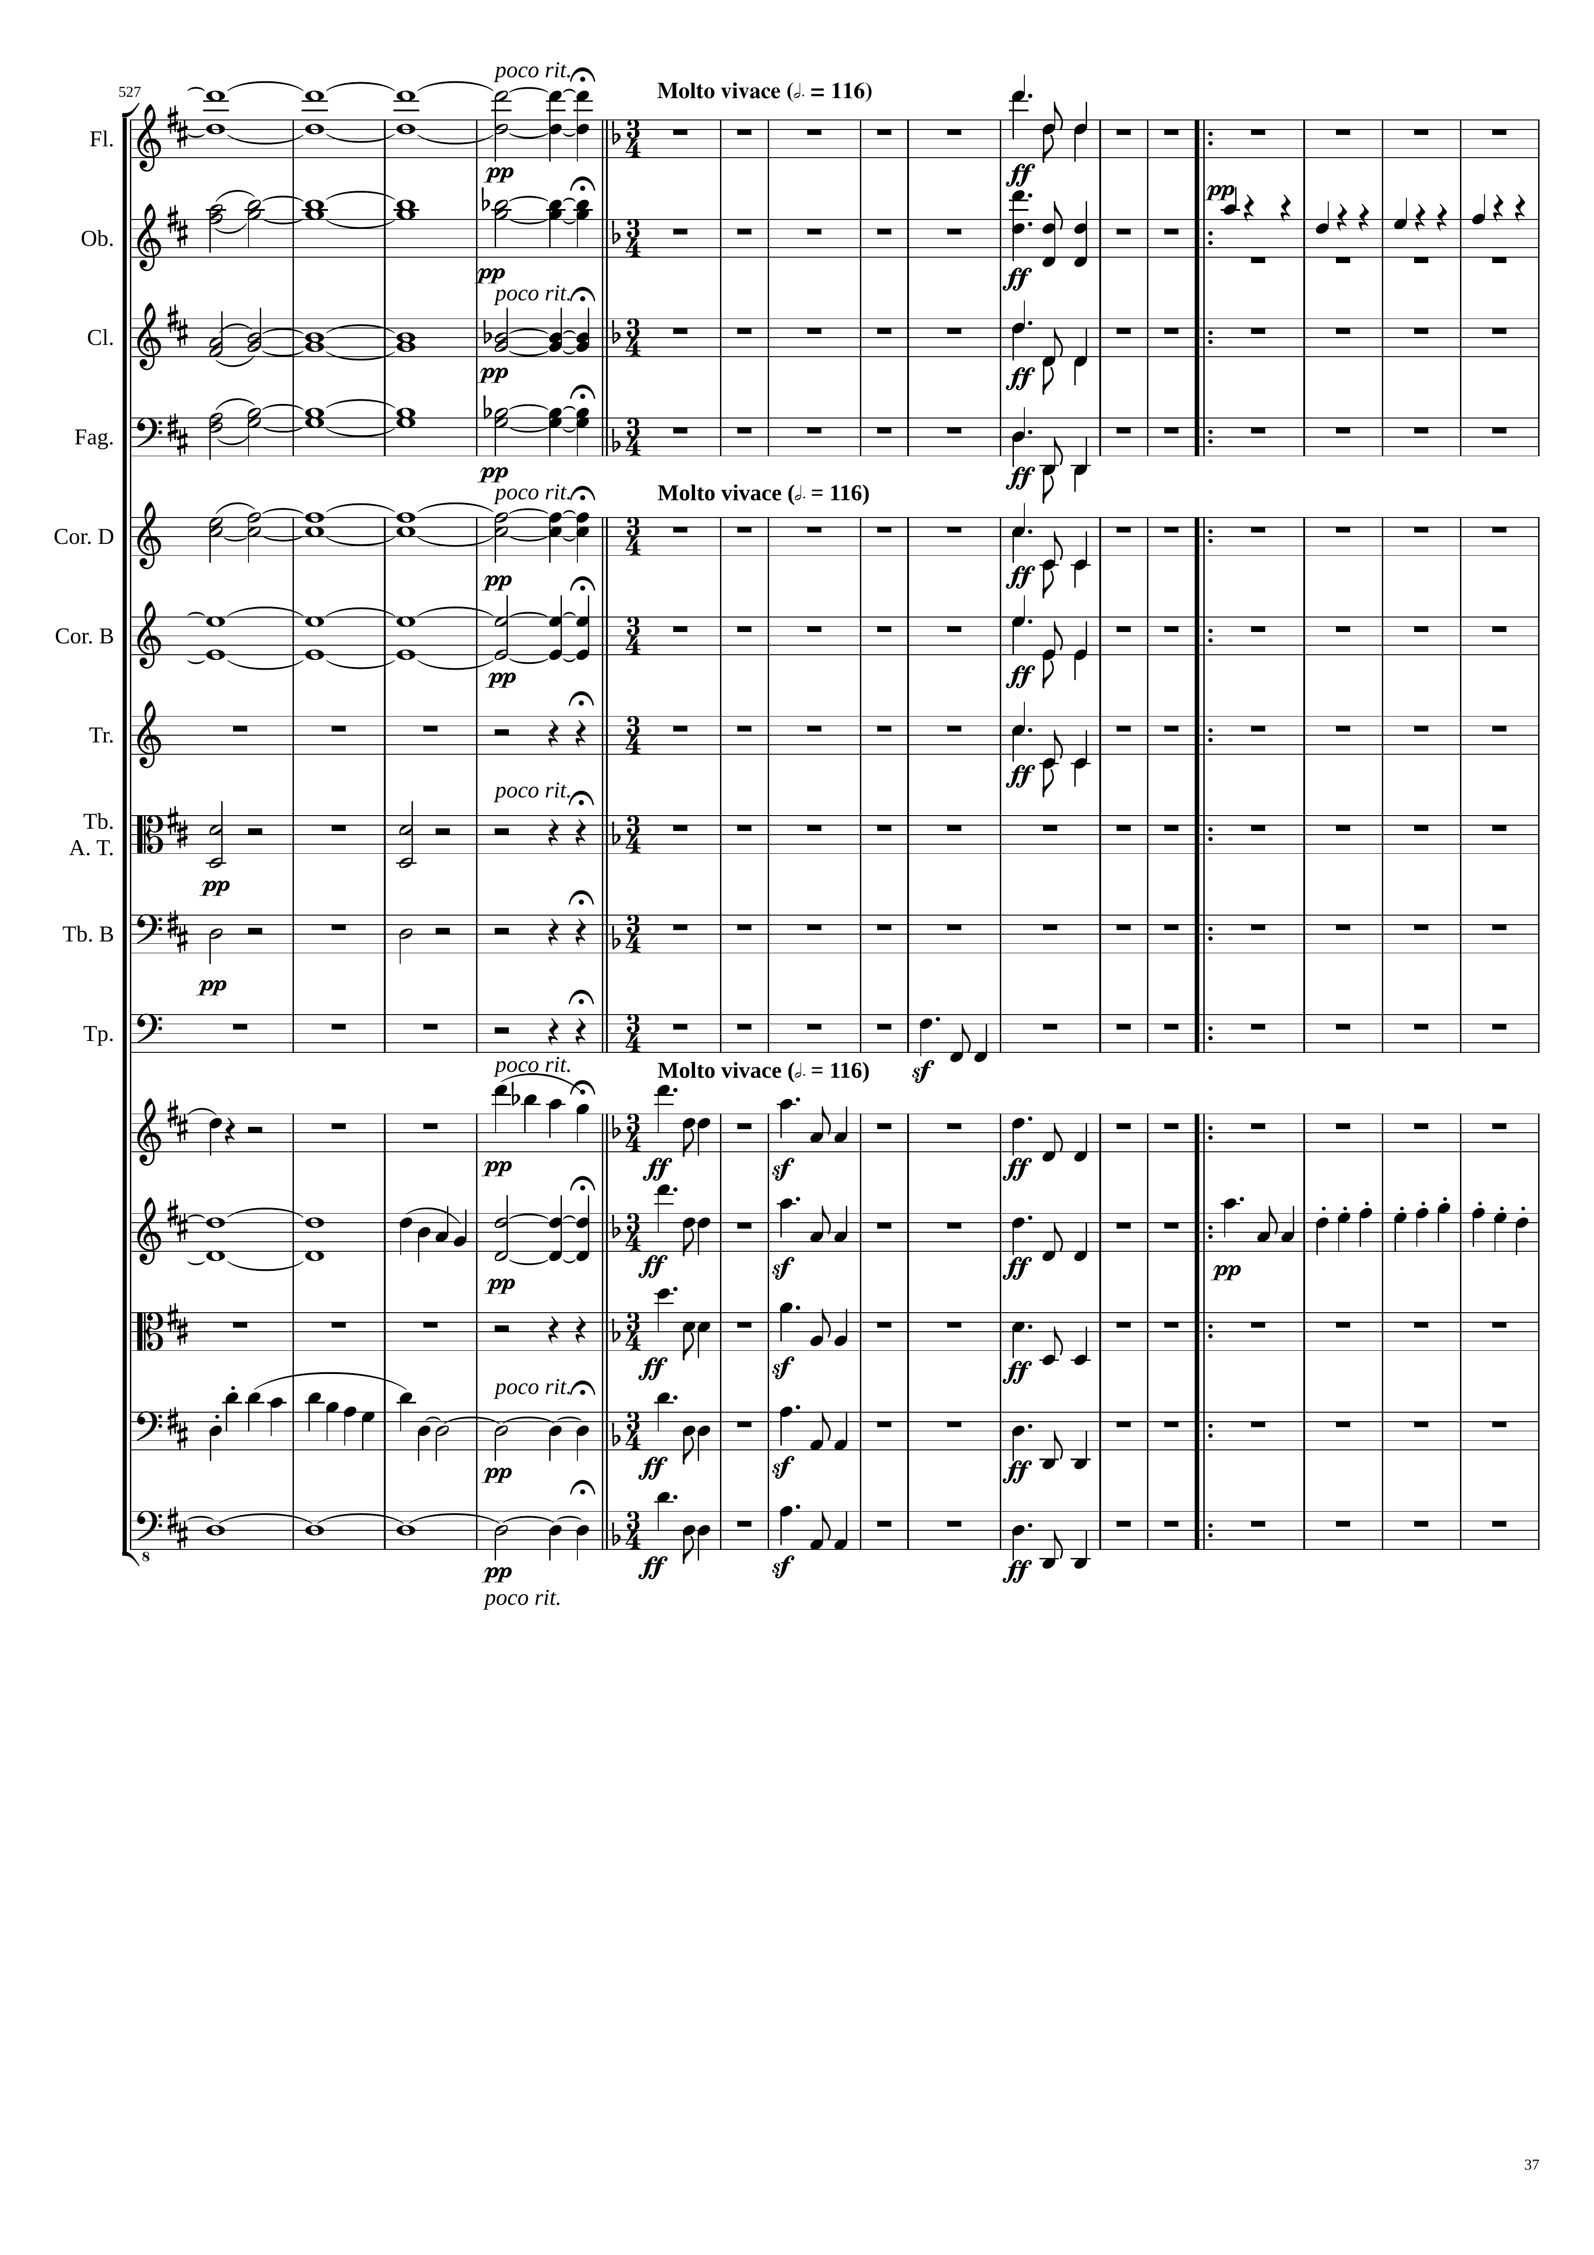
197th bar in4/4
harm
784
mel
harm
mel
rhythm
harm
mel
harm
mel
harm
mel
harm
mel
mel
rhythm
rhythm
mel+rhythm
mel
mel
mel
mel
mel
mel
mel
mel+rhythm
harm
harm
mel
mel
mel
mel
mel
harm
mel
mel
harm
mel
mel

Slide 38
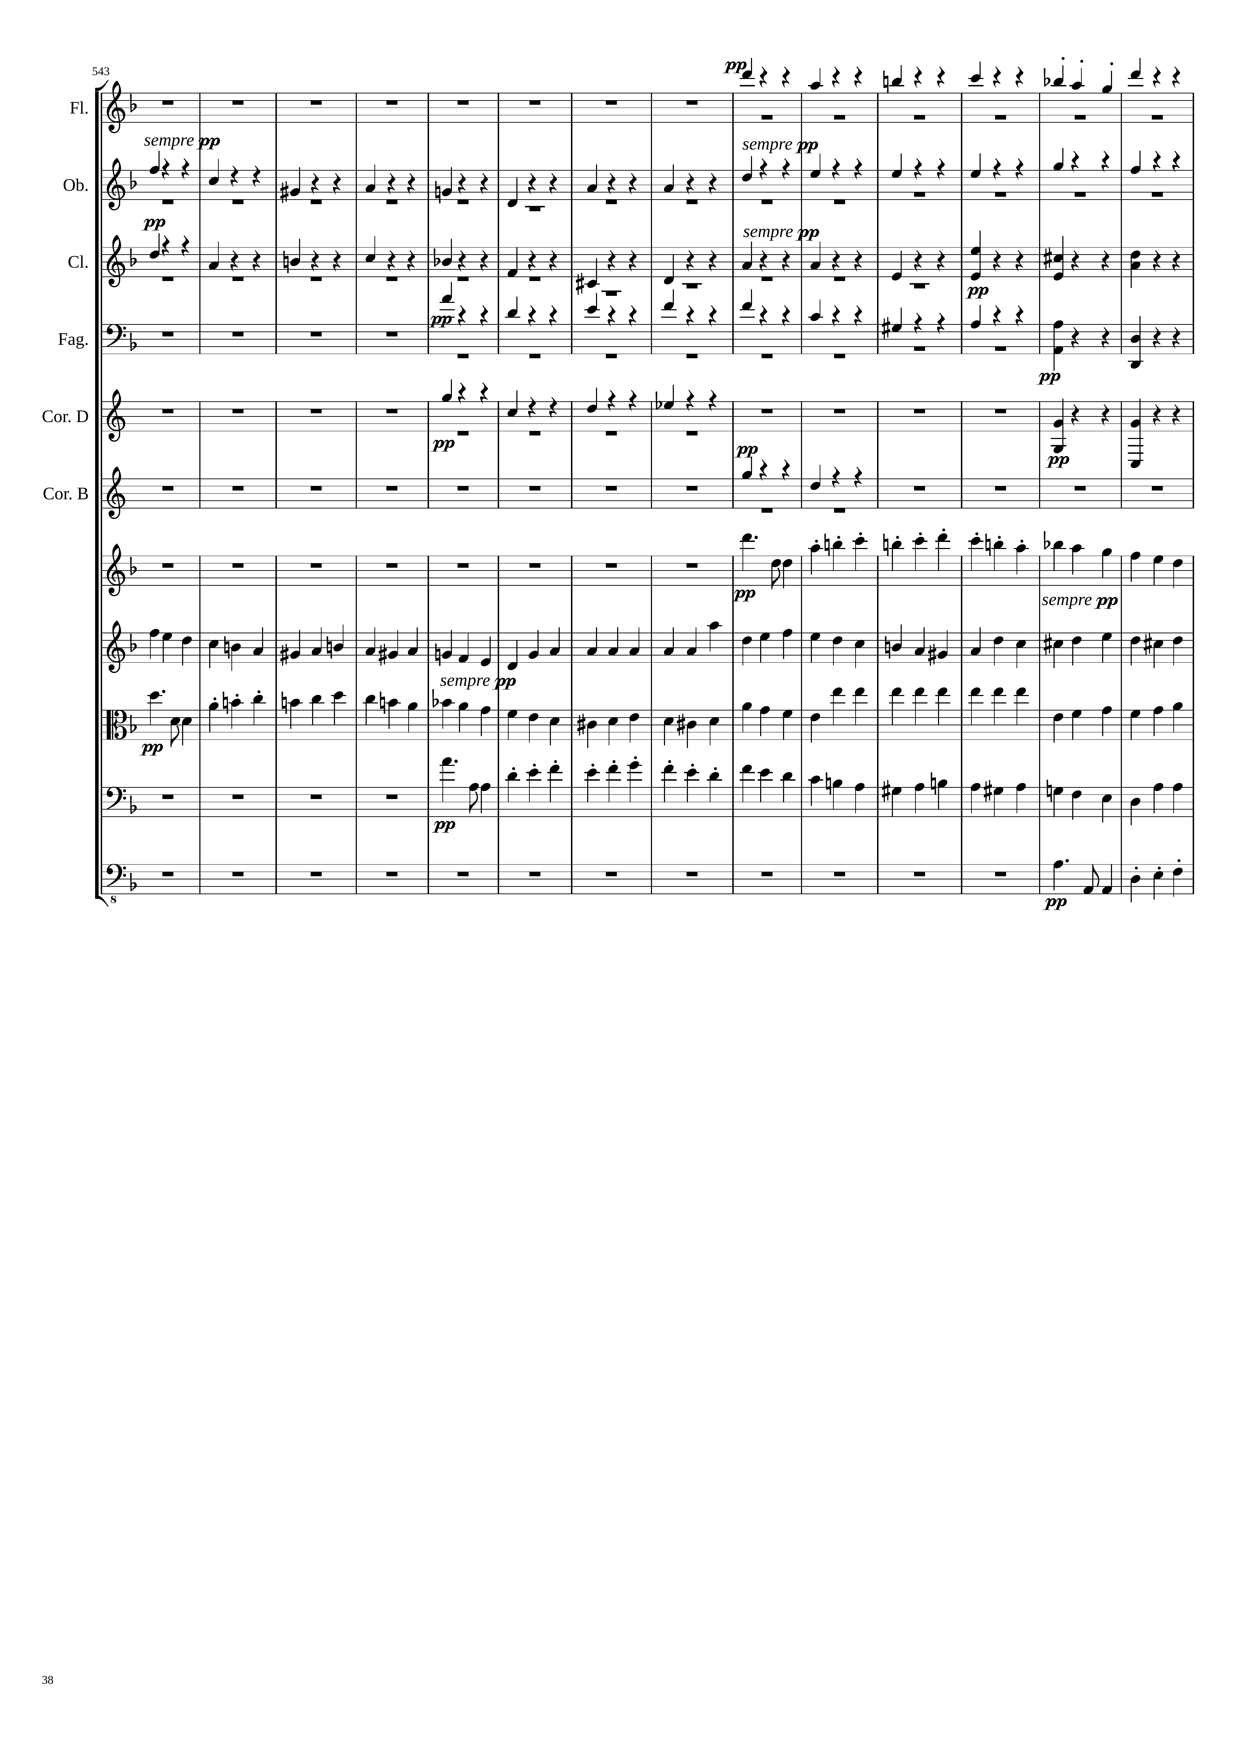
rhythm
rhythm
rhythm
rhythm
rhythm
rhythm
rhythm
mel+rhythm
mel+rhythm
mel+rhythm
mel+rhythm
mel+rhythm

Slide 39
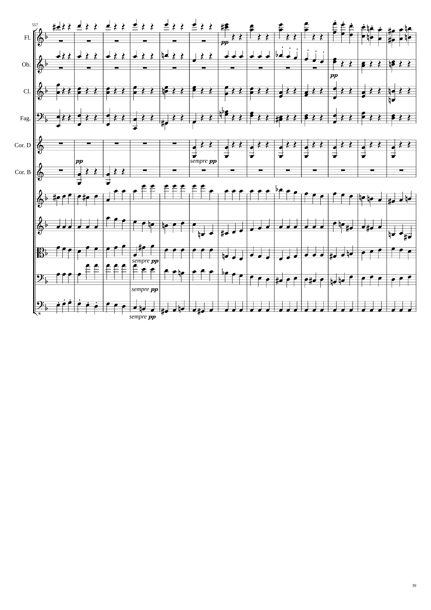
rhythm
mel+rhythm
rhythm
mel+rhythm
rhythm
rhythm
rhythm
rhythm
rhythm
mel+rhythm
mel+rhythm
mel+rhythm
mel+rhythm
mel+rhythm
rhythm

Slide 40
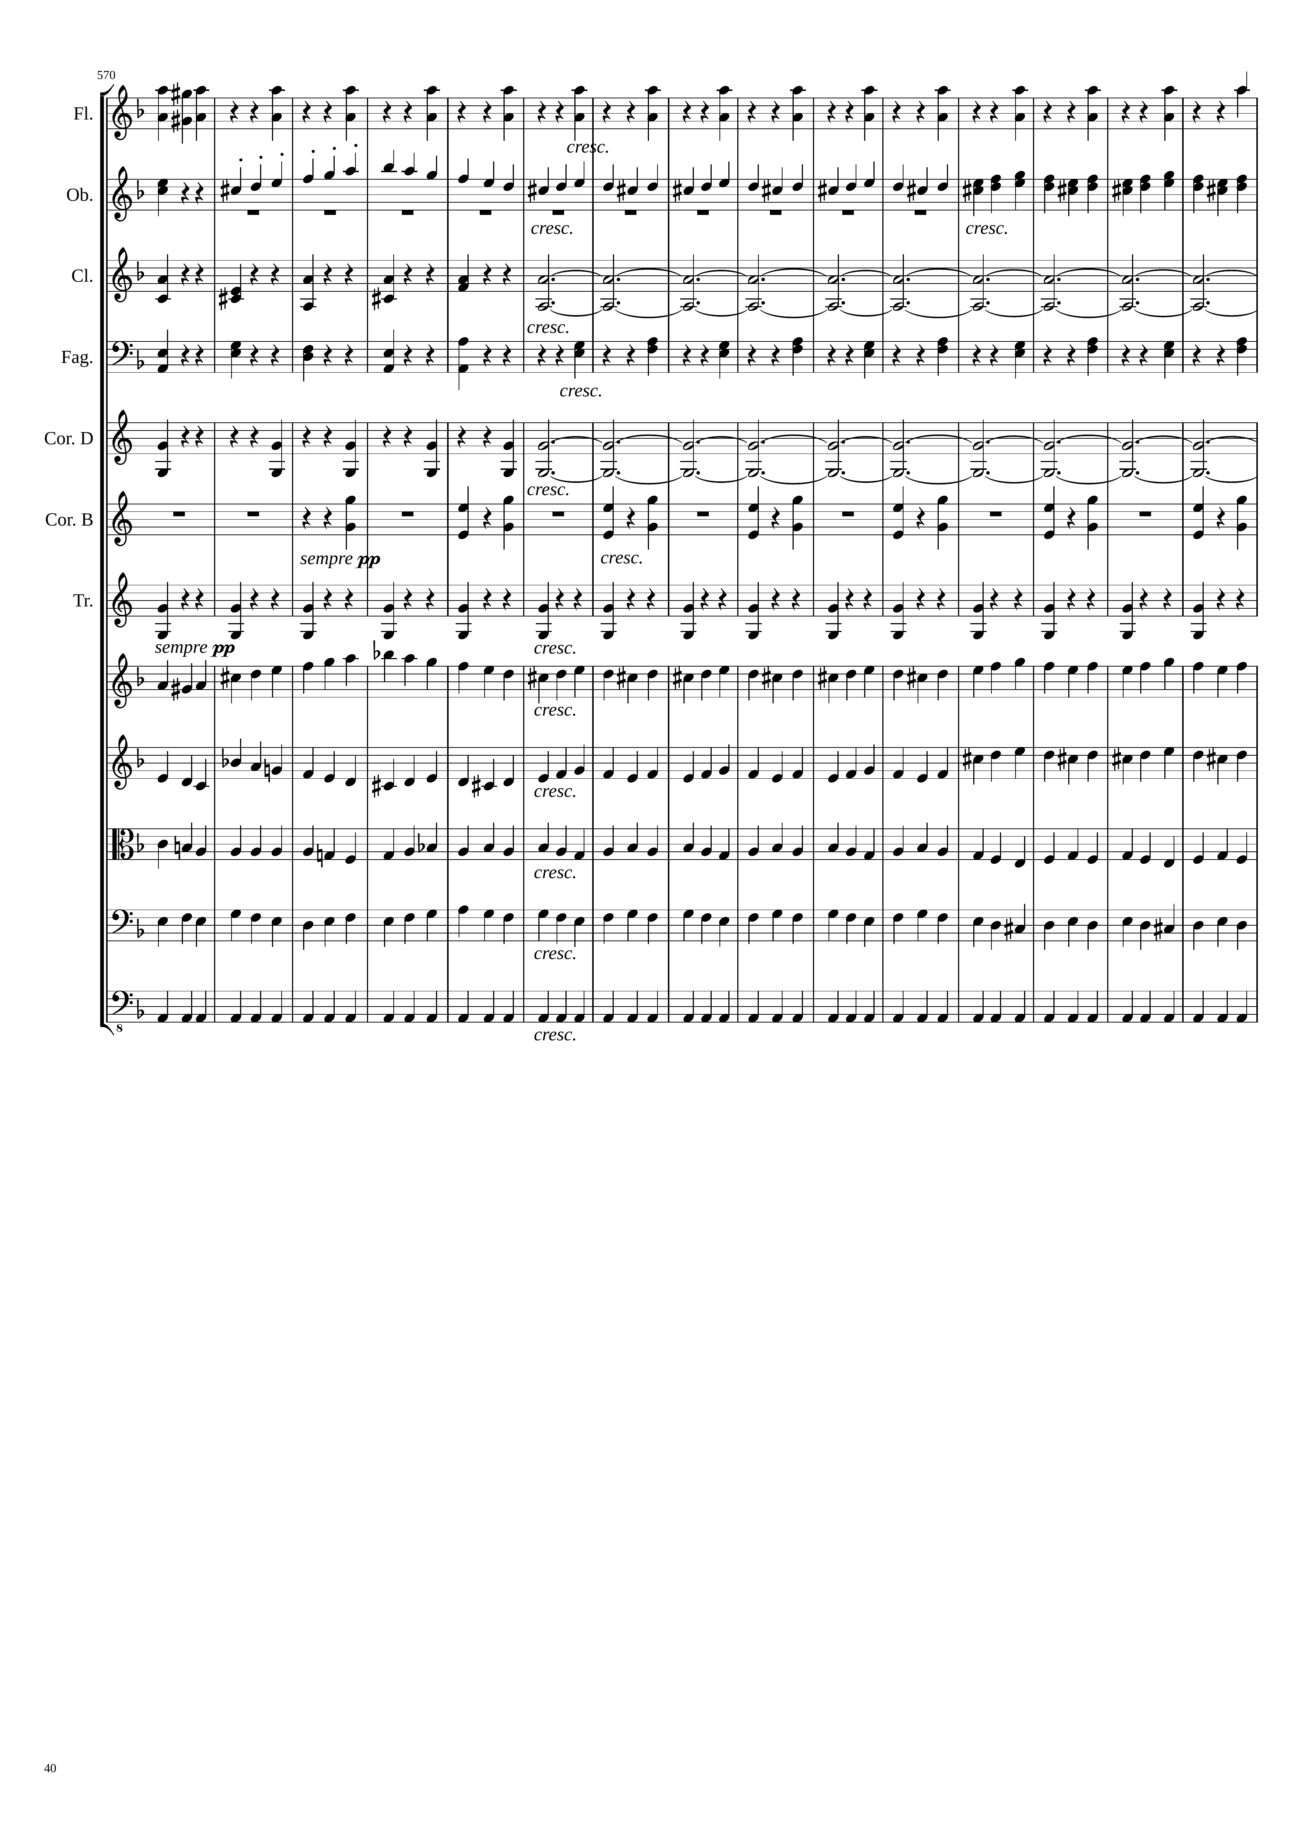
mel+rhythm
rhythm
rhythm
mel+rhythm
rhythm
harm
rhythm
rhythm
rhythm
rhythm
rhythm
mel+rhythm
mel+rhythm
mel+rhythm
mel+rhythm
rhythm

Slide 41
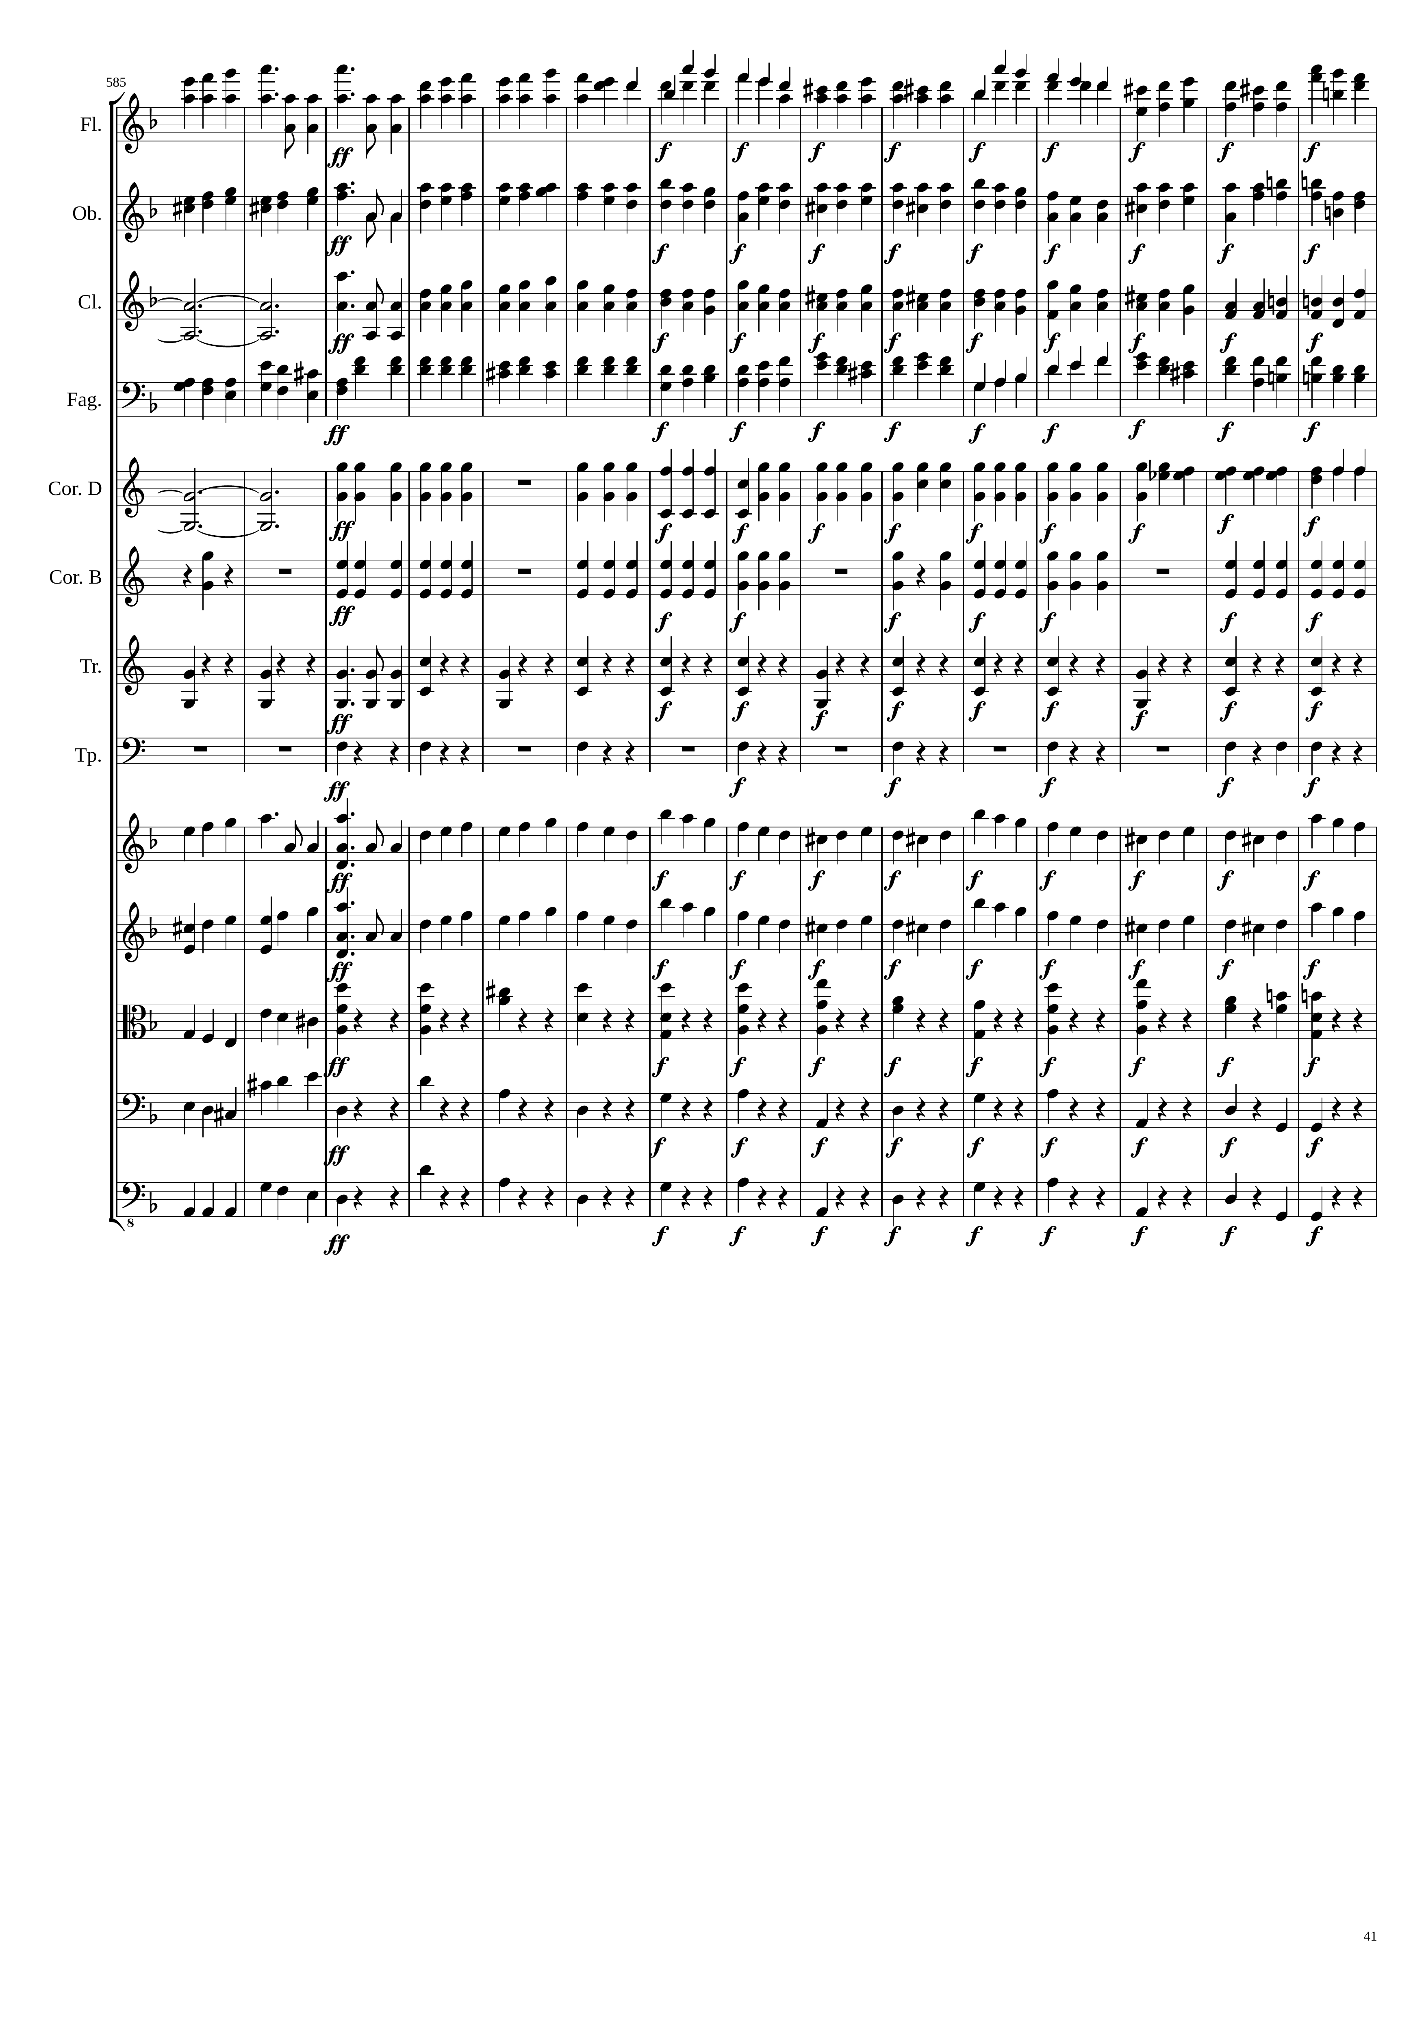
mel+rhythm
mel+rhythm
mel+rhythm
rhythm
harm
mel+rhythm
mel+rhythm
mel+rhythm
harm
rhythm
rhythm
rhythm
rhythm
rhythm
rhythm
mel+rhythm
mel
mel+rhythm
mel
mel+rhythm
rhythm
rhythm
mel+rhythm
rhythm
rhythm
rhythm

Slide 42
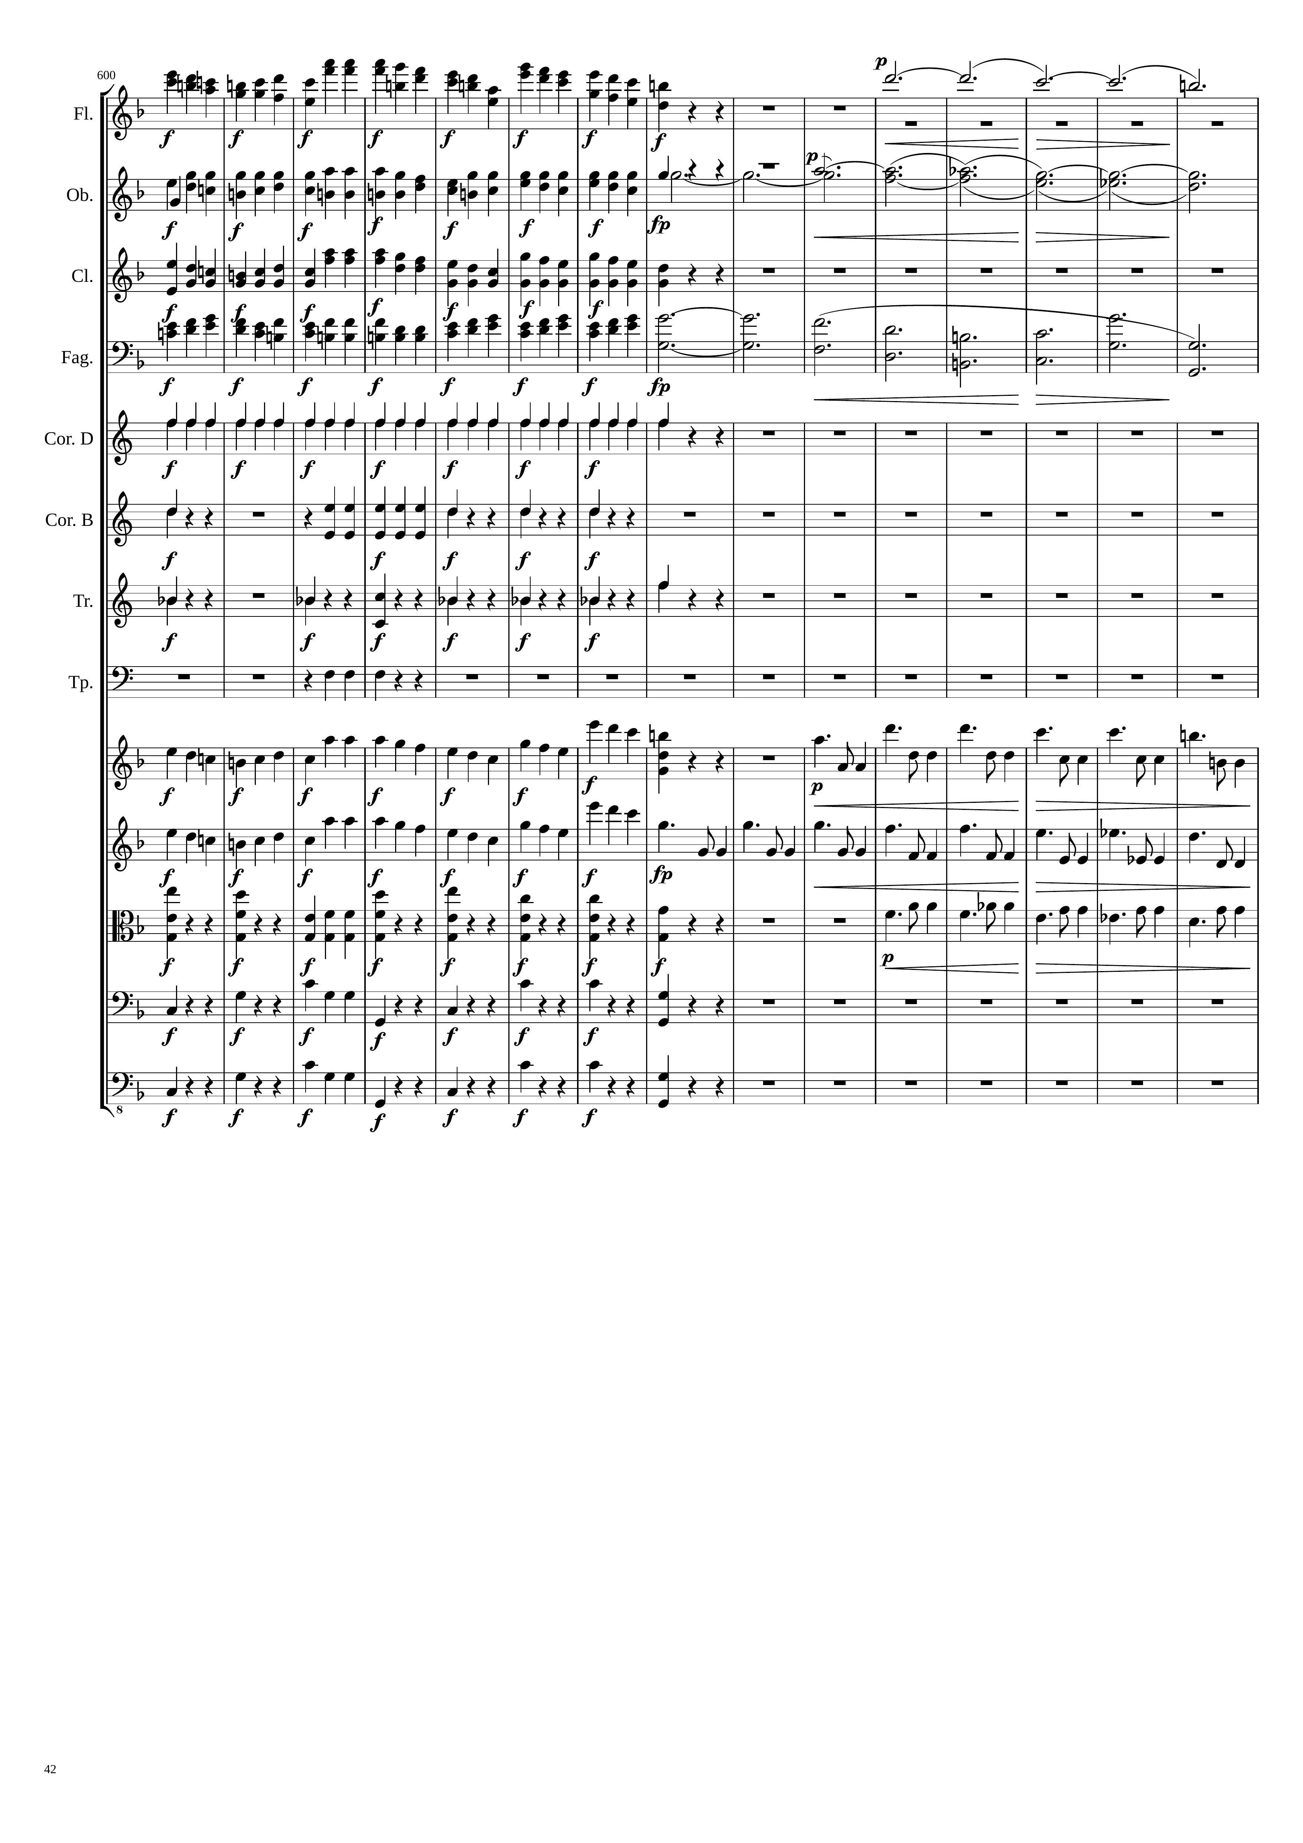
mel+rhythm
harm
rhythm
harm
mel+rhythm
mel+rhythm
harm
rhythm
rhythm
rhythm
rhythm
mel
mel+rhythm
mel
mel+rhythm
rhythm
rhythm
rhythm
rhythm

Slide 43
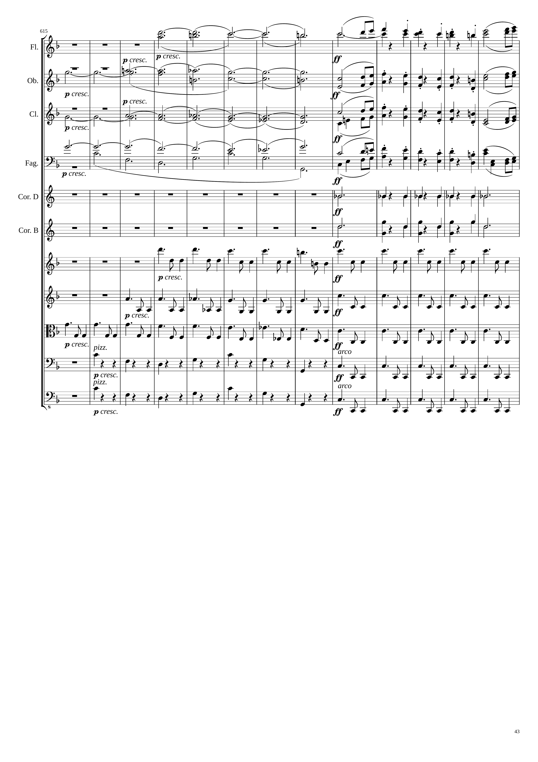
harm
mel
harm
mel
harm
mel
harm
harm
mel
harm
rhythm
rhythm
mel+rhythm
rhythm
mel+rhythm
rhythm
mel+rhythm
rhythm
rhythm
rhythm
rhythm
rhythm

Slide 44
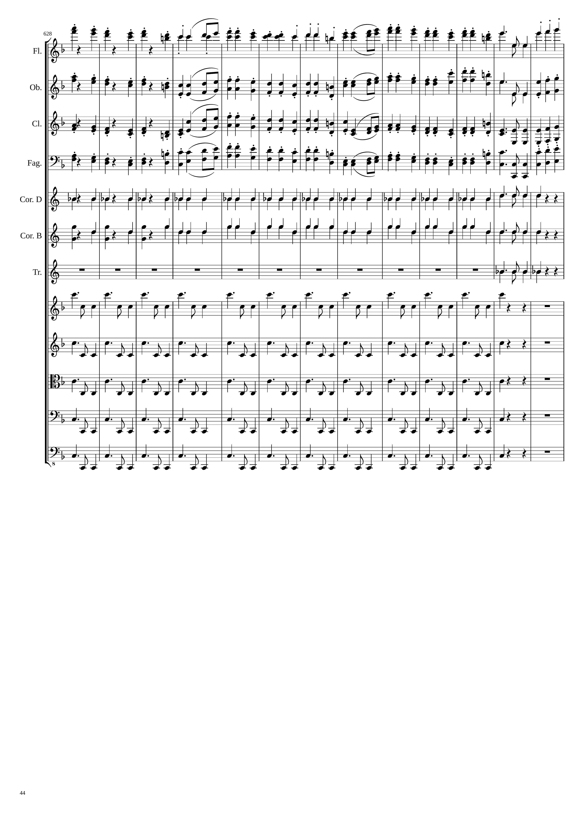
mel
mel+rhythm
mel
mel+rhythm
mel
mel+rhythm
mel
mel+rhythm
rhythm
rhythm
rhythm
rhythm
rhythm
rhythm
rhythm
rhythm

Slide 45
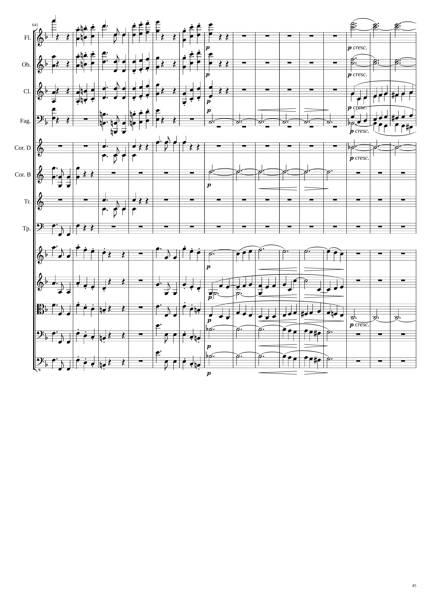
mel+rhythm
harm
mel+rhythm
harm
mel+rhythm
mel
mel+rhythm
harm
mel
rhythm
harm
rhythm
harm
rhythm
rhythm
mel+rhythm
mel
mel+rhythm
mel+rhythm
mel+rhythm
mel+rhythm
harm
mel+rhythm
rhythm+harm
mel+rhythm
rhythm+harm

Slide 46
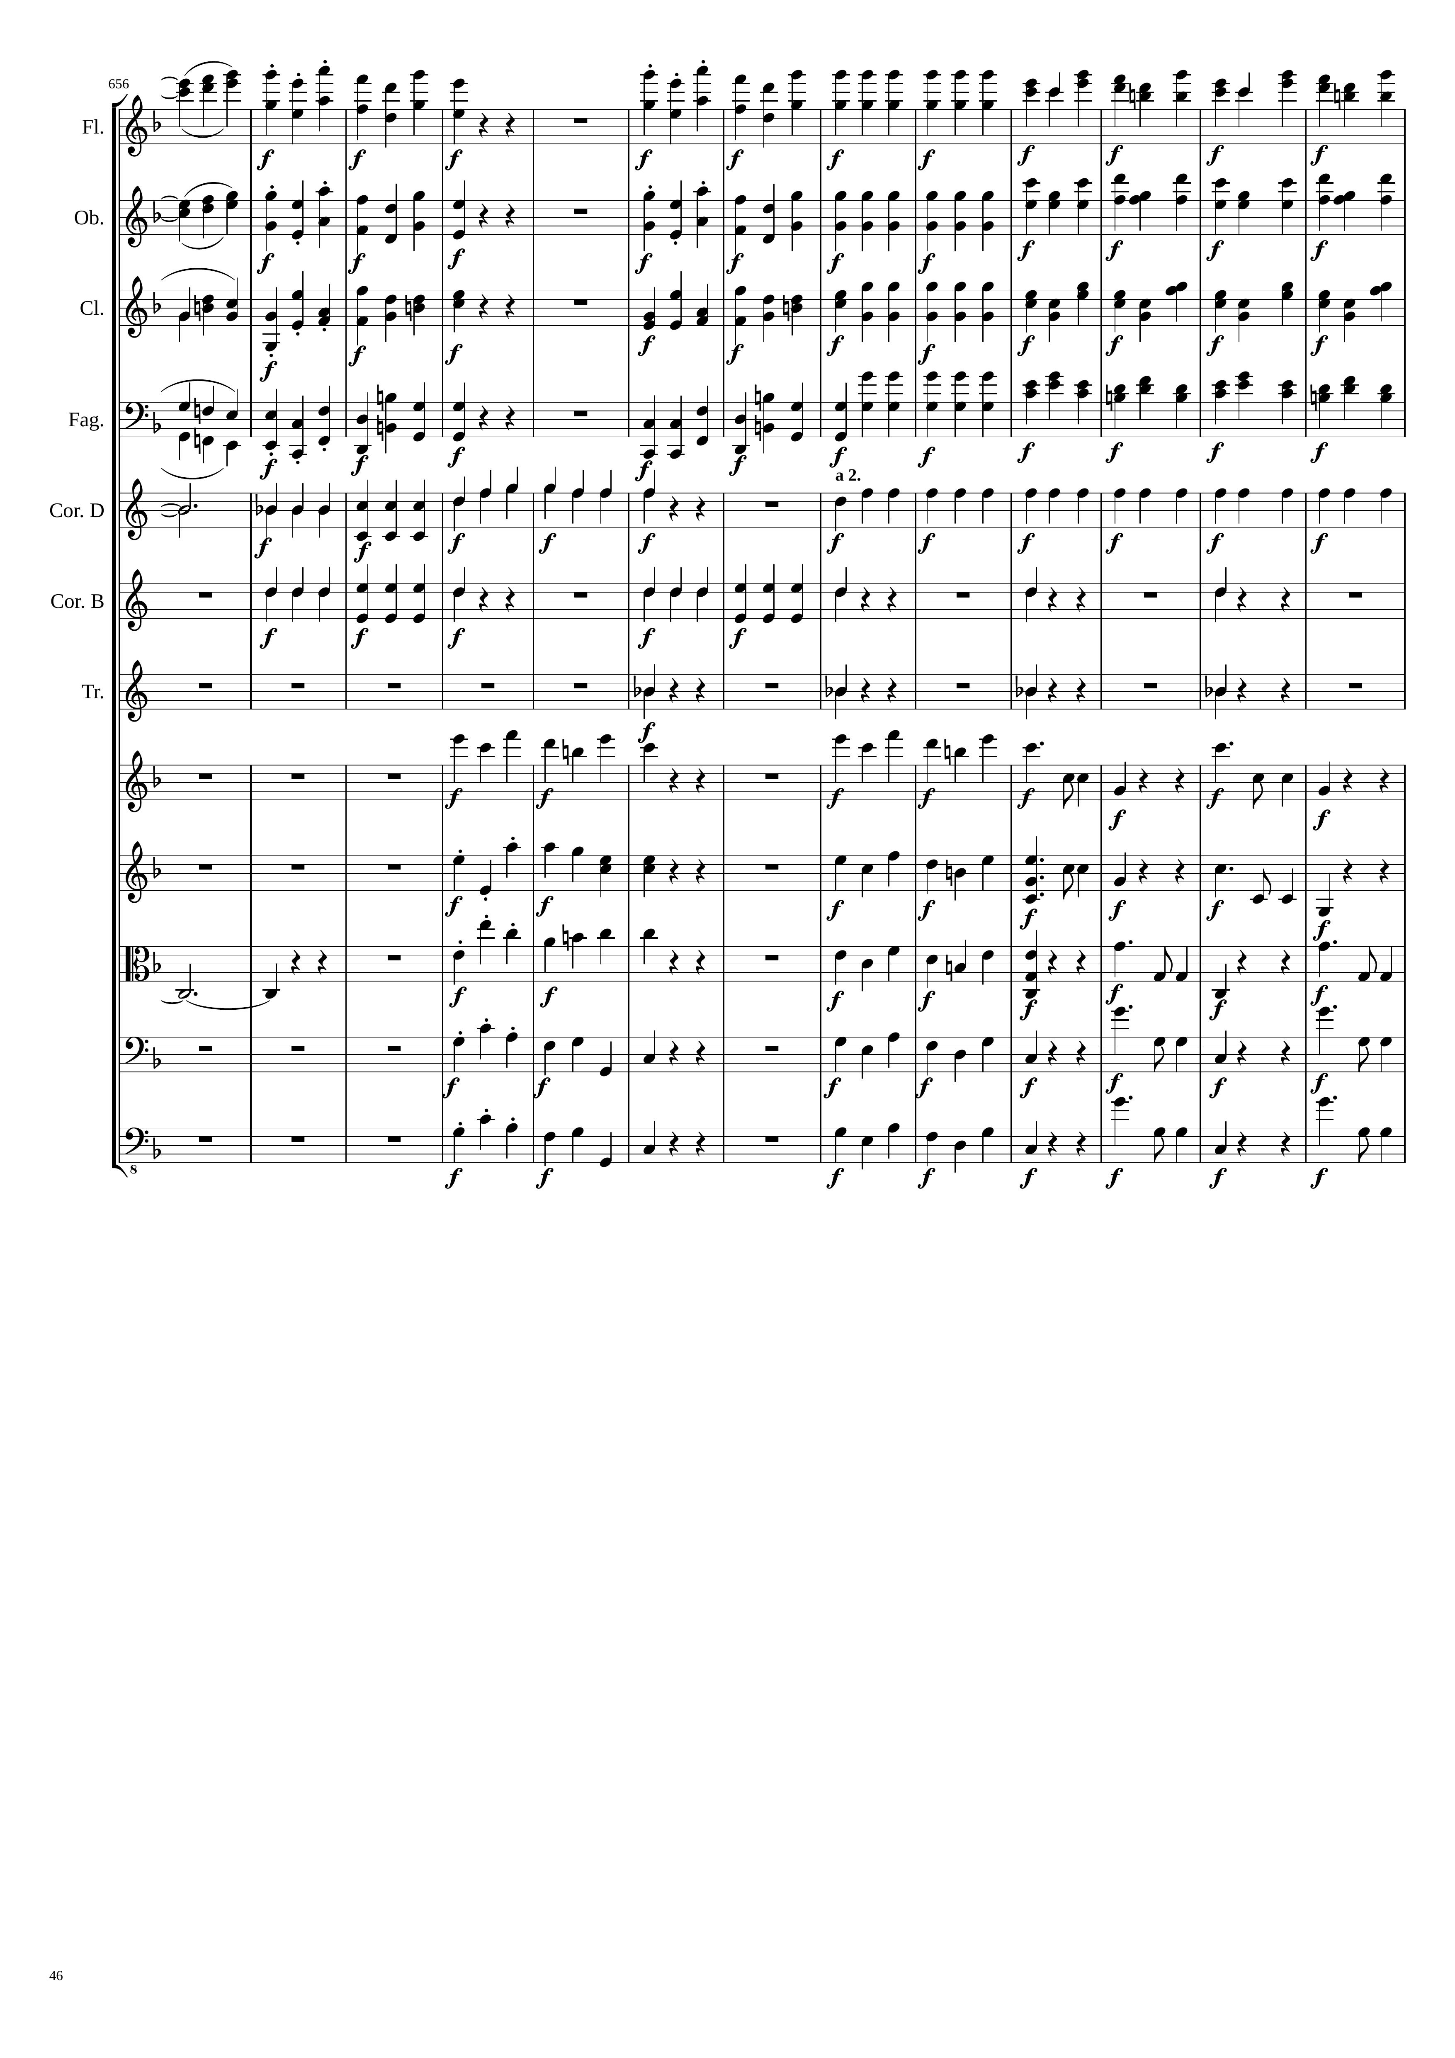
mel
mel
rhythm
mel+rhythm
mel
mel
rhythm
mel+rhythm
mel
mel
rhythm
mel+rhythm
mel
mel
rhythm
mel+rhythm
harm
rhythm
rhythm
rhythm
mel
mel
rhythm
mel
mel
rhythm
harm
mel
mel
rhythm
mel
mel
rhythm
mel
mel
rhythm

Slide 47
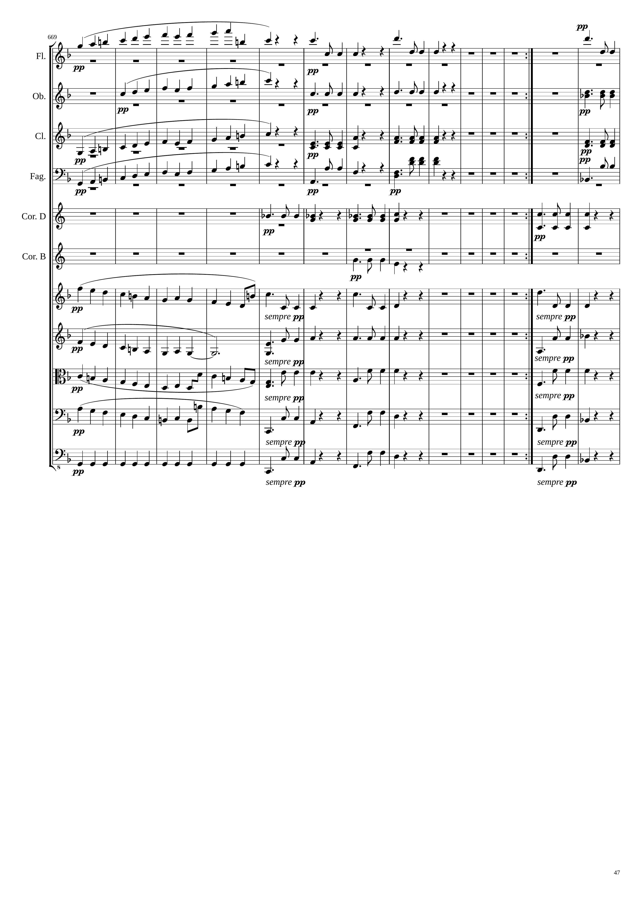
mel+rhythm
mel+rhythm
mel+rhythm
mel+rhythm
rhythm
rhythm
mel+rhythm
rhythm
rhythm
mel+rhythm
rhythm
rhythm
rhythm
rhythm
rhythm
mel+rhythm
mel+rhythm
mel+rhythm
mel+rhythm
rhythm
rhythm
mel+rhythm
rhythm
rhythm
mel+rhythm
rhythm
rhythm
rhythm
rhythm
rhythm

Slide 48
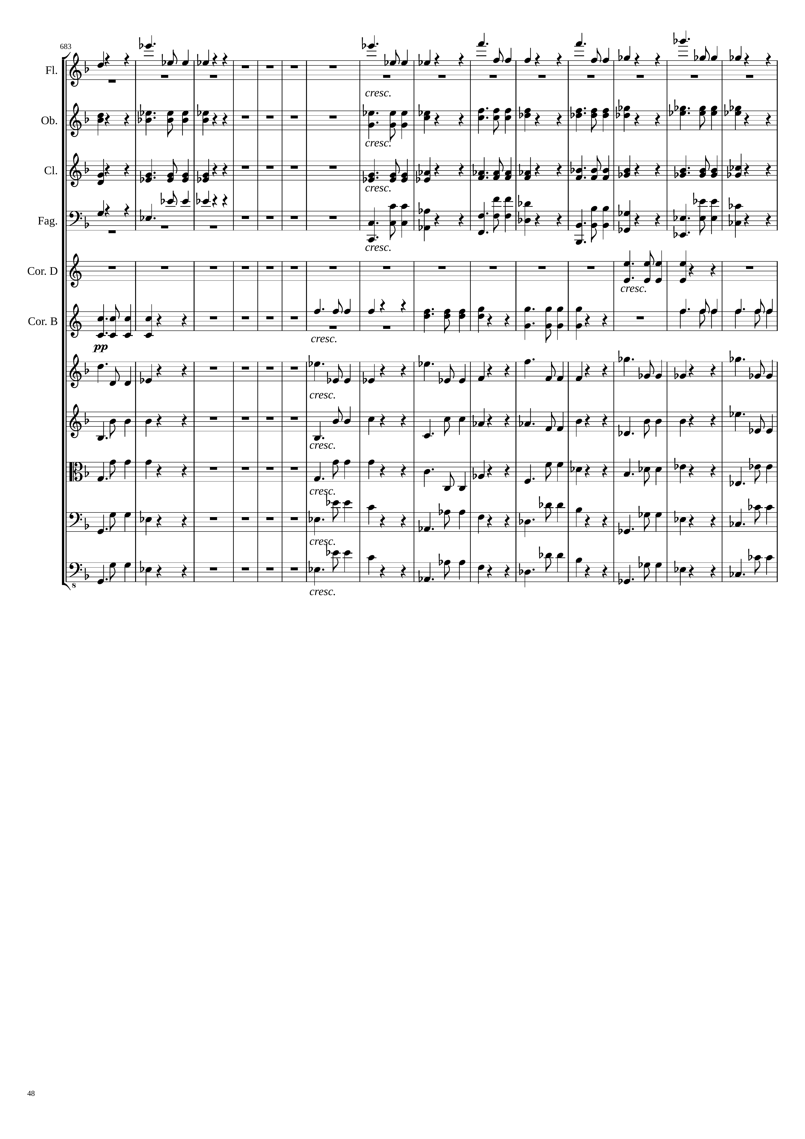
跟前面一模一樣的段落比
這裡少了一個反覆記號的開頭
mel+rhythm
|
mel+rhythm
1680
rhythm
rhythm
rhythm
rhythm
rhythm
rhythm
rhythm
rhythm
rhythm
mel+rhythm
mel+rhythm
rhythm
rhythm
rhythm
rhythm
rhythm
rhythm
rhythm
rhythm

Slide 49
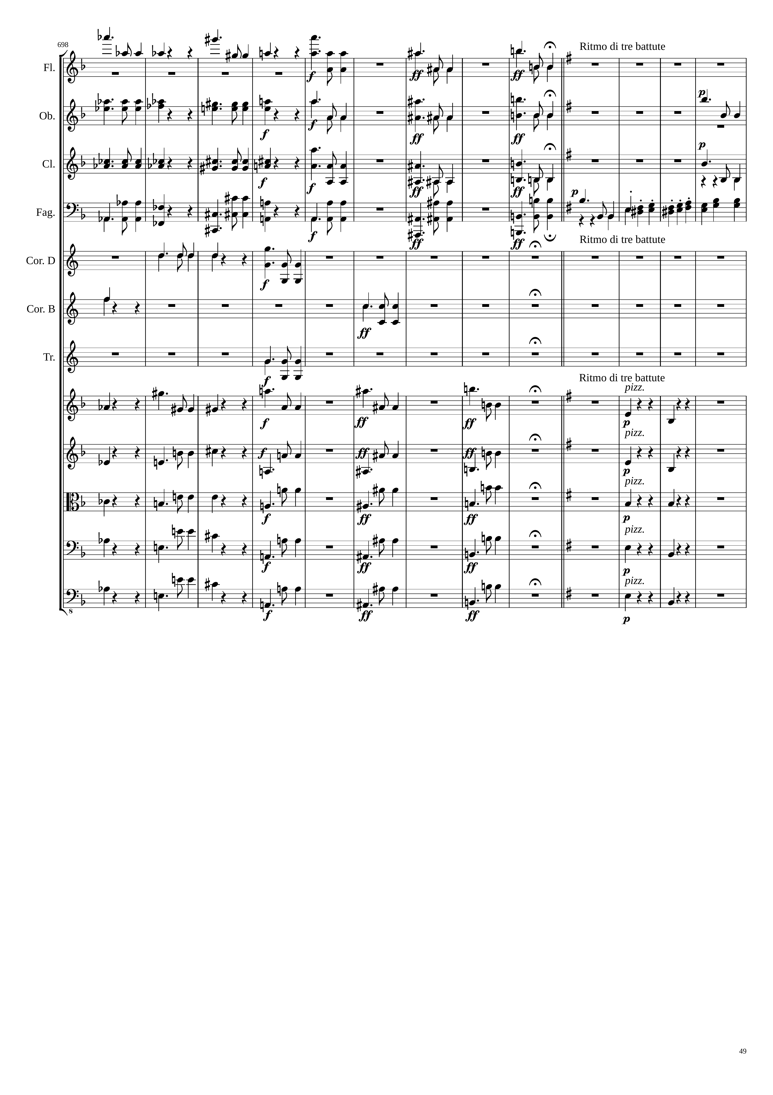
mel+rhythm
mel+rhythm
mel+rhythm
mel+rhythm
rhythm
mel+rhythm
mel+rhythm
mel+rhythm
mel+rhythm
rhythm
mel+rhythm
mel+rhythm
mel+rhythm
mel+rhythm
rhythm
mel+rhythm
mel+rhythm
mel+rhythm
mel+rhythm
rhythm
rhythm
rhythm
mel+rhythm
mel+rhythm
mel+rhythm
mel+rhythm
rhythm
rhythm
mel+rhythm
mel+rhythm
mel+rhythm
rhythm
rhythm
mel+rhythm
mel+rhythm
mel+rhythm
rhythm
rhythm
mel+rhythm
mel+rhythm
mel+rhythm
rhythm
rhythm
mel+rhythm
mel+rhythm
mel+rhythm
rhythm

Slide 50
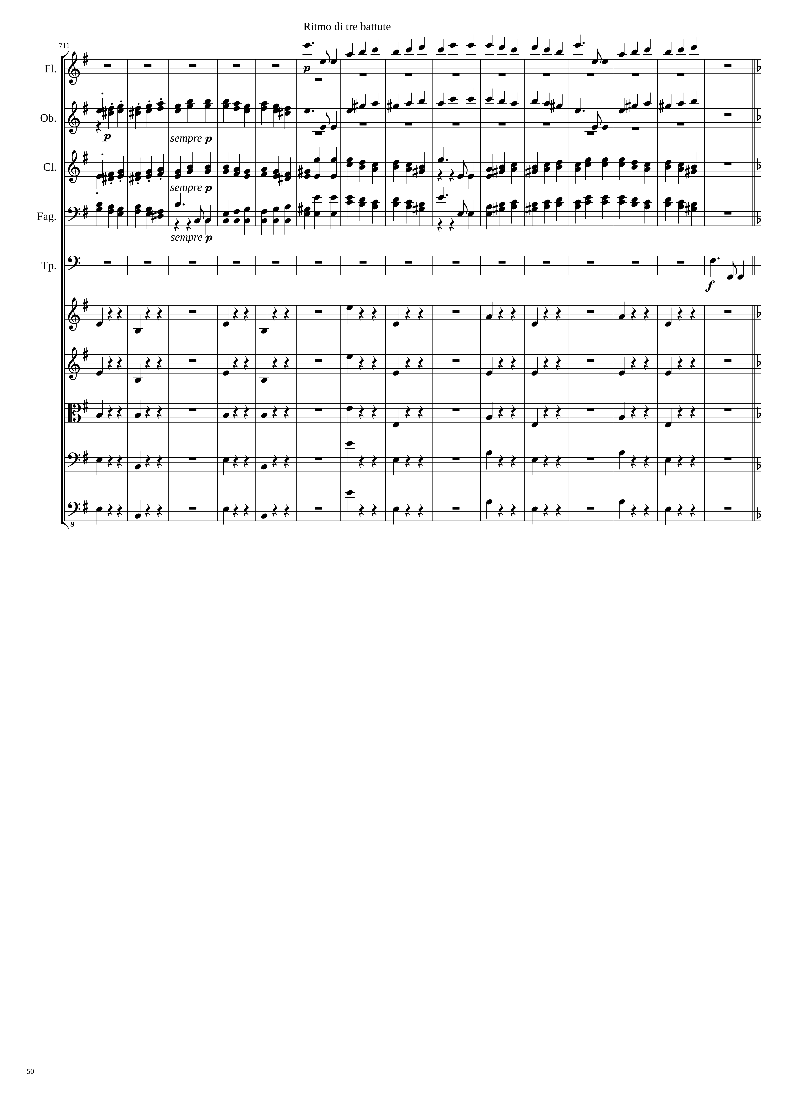
mel+rhythm
mel+rhythm
mel+rhythm
mel+rhythm
mel+rhythm
rhythm
rhythm
rhythm
rhythm
rhythm

Slide 51

mel+rhythm
rhythm
mel+rhythm
rhythm
mel+rhythm
mel+rhythm
rhythm
rhythm
mel+rhythm
rhythm
mel+rhythm
rhythm
mel+rhythm
rhythm
mel+rhythm
rhythm
rhythm
rhythm
rhythm

Slide 52

mel+rhythm
mel+rhythm
mel+rhythm
mel+rhythm
mel+rhythm
mel+rhythm
rhythm
mel+rhythm
rhythm
mel+rhythm
mel+rhythm
mel+rhythm
rhythm
rhythm
rhythm
mel+rhythm
rhythm
mel+rhythm
rhythm
mel+rhythm
rhythm
mel+rhythm
rhythm
mel+rhythm
rhythm
mel+rhythm
rhythm
mel+rhythm
rhythm
mel+rhythm
rhythm
mel+rhythm
rhythm
rhythm
rhythm

Slide 53

mel+rhythm
rhythm
mel+rhythm
rhythm
mel+rhythm
rhythm
mel+rhythm
mel+rhythm
rhythm
rhythm
mel+rhythm
rhythm
mel+rhythm
rhythm
mel+rhythm
rhythm
mel+rhythm
rhythm
mel+rhythm

Slide 54

rhythm
mel+rhythm
rhythm
rhythm
rhythm
rhythm
rhythm
rhythm
rhythm
mel+rhythm
rhythm
rhythm
rhythm
mel+rhythm
rhythm
mel+rhythm
mel+rhythm
rhythm
mel+rhythm
mel+rhythm
harm
mel+rhythm
mel+rhythm
harm
mel+rhythm
mel+rhythm
harm
mel+rhythm
mel+rhythm
harm
mel+rhythm
harm

Slide 55

rhythm
rhythm
rhythm
rhythm
rhythm
rhythm
rhythm
rhythm
mel+rhythm
mel+rhythm
rhythm
rhythm
mel+rhythm
mel+rhythm
mel+rhythm
rhythm
mel+rhythm
mel+rhythm
rhythm
mel+rhythm
mel+rhythm
rhythm
mel+rhythm
harm
mel+rhythm
rhythm
mel+rhythm
harm
mel+rhythm
rhythm
mel+rhythm
harm
mel+rhythm
rhythm+harm
harm
rhythm
rhythm
harm
rhythm
rhythm

Slide 56

rhythm
mel+rhythm
rhythm
mel+rhythm
rhythm
mel+rhythm
rhythm
rhythm
rhythm
rhythm
rhythm
rhythm
rhythm
rhythm
rhythm
rhythm
rhythm
mel+rhythm
rhythm
mel+rhythm
rhythm+harm
mel+rhythm
rhythm
rhythm
rhythm
rhythm

Slide 57

mel+rhythm
mel+rhythm
mel+harm
mel+rhythm
mel+rhythm
mel+harm
mel+rhythm
mel+rhythm
rhythm
mel+rhythm
mel+harm
rhythm
rhythm
rhythm
rhythm
rhythm
rhythm
rhythm
mel+rhythm
rhythm
mel+rhythm
mel+rhythm
mel+rhythm
mel+rhythm
mel+rhythm
rhythm
mel+rhythm
rhythm
mel+rhythm

Slide 58

mel+harm
harm
mel+harm
harm
mel+harm
harm
mel+harm
harm
harm
harm
mel+rhythm
mel+rhythm
mel+rhythm
mel+rhythm
mel+rhythm
mel+rhythm
rhythm
rhythm

Slide 59

harm
mel+harm
harm
mel+harm
harm
mel+harm
harm
mel+harm
mel+harm
harm
rhythm
mel+rhythm
mel+rhythm
rhythm
mel+rhythm
mel+rhythm
rhythm
mel+rhythm
mel+rhythm
rhythm
mel+harm
mel+rhythm
rhythm
rhythm

Slide 60

mel+harm
mel
mel+harm
mel
mel+harm
mel
mel+harm
mel
rhythm
rhythm
rhythm
rhythm
rhythm
rhythm
rhythm
rhythm
rhythm
rhythm
rhythm
mel+rhythm
rhythm
rhythm
rhythm

Slide 61

mel
mel
mel
mel
mel
mel
rhythm
rhythm
rhythm
rhythm
rhythm
rhythm
rhythm
mel
rhythm
mel
rhythm
mel
rhythm
mel
rhythm
mel

Slide 62

mel
rhythm
harm
mel
rhythm
harm
mel
rhythm
rhythm
mel
rhythm
rhythm
rhythm
harm
rhythm
rhythm
harm
rhythm
rhythm
mel
mel
rhythm+harm
mel
mel
rhythm+harm
mel
mel
rhythm+harm
mel
mel
rhythm+harm
mel
mel
rhythm+harm

Slide 63

mel
mel
rhythm
mel+rhythm
mel
mel
rhythm
rhythm
mel
mel
rhythm
rhythm
mel
mel
mel
rhythm
rhythm
mel
rhythm
rhythm
rhythm
rhythm
mel
mel
rhythm
mel
mel
rhythm
mel
mel
rhythm
mel
mel
rhythm
mel
mel
rhythm

Slide 64

rhythm
rhythm
rhythm
rhythm
rhythm
rhythm
rhythm
rhythm
rhythm
rhythm
rhythm
rhythm

Slide 65

跟原本的段落比較
原本會先接1房 這邊直接從2房開始
|
rhythm
mel
rhythm
rhythm
mel
rhythm
mel
rhythm
rhythm
rhythm
rhythm
rhythm
mel+rhythm
rhythm
mel+rhythm
rhythm
mel+rhythm
rhythm
mel+rhythm
rhythm
mel+rhythm

Slide 66

mel
mel
mel
mel
rhythm
rhythm
rhythm
mel
mel+rhythm
mel
mel+rhythm
mel
mel+rhythm
mel
mel+rhythm
mel

Slide 67

開始跟前面不一樣!!!
2447
2479
2439
mel
mel+rhythm
mel+rhythm
mel+rhythm
mel
mel
mel+rhythm
harm
mel+rhythm
mel
mel
mel+rhythm
harm
mel+rhythm
mel+rhythm
mel+rhythm
mel+rhythm
mel+rhythm
mel+rhythm
rhythm
rhythm
mel+rhythm
harm
mel+rhythm
mel+rhythm
harm
mel+rhythm
mel+rhythm
harm
mel+rhythm
mel+rhythm
harm
mel+rhythm
mel+rhythm
harm
mel+rhythm
mel+rhythm
harm
mel+rhythm

